Slide 1
U.S. Department of Commerce, National Oceanic and Atmospheric Administration (NOAA), Radio Frequency Management Division (RFMD)
Carlos Flores
18 July 2019

Slide 2
WRC-19 Agenda Items of interest
Why is weather forecasting important?
CTU Spectrum Management Task Force (SMTF) Priorities Group C: 1.2, 1.3 and 1.7
  Agenda item 1.2 In-band power limits
  Agenda item 1.3 Upgrade allocation for MetSat/EESS
  Agenda item 1.7 non-GSO short duration missions
Other Agenda Items
Contacts

Slide 3
Weather forecasting
Why is weather forecasting important?
  Monitors and forecasting extreme weather events and disasters
    Hurricane, Tropical storms, Floods, Landslides, Tornadoes, Earthquakes, Tsunami
  Water Resources
    Droughts, Agricultures
  Public Health
    Disease tracking (e.g. Mosquito-borne disease: Dengue, Zika virus, etc.)
Earth observation RF Systems
  Weather Radar, MetAids (Radiosondes, Dropsondes), Satellite systems (passive sensors)
    Hurricane Maria
Weather forecasting
  Numerical Weather Prediction (NWP) model

Slide 4
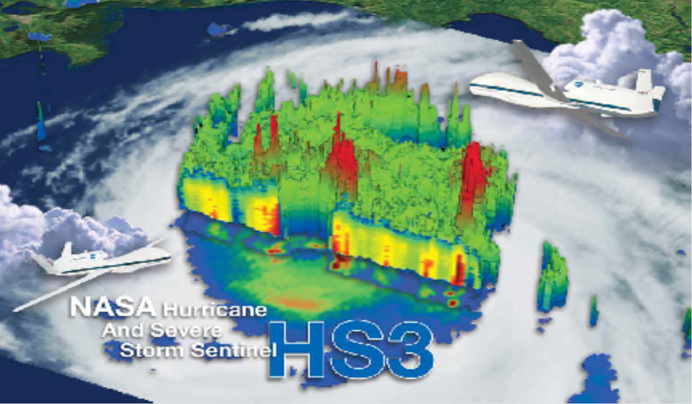
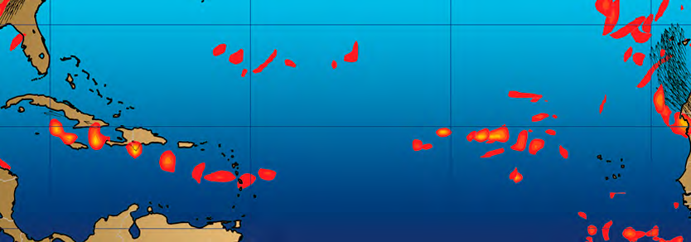
Weather forecasting: continues
NASA HS3 airborne mission to investigate hurricane formation and intensity changes
Contribution of meteorological satellites to forecasting, example: Hurricane Irma
The initial conditions, largely
determined by satellite
observations (top right, red),
were essential for the ECMWF
to forecast the development
and trajectory of Hurricane Irma
four days in advance.
(Source: ECMWF)
Without satellite observations
the model would have missed
the initial development of Irma.
(Source: ECMWF)

Slide 5
WRC-19 Agenda Item 1.2
Agenda Item 1.2 to consider in-band power limits for Earth stations operating in the mobile-satellite service, meteorological-satellite service and Earth exploration-satellite service in the frequency bands 399.9-400.05 MHz and 401-403 MHz, in accordance with Resolution 765 (WRC-15).
U.S. CITEL Proposal:
  Supports in-band power limits in the frequency band 399.9-399.99 MHz (MSS) and 401-403 MHz (MetSat/EESS) from any Earth stations (Earth-to-space). These limits shall apply after 22 November 2026 for which complete notification information is received by the BR and have been brought into use prior to 22 November 2019.
  CITEL Doc 4357, AI 1.2, Option 2 (399.9-399.99 MHz) and Option B (401-403 MHz). Currently, status of Option 2 is a PP and the status of Option B is a DIAP supported by MEXICO, USA.
Reasons:
  ITU-R studies results are contained in Report ITU-R SA.2430. and they have shown a need to provide in-band power limits applicable to Earth stations in order to ensure the existing and future operation of DCS in the MSS, EESS, and MetSat service will continue to operate without interference.
WMO Position:
WMO supports the establishment of an appropriate set of in band e.i.r.p. limits for non-GSO and GSO satellite operating under the MetSat and EESS (Earth-to-space) allocation to ensure the protection of existing and future use of meteorological operations in the 401-403 MHz frequency band.

Slide 6
WRC-19 Agenda Item 1.3
Agenda Item 1.3 to consider possible upgrading of the secondary allocation to the meteorological-satellite service (space-to-Earth) to primary status and a possible primary allocation to the Earth exploration-satellite service (space-to-Earth) in the frequency band 460-470 MHz, in accordance with Resolution 766 (WRC-15).
U.S. CITEL Proposal:
  Supports CPM Method C which UPGRADES the MetSat and EESS (space-to-Earth) allocations to PRIMARY.
  CITEL Doc. 4358, AI 1.3, DIAP supported by BRAZIL, CANADA, MEXICO, USA.
Reasons:
  ITU-R study results have demonstrated that the allocation upgrade from secondary to primary is possible between meteorological-satellite (space-to-Earth)/Earth-exploration-satellite (space-to-Earth) services in the 460 – 470 MHz frequency band if the power-flux density (pfd) limits are applied.
  This proposal applies a set of elevation angle dependent pfd limits to the meteorological-satellite and earth exploration-satellite services to protect the incumbent services globally.
WMO Position:
  WMO supports the upgrade of the MetSat (space-to-Earth) allocation to primary in the frequency band 460-470 MHz with the use of appropriate PFD limits for GSO and non-GSO satellites to protect incumbent services.

Slide 7
WRC-19 Agenda Item 1.7
Agenda Item 1.7 calls for studies of Telemetry, Track and Control (TT&C) in the space operation service (SOS) for non-GSO (NGSO) satellites with short duration missions to assess the suitability of existing SOS allocations and if necessary, to consider possible new allocations within 150.05-174 MHz and 400.15-420 MHz
U.S. CITEL Proposal:
  Supports NO Changes (NOC) to the Radio Regulations
  DIAP supported by [BRAZIL], MEXICO, USA
Reasons:
  ITU-R studies have been completed and they are contained in Report ITU-R SA.2427. There are an ongoing adjacent band studies below the frequency band 137 MHz addressing the impact to AM(R)S allocation.
  ITU-R studies in the 400.15-420 MHz frequency band have shown that sharing with incumbent services and NGSO short duration is not feasible.
WMO Position:
  WMO emphasizes that the frequency band 400.15 – 406 MHz is the key band for global radiosonde and DCS operations. Based on studies undertaken in ITU-R, WMO supports NO Change (NOC) under this agenda item in this frequency band.

Slide 8
Other WRC-19 Agenda Items
Agenda Item 1.6 to consider the development of a regulatory framework for non-GSO FSS satellite systems that may operate in the frequency bands 37.5-39.5 GHz (space-to-Earth), 39.5-42.5 GHz (space to Earth), 47.2-50.2 GHz (Earth-to-space) and 50.4-51.4 GHz (Earth-to-space), in accordance with Resolution 159 (WRC-15).
  The U.S. supports limits for both FSS GSO and FSS NGSO; however, limits are currently TBD.
Future Agenda Item(s)
  ALL new future agenda item(s) need to ensure the protection of MetSat, EESS (active) and EESS (passive) allocations.

Slide 9
NOAA Contacts
Carmelo Rivera, CITEL PCC II, WG 3.1 WRC-19 Chairman
Carmelo.Rivera@noaa.gov
David Franc, Agenda item 1.2 U.S. spokesperson
David.Franc@noaa.gov
James Mentzer, Agenda item 1.3 U.S. spokesperson
James.Mentzer@noaa.gov
Carlos Flores, Agenda item 1.7 U.S. spokesperson
Carlos.Flores@noaa.gov

