Slide 1
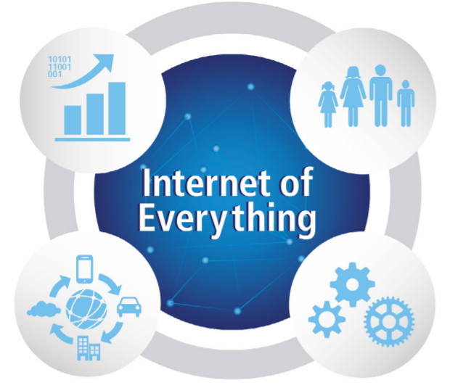
Internet of Things in logistics
Country Implementation
DHL Express
Notes:
Welcome to the Global Call Planning Tool Kick-Off

Slide 2
DHL Fact Sheet
Head Office is in Bonn, Germany
Over 220 countries and territories and approximately 500 airports served globally- The most international company in the world.
More than 60,000 service points
Over 250 dedicated aircrafts
Approximately 2,500 daily flights
Over 2.7 million customers
DHL is the leading global brand in the logistics industry with four divisions- DHL Express, DHL Ecommerce, DHL Supply Chain, DHL Global Forwarding, DHL Parcel, DHL Freight, Deutsche Post International.
Logistic Services:
National and International Parcel Delivery
Road, Air and Ocean Transport
Industrial Supply Chain Management
We serve all industries and also provide specialized services for growth markets, technology, life sciences and health care, energy, automotive and retail.

Slide 3
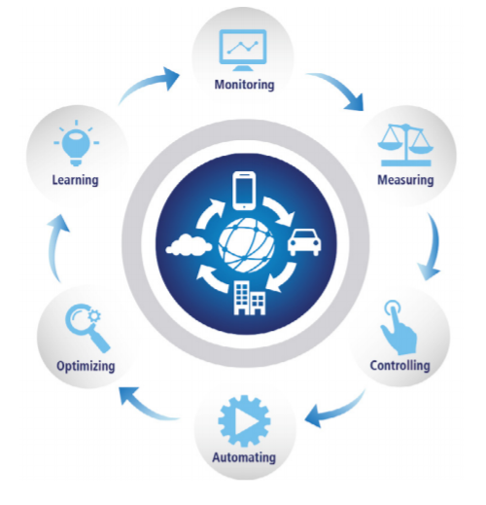
Why IoT- We Move Things
The Internet of Things (IoT) has the potential to connect virtually anything to the internet and accelerate data-driven logistics.
IoT presents 1.9Trillion opportunity in logistics with global connected logistics market estimated to substantially grow to $27 billion at a CAGR of 7.6% until 2023,
Significant Implications for logistics and benefits that extend across the entire supply chain:
Operations
Warehousing
Freight Transportation
Last Mile Delivery
Customer Experience
Notes:
At Dhl we are constantly exploring innovative way to improve efficiency, productivity, safety and to increase value to our employees, investors and customers.
With the breath of our operations it is critical that we are able to put information into context.
IoT allow us to take decisions now about things happening now.

Slide 4
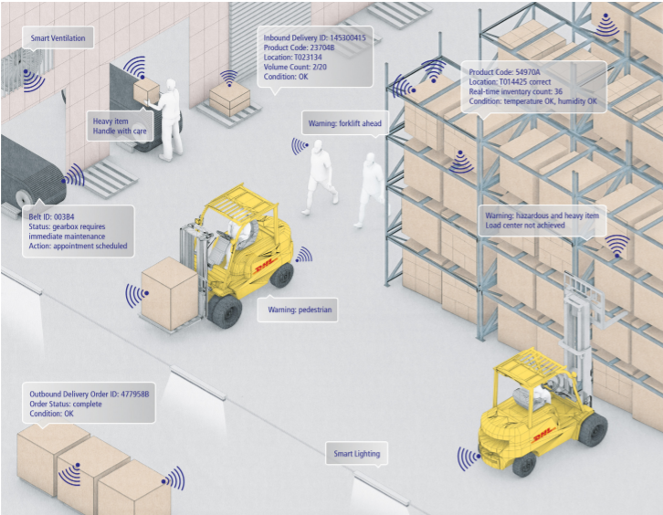
DHL and IoT
Notes:
IoT driven by the need for

Slide 5
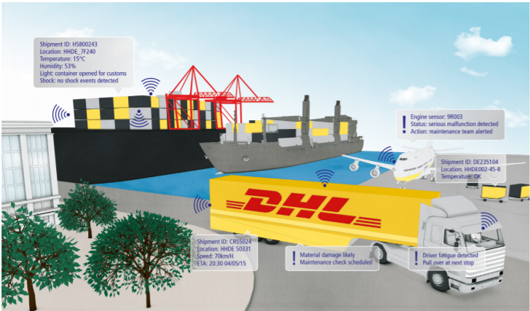
DHL and IoT
Augmented Reality
Sensor Technology
Self Driving Vehicles
Unmanned Aerial Vehicles
Big Data in logistics

Slide 6
IoT in Action - Logistics
Smart Warehousing
Wireless readers (scanners) capture data – aggregate- process ( product information, volume, dimension etc)
Tags on pallets/ shipments transmit signals to the WMS advising of each movement and providing real-time visibility. Supports and managements inventory levels.
Sensors can track misplaced packages and alert warehouse manager for corrective action
Sensors monitor and alert changes in temperature for temperature sensitive items and provide alerts to ensure quality and greater customer confidence.
Heat maps to increase safety, support supervisor/managers in monitoring warehouse floor, prevent accidents ( Traffic plan) , identify opportunities.
Real-time visibility of employees and events
Freight Transportation
Telematics sensors in trucks and multi-sensor tags on items transmit data on location, condition (whether any thresholds have been crossed), and if a package has been opened (to detect possible theft).
Fleet and asset management. For example, sensors can monitor how often a truck, container or ULD is in use or idle. They then transmit this data for analysis on optimal utilization
End-to-end supply chain risk management - DHL Resilience360 for supply chain risk management, which provides a multi-tiered visualization of the end-to-end supply chain.
Notes:
Warehouse is no longer a storage for flow of goods, it now stands as a source of competitive advantage for providers who can deliver fast, cost-efficient and with increasingly flexible warehousing operations for their customers.

Slide 7
Factor Driving IoT in Logistics
Rise in Mobile Computing
Customer Demand for IoT based solutions
Consumerism of IT
5G networks
Data Analytics
Need for transparency and integrity control ( Right product, time, place, quality, conditions, cost)
Customer demand for detailed shipment tracking and visibility in real0time
Integrity control of sensitive goods ( e.g. medical )
Warehousing efficiency and cost optimization– smart inventory, damage detection, asset utilization, predictive maintenance

Slide 8
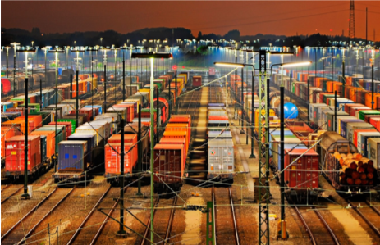
IoT in Logistics: Key Factors for Success & Main Challenges
Success
Seamless interoperability in heterogeneous environments
Establishment of trust and ownership of data dealing with privacy issues in IoT supply chain
Focus on clarity of architecture for IoT
Change in business mindset to embrace full potential of IoT
Challenges
Cost of Deployment
Security Concerns
Absence of Standards in logistics industry ( Industry fragmented)
Outlook
Breakthroughs in development of low-cost IoT networks and reduction in sensor prices thus enabling large-scale IoT deployments in logistics

