Slide 1
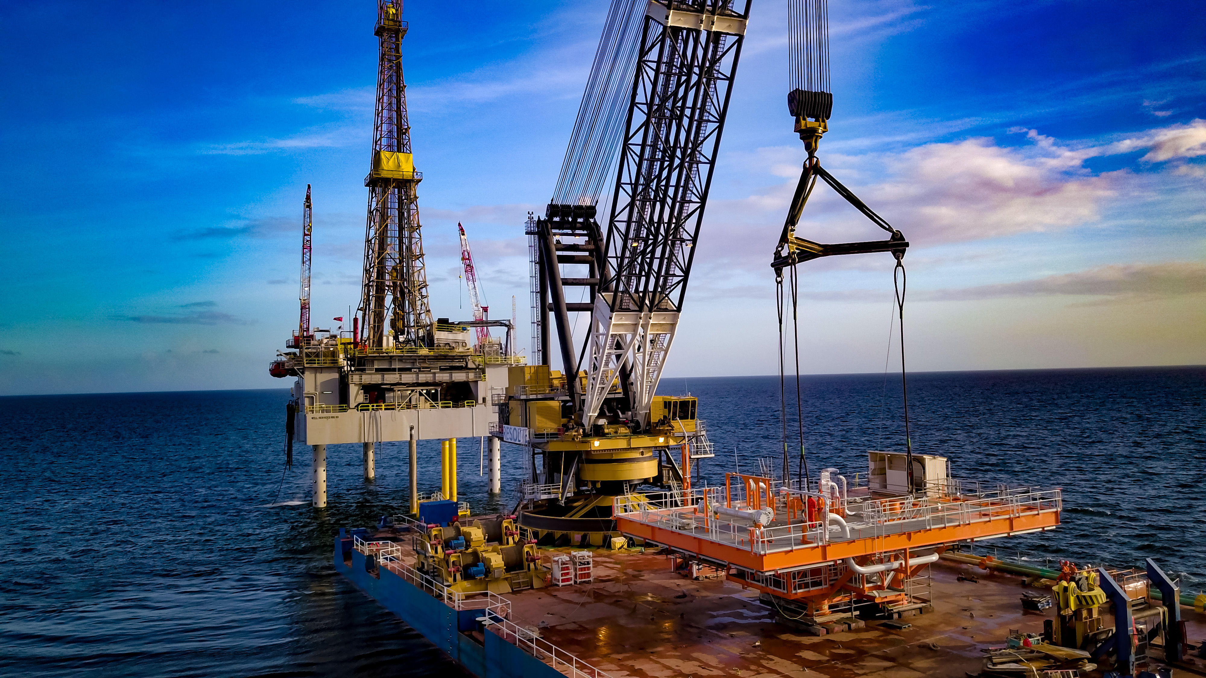
Denovo beginning again, afresh, from new
DeNovo is Trinidad and Tobago’s first local independent upstream natural gas producer
Operator of Block 1(a) offshore the west coast of Trinidad.
Experienced and professional team, determined on leveraging their expertise and skills in a niche mature hydrocarbon basin, to lead a fit for purpose, well-capitalised, and technology driven business, with aligned strategic partners to deliver significant value to all stakeholders.

Slide 2
Iguana FIELD DEVELOPMENT
Simple, low-risk, low cost development
Unmanned minimum facilities platform.
3 production wells – combined production of 80 MMSCFD.
Installation and operation of a 45 km offshore and onshore 14-inch pipeline from the platform to the Pt. Lisas Industrial Estate.
Gas processing, condensate removal, and gas conditioning at onshore Gas Processing Unit (GPU); platform controlled from GPU.

Slide 3
KEY DISRUPTIVE TECHNOLOGIES
Industrial Internet of Things (IIoT)
Data Acquisition, Inventory Tracking, Surveillance, Wearables (HSSE)
Digital Twins
Production Optimisation, Predictive Maintenance.
Augmented Reality/Virtual Reality
Training, Maintenance.
Artificial Intelligence & Business Intelligence
Performance Management, Prescriptive Maintenance.

Slide 4
Technology Vision
Transmission & Transportation
Management & Stakeholders
Processing & Storage
Exploration & Production
Operations & Maintenance
Sale & Export
An Integrated value chain enabled by technology to provide superior returns through information driven, centralised management.

