Slide 1
Operator Based Authentication

Slide 2
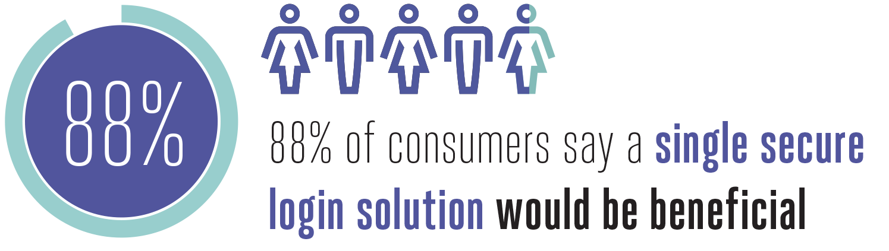
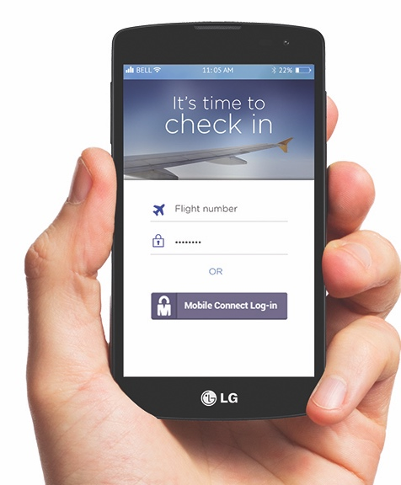
The global, mobile-operator facilitated, secure identity service
Mobile Connect is a portfolio of mobile-based secure identity capabilities giving simple, secure and convenient access to online services
Combines the user’s unique mobile number and optional PIN to:
Simple and ubiquitous log-in or step-up authentication
  Verify or provide user identity
  Confirm insights about user’s mobile account or device
  Authorise digital transactions and payments
Sources: GSMA Consumer Research 2015, Cyber Streetwise
68%
of users say forgetting passwords is a significant problem
Sources: GSMA Consumer Research 2015, KRC
Notes:
Proving identity is a critical part of digital commerce
MNOs are well placed to leverage their assets and create propositions that can add value to the ecosystem
An increasing number are recognising this and engaging in developing and deploying solutions using Mobile Connect
This includes:
Authentication – log in- multiple deployments across the globe
Attributes - use of data as an input into a decision making process e.g. account opening - UK, Spain
Mobile number verification - a key piece of data - interesting to a number of global service providers
2019 plan is to continue to support the development of these propositions working with all partners in the ecosystem to deliver strong solutions
30% of all log-ins to Turkcell’s web self-care portal is done using Mobile Connect
27% net promoter score (Orange Spain)
82% of users satisfied (46% very satisfied)
3rd most important reason to chose a mobile operator – 88% (Telenor Norway)
10-12x transactions per month (Norway, Finland, Korea)
92% of active users perceive Mobile Connect as a useful solution (Orange Spain)
97% said that it worked well and they would use it again (Turkcell)
Very fast on header enrichment – better than SMS OTP (India)
75% prefer Mobile Connect to passwords (10%) (Orange Spain)
Proven willingness to pay (Norway, Estonia, Finland)
Privacy protection is important for money-related services (India)

Slide 3
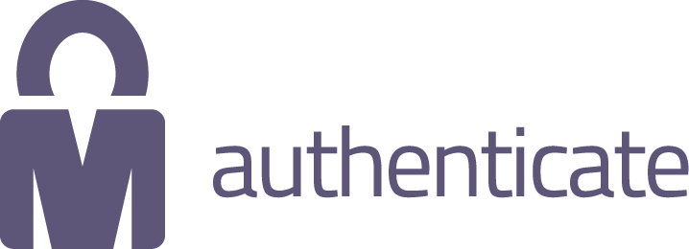
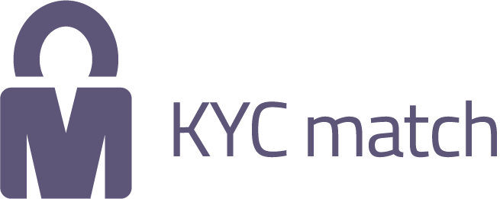

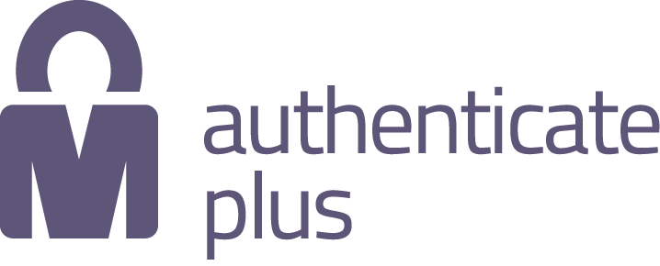

Mobile Connect Services (defined & supported by GSMA)
Authentication
Identity
Network attributes
Simple and convenient log-in or step-up authentication
Provision or verification of user identity
Insights about the device
and user’s mobile account
Notes:
Insights –
About the user, device or transactions
Country check, verification of customer information

Slide 4
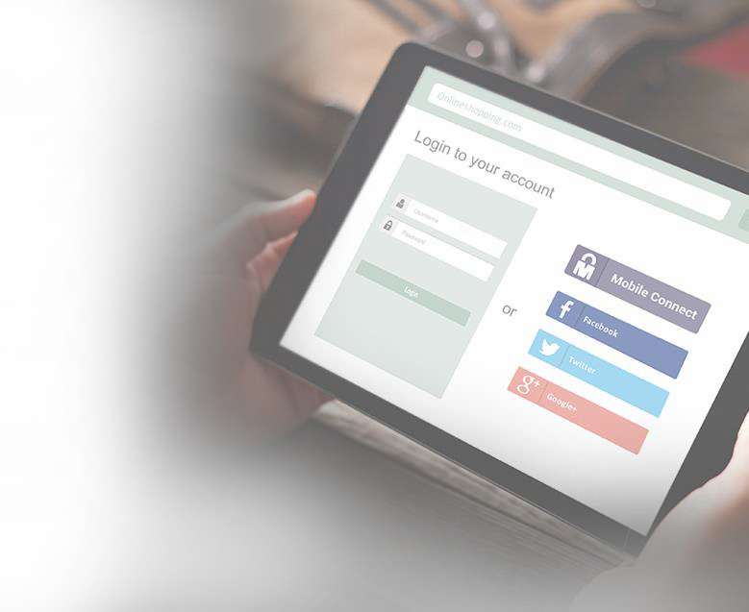






Mobile Connect Authentication
Single mobile operator identity solution for online
services using the mobile phone- always with customer
Verifies that the user is in control of their mobile phone providing a single-factor authentication (Level of Assurance 2) - something I have(the phone) - or LOA3 with pin - something I know
Secure personal data sharing.Distributed, federated framework
utilising open standards
Password-less login to online resources across any device (mobile, tablet, laptop) reducing friction
88%
of consumers say a single secure login
solution would be beneficial to them
Sources: GSMA Consumer Research 2015, Cyber Streetwise
Copyright © 2018 GSMA. The Mobile Connect logo is a trade mark registered and owned by the GSMA.

Slide 5
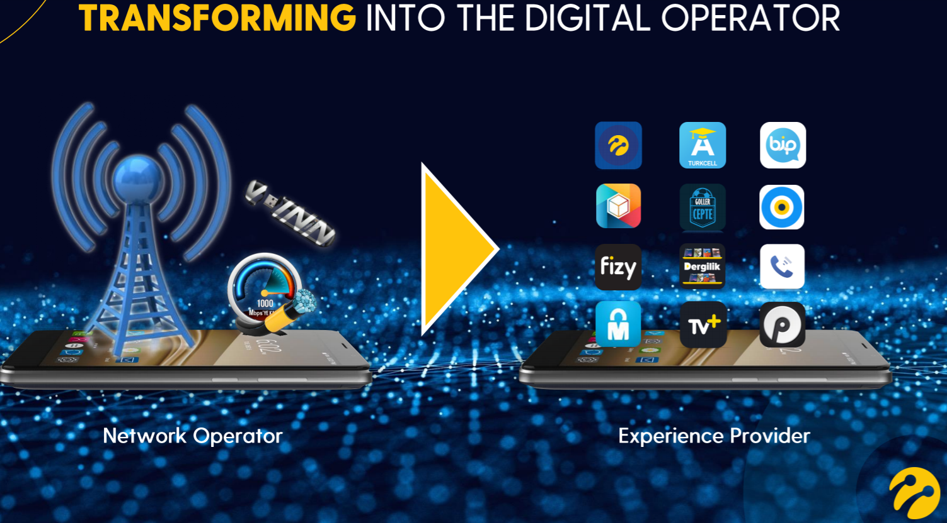
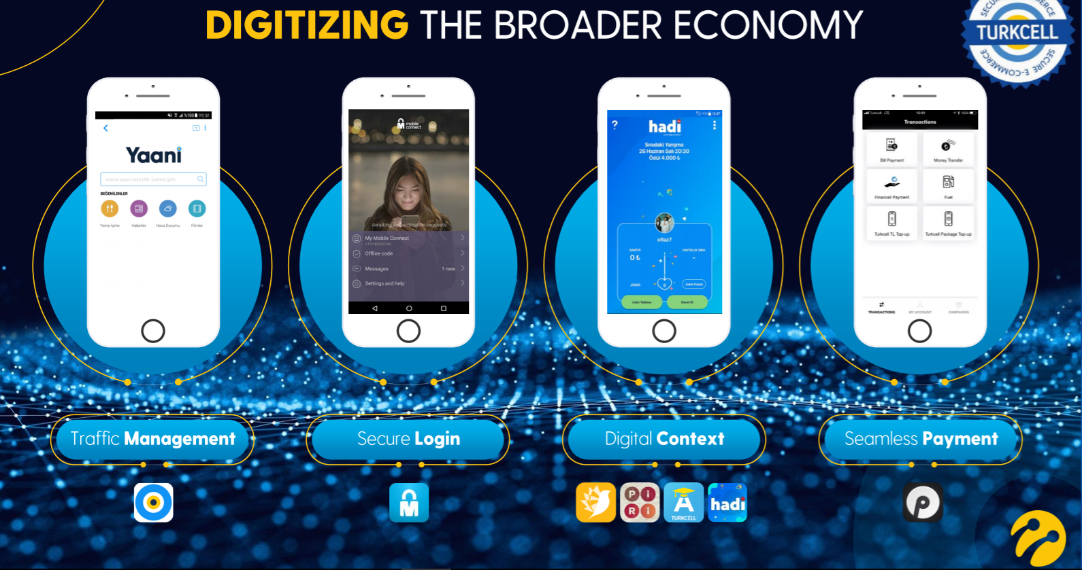
Turkcell digital transformation strategy
MC Authenticator
Turkcell 1
Turkcell 2
Turkcell 3
3rd party
Mobile Connect provides
a consistent log in experience across multiple applications
powering rapid adoption
Turkcell strategy-1440 strategy- is to increase share of
customers daily digital experience from c.25 minutes
by developing new Turkcell digital propositions and
partnering
A single identity authentication experience is central to this

Slide 6






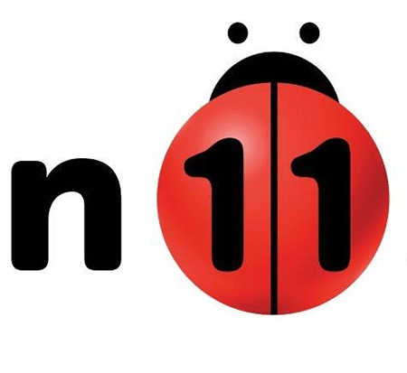



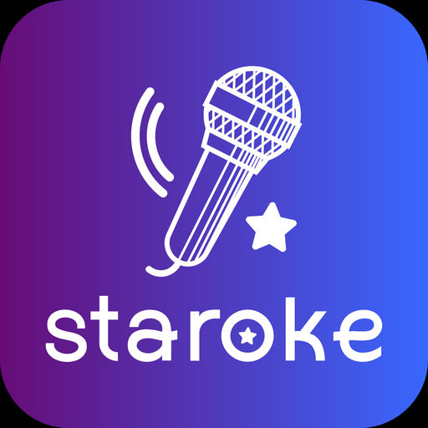



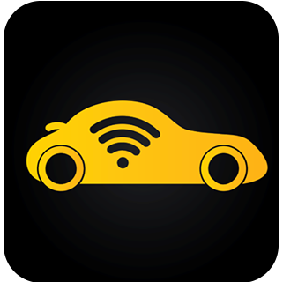




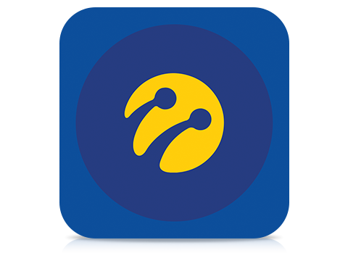






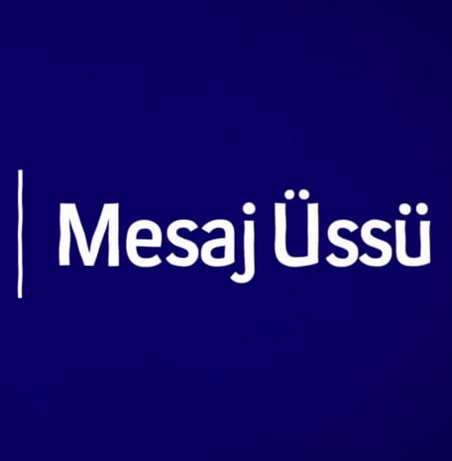




IMPACT OF DIGITAL SERVICES ON MOBILE CONNECT USE
50 apps
and services integrated
16 M+
Registered users
25.9M
Hadi
Launch
24.1 M
Dergilik
Integration
Accessible
to users of all operators
22.8 M
Hesabım
Integration
21.1 M
Header
Enrichment
Effect
Repositioning
Rebreanding
16.4 M
5.2 M
0.9 M
50 K
SEP 2016
DEC 2017
JAN 2018
MAR 2018
MAY 2018
AUG 2018
OCT 2018
DEC 2018

Slide 7
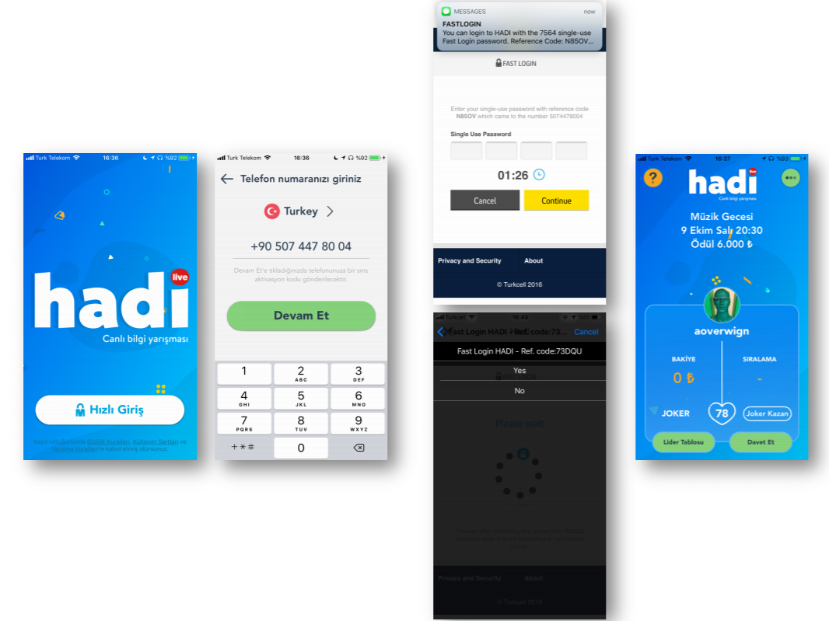
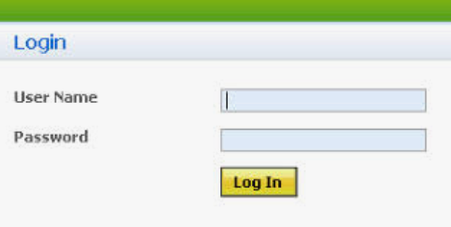
Mobile Connect can replace user names and passwords
Hadi is one of Turkcell’s merchants and uses Mobile Connect as the only authentication solution.

Slide 8
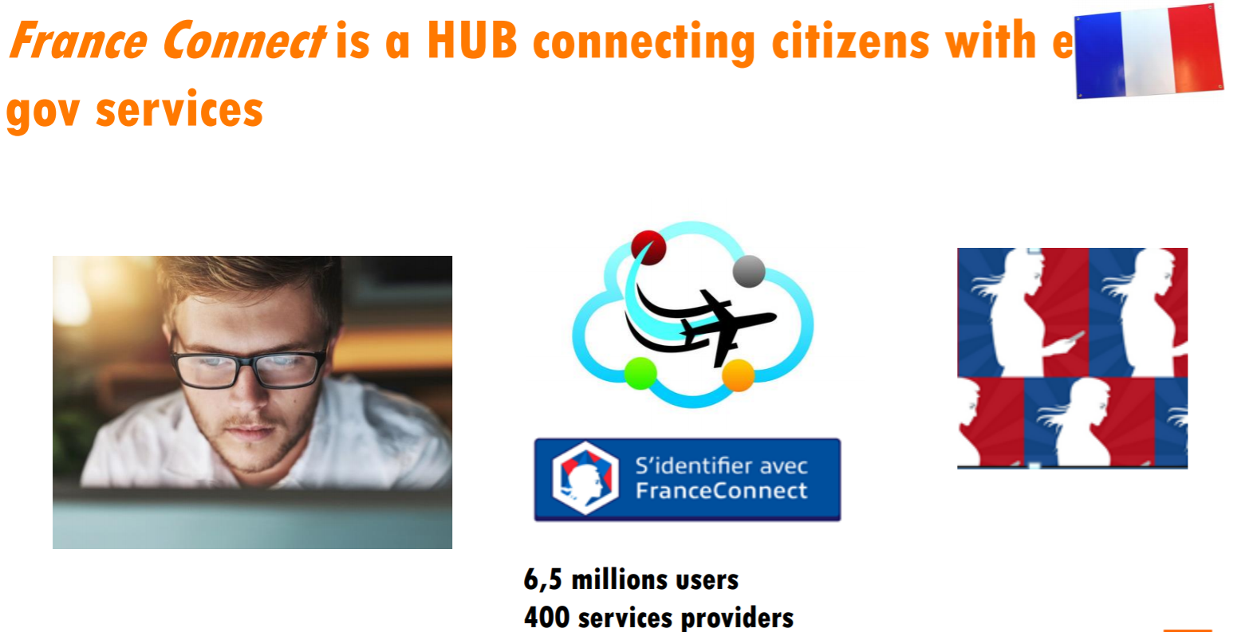
Orange France:Digital transformation
The French Government is driving the digitisation of public services through France Connect the public services digital platform.500 public services are accessible.
The goal is that every citizen will have a digital identity which would drive the digital transformation of France – reducing costs, simplifying life through the “say it once” initiative, where public bodies have to share information rather than ask citizens for data already held.

Slide 9
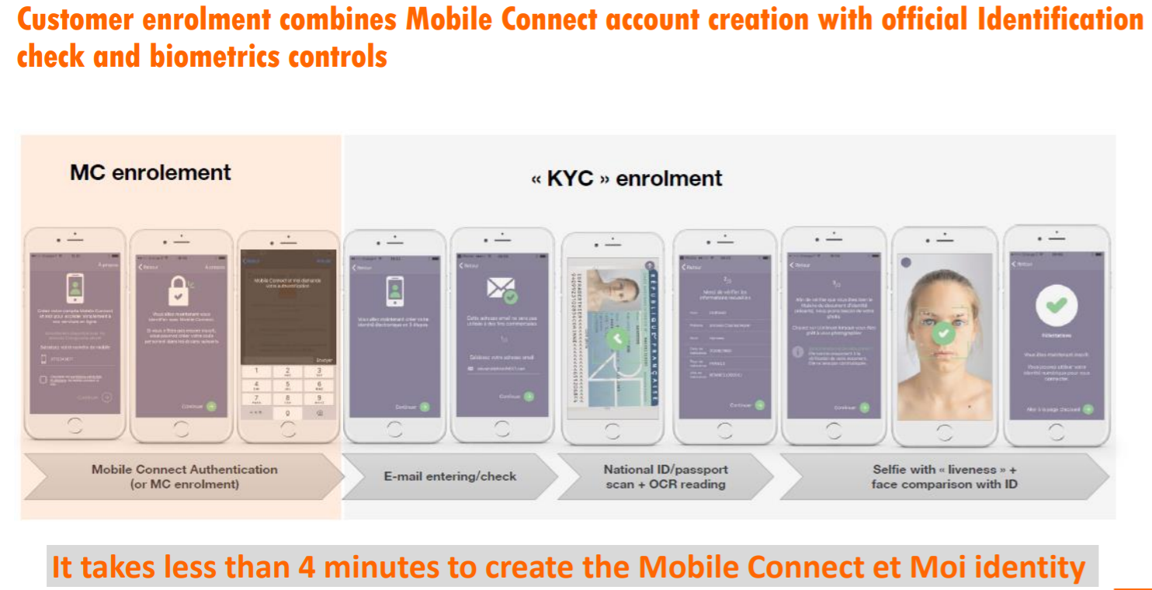
Orange France:Digital transformation
Working with the French Government, Orange has created “Mobile Connect et Moi” a secure mobile authentication solution to access France Connect.This allows customers to register and login with their mobile device.
The citizens’ identity is verified on registration using an ID document scan. They can then access all available public services using their mobile device and a PIN stored on the SIM card.

Slide 10
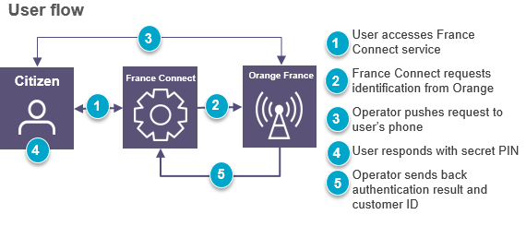

Orange France:Digital transformation
500 public services.All new public services must be delivered digitally through France Connect
8m registered citizens
C.180k-200k uses each day
“Orange sees digital identity as the key to unlocking value from digital transformation.There is an ambitious vision for France Connect and we are delighted to have created a fully mobile proposition to support this vision.”
Serge Llorente- Orange Mobile Connect Director.

Slide 11
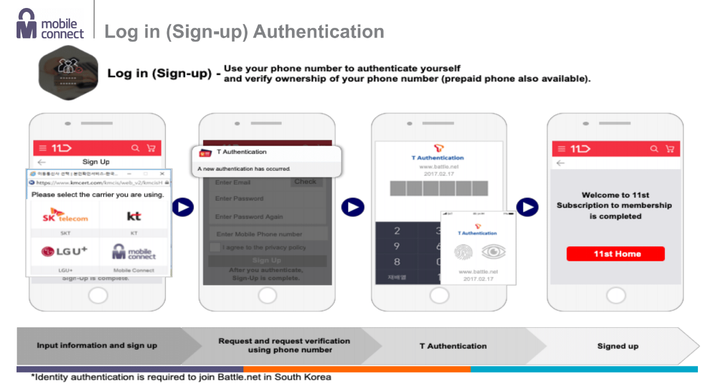

Slide 12
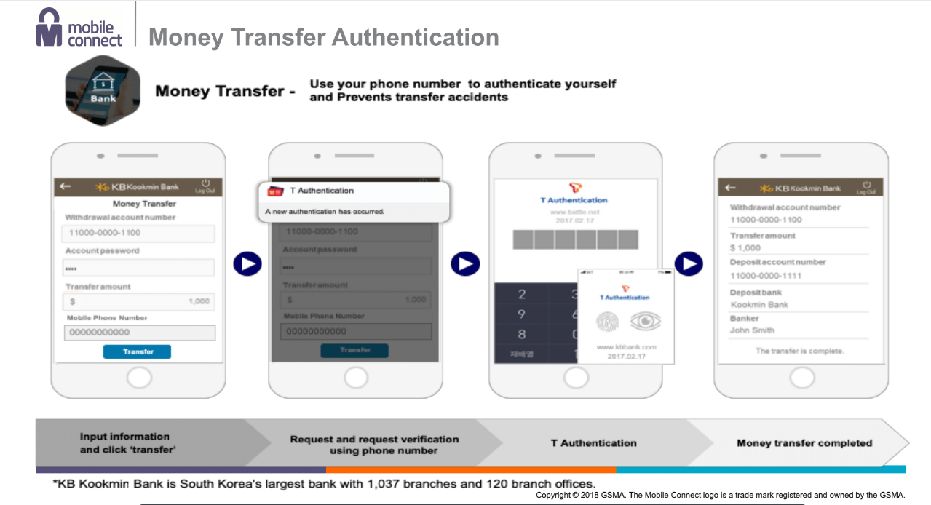

Slide 13
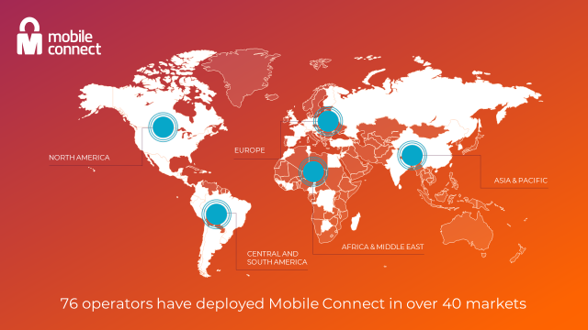
Mobile Connect Deployment
516.8m monthly Mobile Connect active users with over 200 live services worldwide.
Project Verify unveiled by US carriers at MWC Los Angeles 2018.
No operators in the Caribbean have deployed mobile connect or similar identity services.

