Slide 1
Building the
Metaverse
CANTO 37th Annual Conference and Exhibition
Miami Beach, FL
July 18 2022

Slide 2

Building the Metaverse
Notes:
Good morning and thank you we’d like to take this opportunity to share a bit about our vision for the metaverse, and how we intend to get there

Slide 3








Physical world
Augmented reality
Virtual reality
Notes:
we see connections made across 3 worlds. Physical, augmented, virtual.
Physical world: You and I here today
(CLICK) Augmented world: Adding layers to what you see in the physical world to augment it with both expression and utility
(CLICK) Virtual world: Putting yourself in a virtual experience that transcends time and space.
Right now, transitioning between worlds is quite cumbersome -- physical to augmented, you have to use your phone (multiple taps) and to virtual, put on a headset. For those of you who have kids, they will move fluidly between worlds.

Slide 4
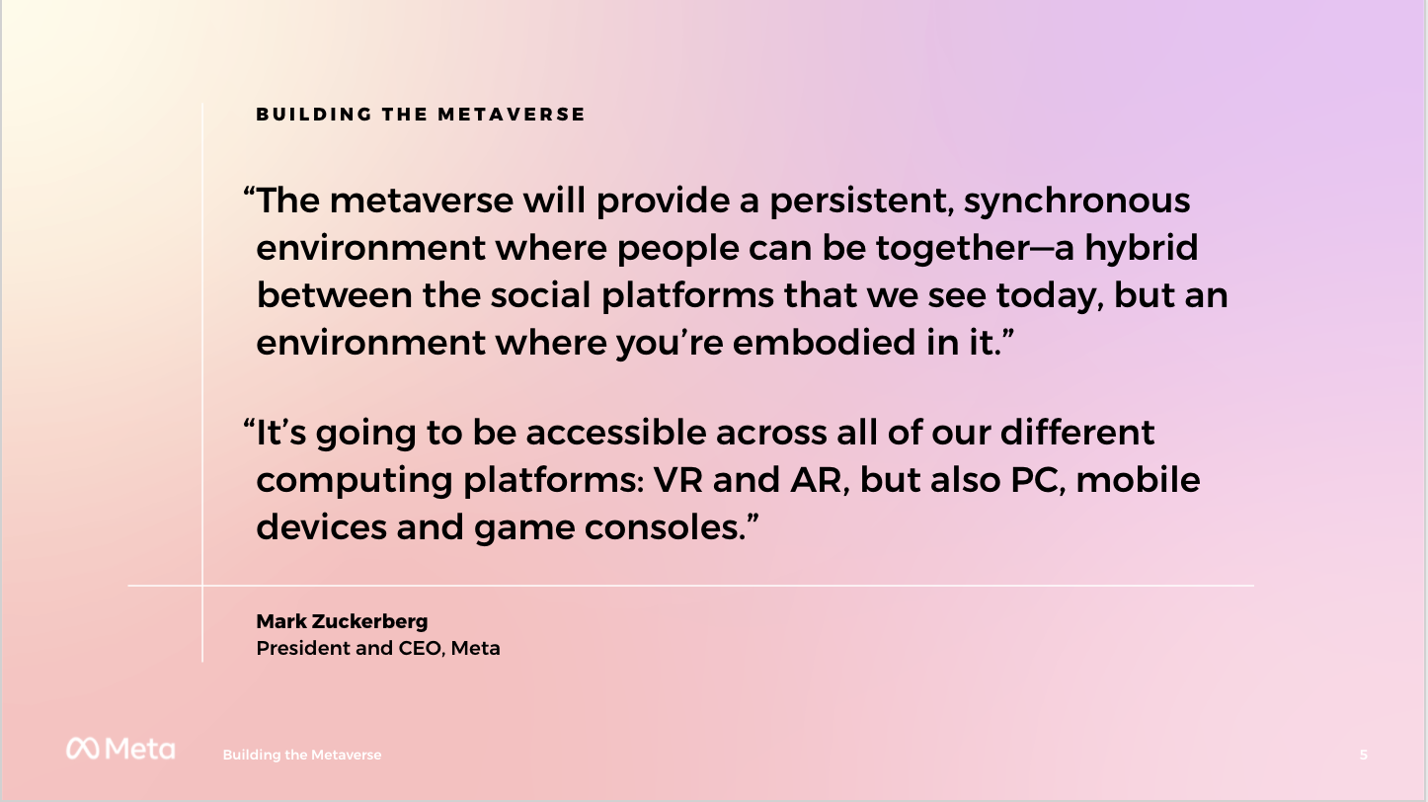

Notes:
The metaverse is a set of virtual 3D spaces where people can create and explore with other people who may not be in the same physical space. You'll be able to hang out together with friends, work, play, learn, shop, create and more. And you’ll be able to access these spaces across devices: AR, VR, PC, smart display and mobile.
The metaverse won't be owned, built or run by any one company. We are just one of many contributors. The vision is that many others will be involved in building services and infrastructure that collectively make up the metaverse. Like the internet, the metaverse is a collective project. The term “metaverse” is not a brand or a name that any one company chose or owns. We’re all going to create and evolve it together.
Lots of companies, creators and developers will be involved in this work and we will be partnering with human rights, civil rights and privacy experts, community-based organizations, and future users.
Crucially, this layer will be accessible from many devices: VR headsets, mobile phones, desktop PCs, AR devices, and so forth.
The metaverse won't be owned, built or run by any one company. We are just one of many contributors to a collective project.

Slide 5
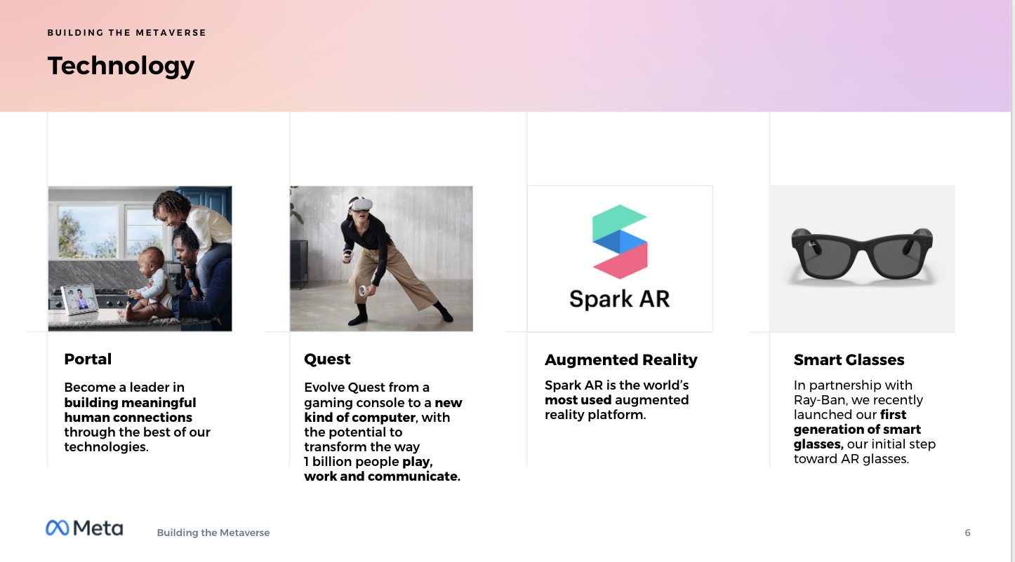

Notes:
So let’s talk about the technology. As much as personal computing has shaped the last 50 years, we believe that augmented and virtual reality technologies will shape the next 50. And a global team of researchers, developers and engineers is working to build the future of connection within virtual and augmented reality.
Our Policy team’s focus is to make sure we are developing AR and VR products responsibly and to build trust in our products by engaging the policy community, such as yourselves.
AR and VR have the capacity to change the way people interact with computers, and it’s critical that we develop and evolve these technologies in a positive and responsible way. The fast pace of technological change can sometimes leave policymakers and regulators playing catch-up. However, we have an opportunity and a responsibility to have a dialogue and collaborate early.
These conversations will help Meta and all companies involved in creating the metaverse implement what we learn from the global community to build responsibly.

Slide 6
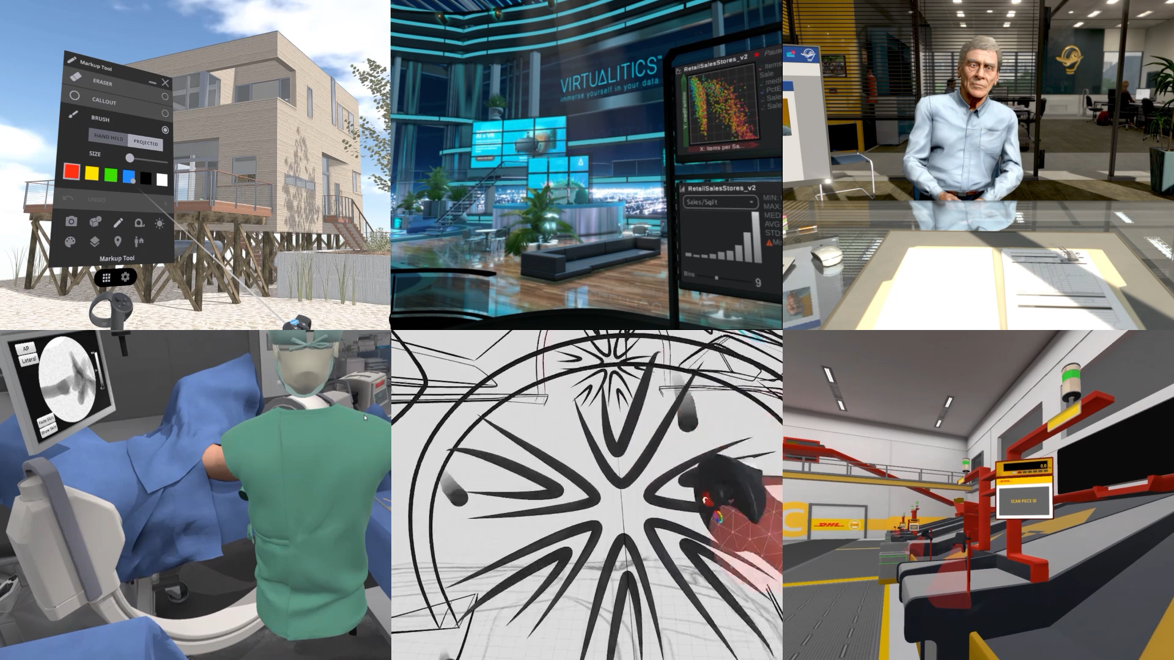
VR is not only about gaming
Notes:
The industry now understands that VR is not only about gaming
Think on having Virtual Meetings with your colleagues, Working on a Product Design across the world, Practice new ways of Telemedicine beyond video call, Have Remote Presence with your loved ones, Talk about Architecture without being there, See before anyone the next on Fashion…
Our business division is partnering with industry leader to make VR a reality in the industry ecosystem.
And VR is becoming 100% Wireless. Improved local compute, but also better networking infrastructure and new spectrum allocation to WiFi and 5G will boost the revolution of AR\VR in the following years

Slide 7
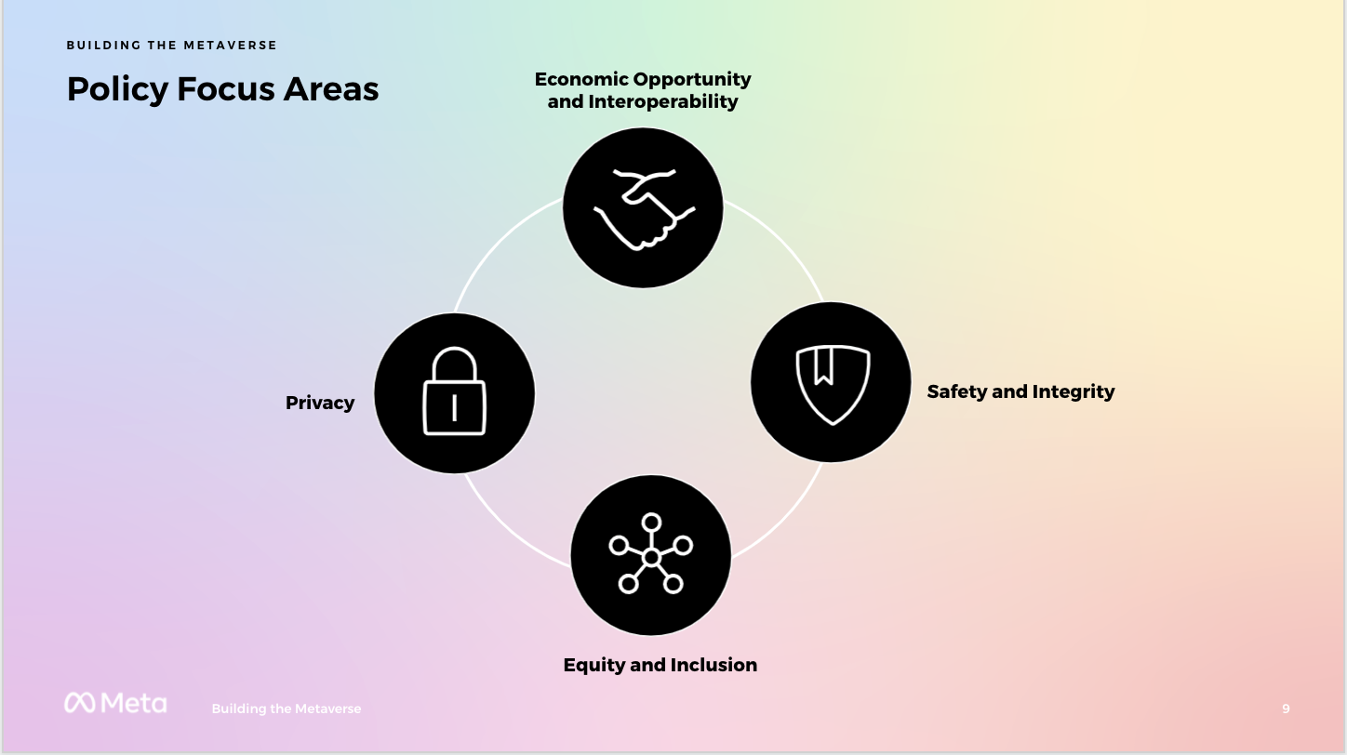


Slide 8


Better Connectivity is key to build connections across worlds
Physical
world
5G
Augmented
reality
WiFi 6E
Virtual
reality
Notes:
To make the Meta dream a reality we firmly believe that better connectivity is key to build connections across the physical world, augmented reality and virtual reality

Slide 9
Best Connectivity will be enabled with 5G and Wi-Fi 6E
As said AR\VR devices will benefit largely of the high bandwidth and low latency advantages of 5G together with Wi-Fi 6E and 7 (6 GHz)
6 GHz will also bring the new “Wi-Fi highways” through a large number of 80 and 160 MHz channels, futureproofing the spectrum to support future traffic increases

Slide 10

Identification of the full 6Ghz Band as unlicensed. Global Momentum.
Consultations open
Region 3
Hong Kong, Taiwan, Malaysia, Australia, New Zealand
Region 2
Mexico, Colombia, Argentina, DR
Region 1
Tunisia, Jordan, Qatar, Oman, Egypt, Russia, UK (upper 6)
Technical Studies
Japan (full band)
India (full band)
Europe (6425-7125 MHz)
Honduras, Guatemala and Costa Rica identified 1200 MHz
1200 MHz adopted
1200 MHz proposed
500 MHz adopted
500 MHz proposed
5925-6425 adopted; above 6425 MHz proposed
ATU recommends licence-exempt 5925-6425 (2021)
General 6 GHz consultations or studies

Slide 11
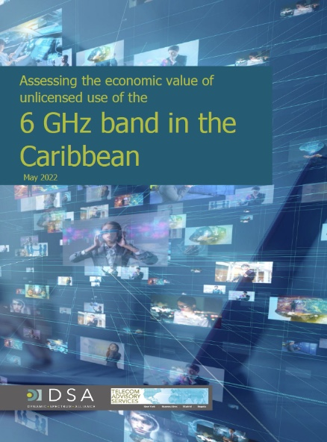
The World is already embracing 6 GHz.
The Caribbean to follow the regional trend.
Many countries and regions are already moving ahead with the adoption of the full 6 GHz Band for unlicensed use.
According to a recent study by Dr. Katz (May 2022) adoption of 1200 MHz in the 6 GHz band for unlicensed use in the Caribbean will result in a total cumulative economic benefit of USD 79.8b in the region.
Let´s harmonize! 1200 MHz of the 6Ghz band will benefit users and markets in traversing to the Metaverse
It’s great to see that more new regions are moving ahead!!
Notes:
We know the world is already embracing the 6 GHz spectrum and these are great news for AR\VR

Slide 12
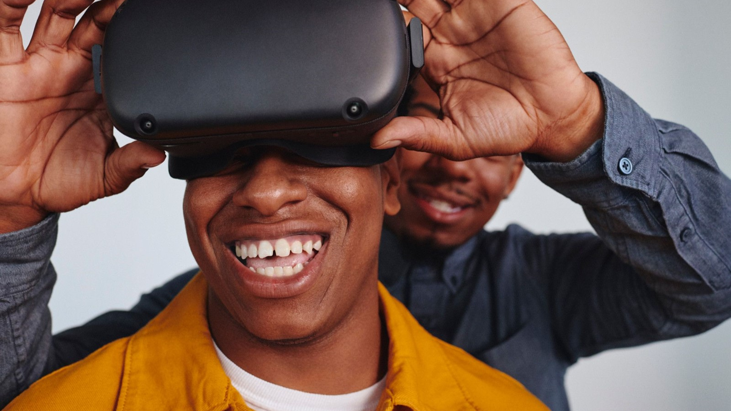
Thanks!!
Notes:
…this journey is only 1 percent finished – there’s still so much to discover, learn, and explore with this technology, especially AR\VR.
But there is a path forward to a reality where you seamlessly thread stories across these three worlds.
Let’s take a look!

