Slide 1
#BeAForwardThinker
CANTO 2022
DevSecOps
A NEW COLLABORATIVE APPROACH

Slide 2
Panelist:
Rory Ebanks
www.symptai.com
Director of Cyber Security
Symptai Consulting Limited
AGENDA
Shifting Security Left
Security in the SDLC
Cost savings of introducing security
Best Practice/Tips

Slide 3
www.symptai.com
A core principle of
DevSecOps
is the need to “shift security left”.

Slide 4
Security in the Traditional
Waterfall Development Model
www.symptai.com
Source: Nullsweep.com
Notes:
https://nullsweep.com/integrating-security-with-agile-development/
The legacy approach to including security in application development was based on the waterfall methodology:
Security set up checkpoints within the development phases.
These checkpoints would halt development activities until security requirements were met.
This approach was often a point of contention, seen as slowing down the development process.

Slide 5
Security in the Agile
Lifecycle
www.symptai.com
Source: Nullsweep.com
Notes:
https://www.osti.gov/servlets/purl/1639955
Ongoing Activities
§ Conduct secure code training with developers: an ongoing activity and will include lunch and learn sessions to transfer knowledge.
§ Security Misuse Stories: User stories are used in agile development methodologies to describe high-level requirements. To leverage this approach to increase security, our Cyber Analysts will create “evil user stories” – descriptions of how malicious users might try to misuse the application, which would then drive requirements for security countermeasures.
§ Threat Modelling: Reviewing the design, architecture, data flow diagram and infrastructure design to confirm the adequacy of security controls. A threat model is typically performed by creating a data flow diagram of the application and then using structured methodology such as STRIDE to identify threats to the data as it moves between application components. It occurs initially and is repeated upon a new release and updates on these releases.
Automated & Manual testing:
o Static Application Security Testing (SAST) - Analysis of source code obtained or
compiled binaries aimed at discovering programmatic examples of security flaws.
o Software Composition Analysis (SCA) - Modern software uses many libraries to implement standard functionality, and they need to be updated whenever vulnerabilities are discovered and disclosed. Any software libraries/components utilized are reviewed to identify any potential vulnerabilities that may put the.
o Dynamic Application Security Testing(DAST)-Oncethesoftwarehasbeenbuiltand is running, security checks are performed against the software to find vulnerabilities in the running version.
o Application program interface (API) - API testing involves testing application programming interfaces directly and as part of integration testing to determine if they meet expectations for functionality, reliability, performance, and security.

Slide 6
Obstacles to
DevSecOps: Skills
76%
of university educated developers were not required to complete any courses focused on security for their degrees.**
www.symptai.com
ALMOST
Unfortunately, most organizations tell us that their developers are inadequately trained in application security and secure coding practices.
58%
70%
of developers say that their employers do not provide them with adequate training in software security.**
say that lack of skills is a significant hurdle in embedding security into development.*
Sources: *Freeform Dynamics, **DevOps.com

Slide 7
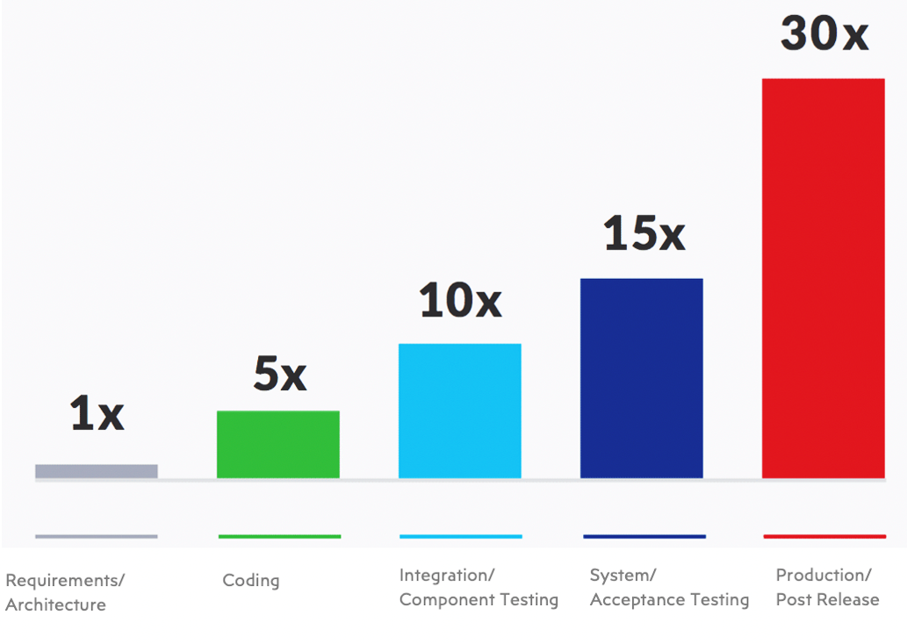
When is Cybersecurity brought
Into New Business Initiative?
www.symptai.com
6x
Times cheaper when security is addressed at design vs implementation
15x
Times more expensive when security issues are addressed at testing
A
B
A
B
A
B
A
B
Source: NIST,
¹ IBM Systems Institute
Notes:
COST SAVINGS of Shifting Security Left
Consider that shift-left security is good for reducing not only cyber risk but also cost.
Vulnerabilities found in production cost up to 30x time and money more to fix?
To reduce the cost of fixing security bugs, find them earlier in the SDLC with these security testing practices:
Perform an architecture risk analysis to identify issues during the design phase of software development.
Use an IDE plugin so developers can resolve security issues as they write code.
Conduct a source code review to identify issues within the code.
Add interactive application security testing to your functional tests.
Prior to release, conduct a penetration test to identify issues and make sure that you’ve resolved the issues you previously identified.

Slide 8
Vulnerabilities Within
the Caribbean
www.symptai.com
Improperly Configured Devices and Systems
Ineffective Patch Management Controls
Insufficient Cryptography
Inadequate or Improper Access Controls
Lack of Data Validation and Sanitization
39%
14.6%
10%
6%
5%
Inadequate or Improper Authentication Controls
Inadequate or Improper Auditing and Logging controls
Poor File and Resource management
Poor Session Management
Vulnerable API and Web Services
A
B
A
B
A
B
A
B
4%
3%
3%
2.8 %
2%
Source: Symptai Consulting Limited Cyber Security Assessment Reports 2020-2022

Slide 9
Best Practices
Frequent collaboration with all members of the team.
Keep up to date with relevant threats.
Educating employees/users on best security practices and ways to avoid socially engineered attacks.
Conduct regular and incremental risk and security assessments.
Frequent reporting.
www.symptai.com
Notes:
Here are some ways your company can combat Cyber Threats through transformed security thinking
Evaluate your choice of security solutions wisely to ensure the solutions you choose are aligned to your strategy and provide the protection you’ll need now and in the future. Be willing to invest in these solutions on an ongoing basis. Don’t depend on a ‘silver bullet’ to solve all issues at once. Selecting the right tools to help automate security testing and provide security-on-demand to developers is essential.
EDUCATE EMPLOYEES Data breach prevention needs to include everyone at all levels — from end-users to IT personnel, and all people in between.
When you’re trying to plan how to prevent data breach attacks or leaks, security is only as strong as the weakest link. Every person that interacts with a system can be a potential vulnerability.
Conduct regular risk and security assessments to identify and mitigate potential risks as they develop. At Symptai, we provide rigorous, end-to-end testing, such as our External and Internal Network Penetration Tests, Mobile and Web Application Testing to ensure that our client's network infrastructure and applications are completely secure from attacks while minimizing the risk exposure to an acceptable level.
Seek Expert Guidance. New risks can be created that existing team members might not be experienced enough at identifying and addressing. Seek the Support of professionals. Short-term skills can be acquired through outsourcing security functions to a managed security service provider (MSSPs) or by reaching out to our team of Cybersecurity experts at Symptai Consulting

Slide 10
#BeAForwardThinker
SCAN ME
Connect
WITH US
WEBSITE
PHONE & EMAIL
BOOTH #28
https://www.symptai.com/
(876) 968-6189
info@symptai.com
Notes:
For more resources, including a digital copy of this presentation.

