Slide 1

CYBERSECURITY AND THE HUMAN FACTOR
Juan Manuel Rodríguez
Senior Manager, Information Security Operations Center
Liberty Latin America

Slide 2




3 CYBERSECURITY PILLARS
Nothing new…
PROCESSES
Guidelines that provide coherent structure to mitigate risks or deal with threats in real-time.
02
PEOPLE
01
Enable everyone (end-users and IT) with cybersecurity skills to implement controls, technologies, and best practices.
TECHNOLOGY
State of the art security tools that help prevent, protect and respond to cyberattacks.
03

Slide 3
THE FIRST PROBLEM WITH PEOPLE IS…
that people are HUMANS and humans make mistakes
Statistics of cybersecurity TRAINED end users regarding Phishing Attacks:
Only 3% of users that received a phishing email reported it to superiors or IT.
30% of phishing emails are opened by the receiver.
12% of users clicked on a malicious link inside a phishing email.
85% of organizations confirmed an attack after a clicked malicious link.
All above happens even though 78% of users say they are aware of the phishing threat.

Slide 4
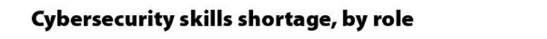
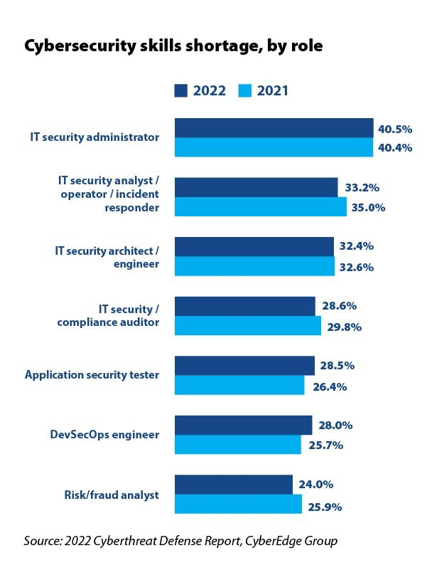
THE SECOND PROBLEM WITH PEOPLE IS…
that people are HUMANS and humans do not reproduce fast enough
There is a critical shortage of specialized cybersecurity talent in the world:
In 2011 cybersecurity job openings exceeded the qualified personnel offer.
The number of unfilled positions globally grew by 350% over the past 8 years.
The shortfall of skilled workers is estimated in 2.72 million.
Millennials and Gen Z (<39yo) represent 39% of the workforce.
Source: Cybersecurity Workforce Study 2021
Notes:
Colonial Pipeline, for example, was openly searching for a cybersecurity manager just weeks before a massive ransomware attack forced the utility provider to temporarily shut off its fuel pipeline -- the largest fuel pipeline in the United States -- and pay $4.4 million in ransom to restore network access. Hackers stole data from a traditional file share using a virtual private network account with a compromised password that had been leaked on the dark web. The VPN account did not have multi-factor authentication (MFA) access controls in place.

Slide 5
HOW DO WE SOLVE THESE PROBLEMS?
The way HUMANS do… TOGETHER!
All of us are responsible for closing the gap… again… TOGETHER!
What ideas do you have?
Make cybersecurity part of your life… it already is.
Keep cybersecurity education as a top priority, for everyone.
Equality, Diversity & Inclusion is a critical component of the solution.
Embrace Work-From-Home.
Hire people without cybersecurity skills but are good problem solvers and are eager to learn.

Slide 6
CYBERSECURITY AND THE HUMAN FACTOR
Juan Manuel Rodríguez
Senior Manager, Information Security Operations Center
Liberty Latin America

