Slide 1
VALIDATION OF
DIFFERENT CALL EVENTS
TO ENHANCE FRAUD DETECTION

Slide 2
VOICE FRAUD TYPES AND LOSSES*
01
CLI spoofing: $2.6 billion
PBX hacking: $3.6 billion
Interconnect bypass: $3.11 billion
Spam, Phishing: $3.24 billion
Wangiri: $1.8 billion
FAS + IRSF: $6.7 billion
OTT bypass: ?
Call stretching: ?
*according to CFCA data

Slide 3
OUT-OF-BAND VALIDATION OF CALL DETAILS
02

Slide 4
OUT-OF-BAND VALIDATION OF CALL DETAILS
03

Slide 5
OUT-OF-BAND VALIDATION OF CALL DETAILS
04

Slide 6
OUT-OF-BAND VALIDATION OF CALL DETAILS
05

Slide 7
OUT-OF-BAND VALIDATION OF CALL DETAILS
0706

Slide 8
OUT-OF-BAND VALIDATION OF CALL DETAILS
07

Slide 9
OUT-OF-BAND VALIDATION OF CALL DETAILS
08

Slide 10
OUT-OF-BAND VALIDATION OF CALL DETAILS
09

Slide 11
OUT-OF-BAND VALIDATION OF CALL DETAILS
10

Slide 12
OUT-OF-BAND VALIDATION OF CALL DETAILS
11

Slide 13
OUT-OF-BAND VALIDATION OF CALL DETAILS
12

Slide 14
OUT-OF-BAND VALIDATION OF CALL DETAILS
13

Slide 15
OUT-OF-BAND VALIDATION OF CALL DETAILS
14

Slide 16
OUT-OF-BAND VALIDATION OF CALL DETAILS
15

Slide 17
OUT-OF-BAND VALIDATION OF CALL DETAILS
16

Slide 18
OUT-OF-BAND VALIDATION OF CALL DETAILS
17

Slide 19
OUT-OF-BAND VALIDATION OF CALL DETAILS
18

Slide 20
OUT-OF-BAND VALIDATION OF CALL DETAILS
19

Slide 21
OUT-OF-BAND VALIDATION OF CALL DETAILS
20

Slide 22
OUT-OF-BAND VALIDATION OF CALL DETAILS
21

Slide 23
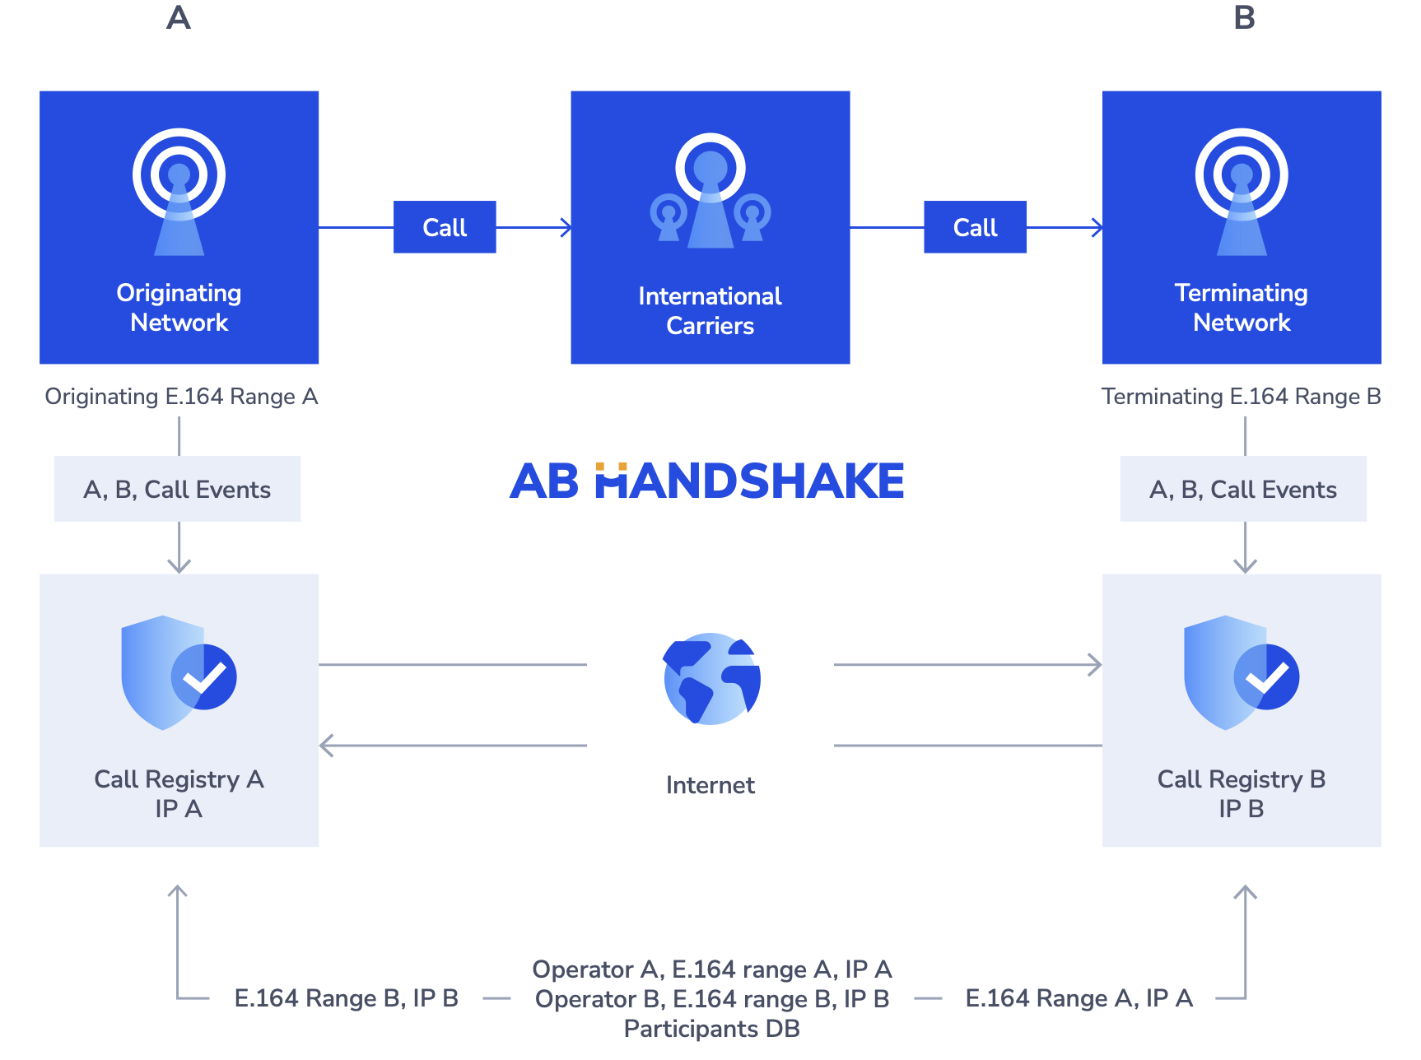
SYSTEM ARCHITECTURE
AND MANAGEMENT
22
Both operators have Call Registries installed at their premises.
An international call originated by Operator A is routed via a cloud of carries to Operator B. Simultaneously, Operator A sends call details to Call Registry A for validation. Operator B sends details of the received call to Call Registry B for validation as well. Both CRs reach out to each other through an encrypted channel to compare call details.
The Call Registry can give commands to stop connecting a call or disconnect an active call
Every Operator that would like to participate provides its own E.164 range and IP address of its Call registry to the coordinating entity.

Slide 24
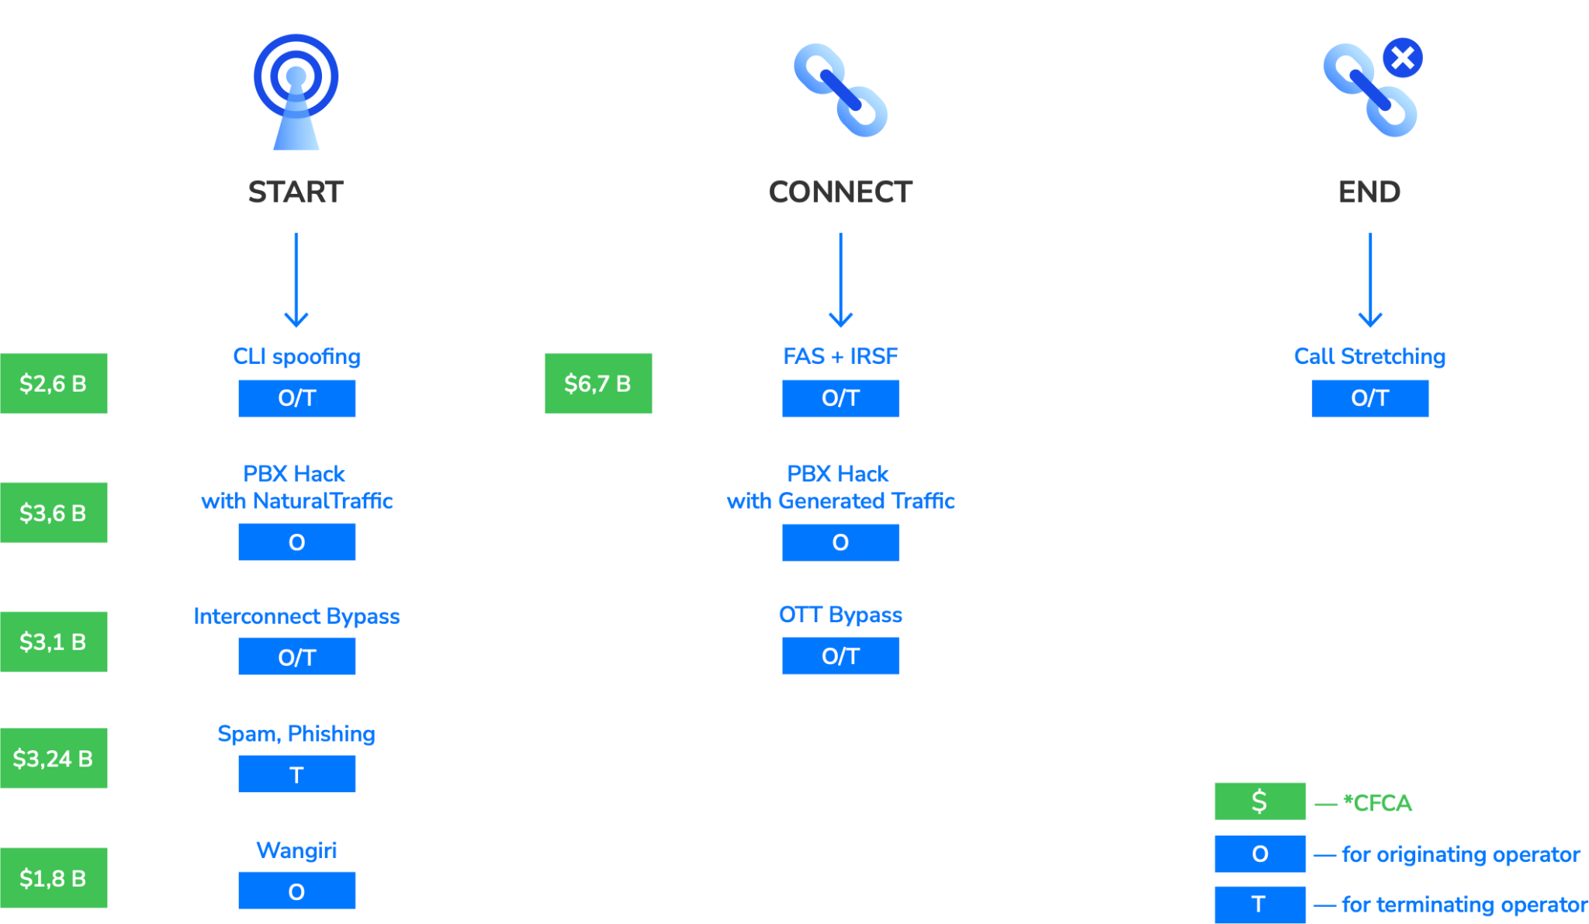
VALIDATION OF DIFFERENT CALL EVENTS
23

Slide 25
VALIDATION OF DIFFERENT CALL EVENTS
24

Slide 26
Call events:
start
connect
end
Validation scheme:
pull
push
Controlling parties:
originating service provider
terminating service provider
Types of fraud:
all types of voice fraud

Slide 27
HOW TO TRANSIT CALL EVENTS FOR VALIDATION
SIP signalling:
SBC
Softswitch
CSCF
Radius AAA:
SBC
Softswitch
CAMEL:
SCP
STP
Camel GW
ISUP:
STP

Slide 28
THANK YOU
Sergei Okhrimenko
abhandshake.com
sergei.okhrimenko@abhandshake.com

