Slide 1

CANTO 2022 Annual Conference and Trade Exhibition: Enabling the Digital Evolution
Denis O’Brien / Chairman and Founder / Digicel Group
19th July 2022

Slide 2
The Global Challenge
50% of the world (3.8bn people) have no broadband access
What must be done?
UN Broadband Commission Recommendations, October 2021:
Any business generating revenue, must make a contribution to network costs, i.e. a percentage of their revenues
Regulatory framework requiring all players to work cooperatively
Australian Code establishes obligation for Big Tech and OTTs to make a proportionate contribution to network costs and usage
Lowering of taxation/regulatory burden on existing and new telco investors

Slide 3
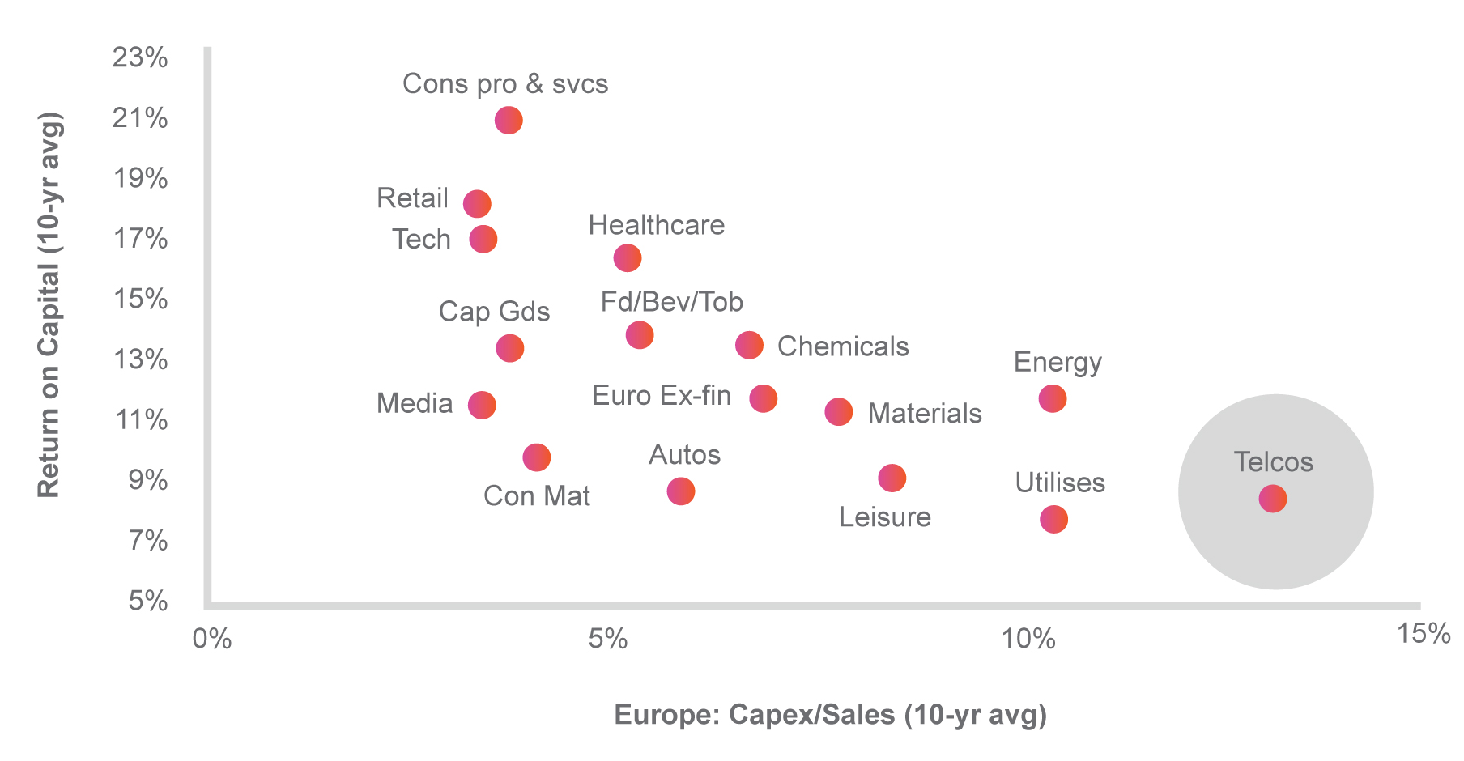
Telecoms is Now Out of Favour

Slide 4
Telecom Reality Check
Revenues static and in some cases declining
Prices reducing in real terms; costs rising
Annual CapEx of 18% required
Tax and licensing fees increasing; talk of new levies
FX challenge; US dollar appreciation is hampering returns
Cost of capital rising due to Fed interest rate rise
Low free cash flow, which is unacceptable to investors

Slide 5

OTTs are freeloading….
and paying nobody

Slide 6
OTTs Freeloading
Data delivers 73% of mobile operators’ revenue today
Six Big Tech operators account for 60% of all internet traffic
OTTs consume 62% of mobile network capacity on Digicel’s Caribbean network (Sandvine study)
Facebook and Google (combined) consume 52% of that capacity
In Europe, OTTs cost telcos US$45 per sub/annum, equivalent to 3-4 months ARPU in the Caribbean
OTTs pay Governments and network operators………..ZERO
It’s the most beautiful business model ever seen!!!

Slide 7
Solutions for the Future
Making the Caribbean a leader in the Digital Economy in the 21st century
This requires a coalition of investment interests: Governments, Regulators, operators and investors
At present, there is no investment case for 5G throughout the region
Cooperation required between CARICOM, CTU, CANTO and operators to achieve the policy objective of a Single Caribbean Regulatory Space (similar to the EU)
The Declaration of St. George’s on roaming; a great example of a Digital Regional Economy
Consolidation of network operators may be necessary

Slide 8


