Slide 1
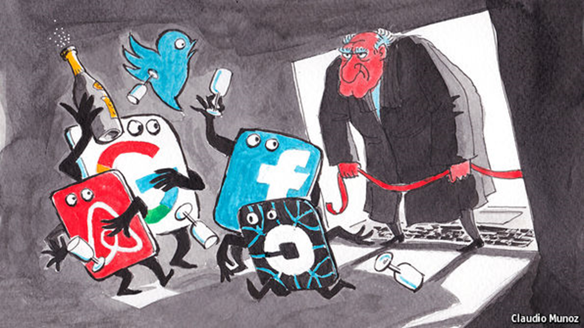
The Party is Over
Alexandre de Streel
Namur University and Centre on Regulation in Europe
CANTO Annual Conference, 19 July 2022

Slide 2
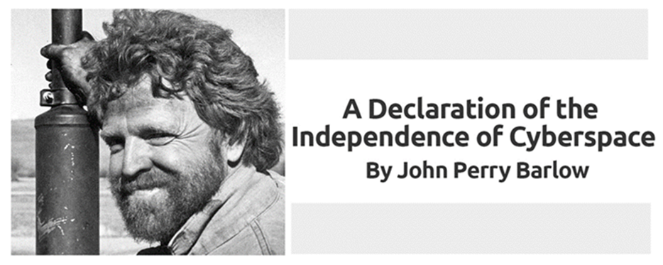
(…) Where there are real conflicts, where there are wrongs, we will identify them and address them by our means.
We are forming our own Social Contract.
This governance will arise according to the conditions of our world, not yours. Our world is different (…)
We will create a civilization of the Mind in Cyberspace. May it be more humane and fair than the world your governments have made before

Slide 3
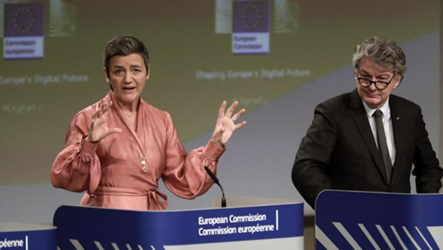
1. State take back control
Concentration of economic, innovation and informational powers among happy few
Unfair results : most of the added value is captured by few innovative firms
esp. because their taxation is (still) very low
Loss of autonomy of citizens, business users and States
Need to take back control!
Notes:
Raisons de la pression politique
Protectionnisme: perdants de la 4e révolution industrielle, cf. cas Australie Murdoch vs Google et Facebook
Concentration de pouvoir, comme en début de chaque Révolution industrielle: cf. Sherman Act et barons de la 2e Rev industrielle, Rockefeller, Carnegie …
Distribution inéquitable de la valeur générée, regulation comme second best a taxation
Perte d’autonomie: réelle ou perçue. Boris Johnson l’a bien exploité.

Slide 4
Emerging Big Tech Regulatory framework
EU
Digital Markets Act (2022): Contestability and fairness
Digital Services Act (2022): Less illegal content and products
US
American Innovation and Choice Online Bill
Open Apps Market Bill
Algorithmic Justice and Online Platform Transparency Bill
China
Draft law on Internet platform to implement the main responsibility
UK, Australia, South Korea …

Slide 5
2. Increase transparency
More transparency on algorithms and date, while respecting IP, trade secret and business confidentiality
Access to data for regulators
Meaningful transparency reports
Risks assessement and audit
Need international standards
As in accounting: International Financial Reporting Standards Foundation (IFRS)

Slide 6
Increase market contestability Reduce entry barriers
 |  | Antitrust | Ex ante regulation
Prohibition of unfair conducts | Exclusivity Unfair leverage
Opening platforms and data | Vertical Interoperability Horizontal interop
Structural separation | Vertical Horizontal

Slide 7
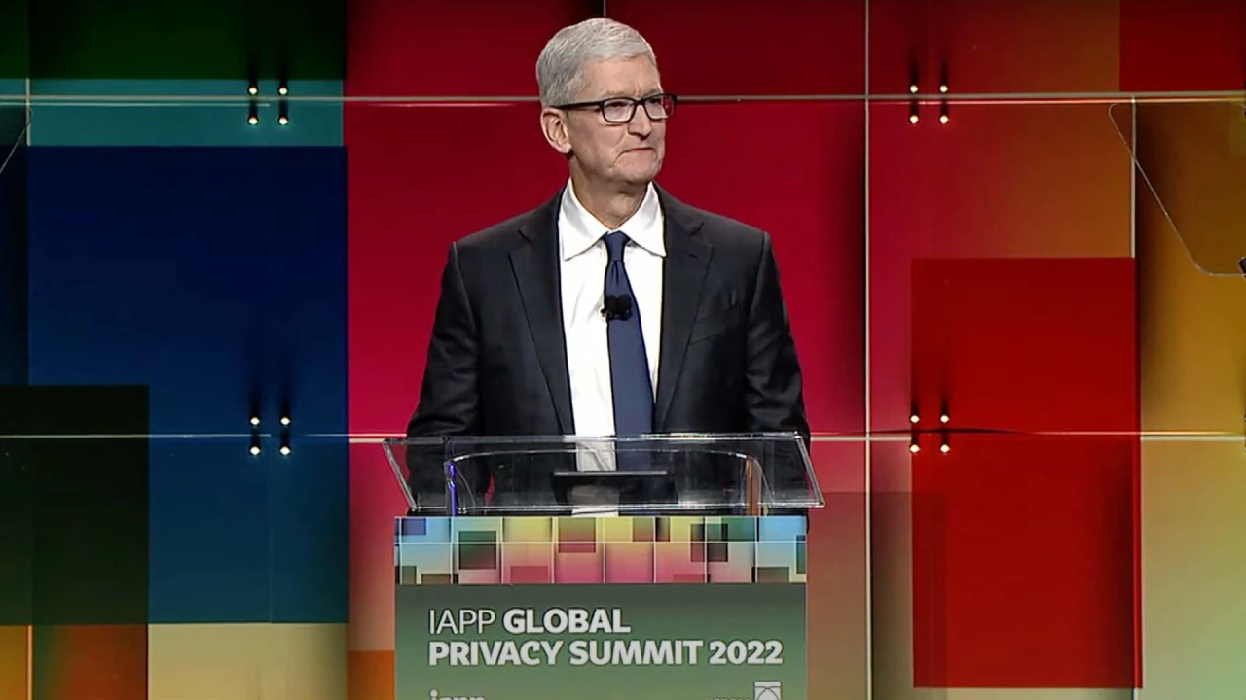
Different reactions
But we are deeply concerned about regulations that would undermine privacy and security in service of some other aim. Here in Washington and elsewhere, policymakers are taking steps, in the name of competition, that would force Apple to let apps onto iPhone that circumvent the App Store through a process called sideloading (…) But if we are forced to let unvetted apps onto iPhone, the unintended consequences will be profound.
“It doesn’t matter whether you like it or hate it,”
“And it’s right for people to point out the issues that cause concern, but more than anything, we need to lean in and figure out how to make this work, because it is not going to be a success unless we do that.”

Slide 8
Reduce online harms
Maintain liability exemption
In some jurisdictions, due process obligations
Notice and take down
Risks assessement and audit
More obligations when higher risks
More harmful content (e.g. child abuse, terrorism)
Weaker recipients: children

Slide 9
Participatory regulation
Internal tools of platforms
- Compliance report
- Compliance function
- Protected whistleblowers
National Authorities
Platforms
Business users
End-users
Complaint
Consultation on specification design
Federal Big Tech Regulator
Guidance: general /individual

Slide 10
Regulatory principles
Risk based
Proportionality
Participatory enforcement

Slide 11
3. Caribbeans authorities
Adopting a platform regulatory framework
Enhanced coordination between national regulators
Antitrust, consumer protection, telecom, privacy, media, financial …
Participation to international agencies networks
Learning and exchanging best practices
Sharing information

