Slide 1
CANTO Data Economy Panel
Said Zaghloul
VP Strategy, PhD
July 19, 2022

Slide 2
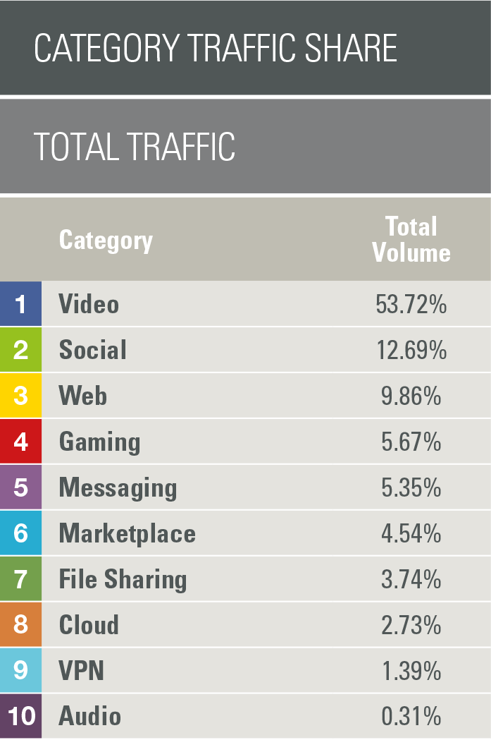
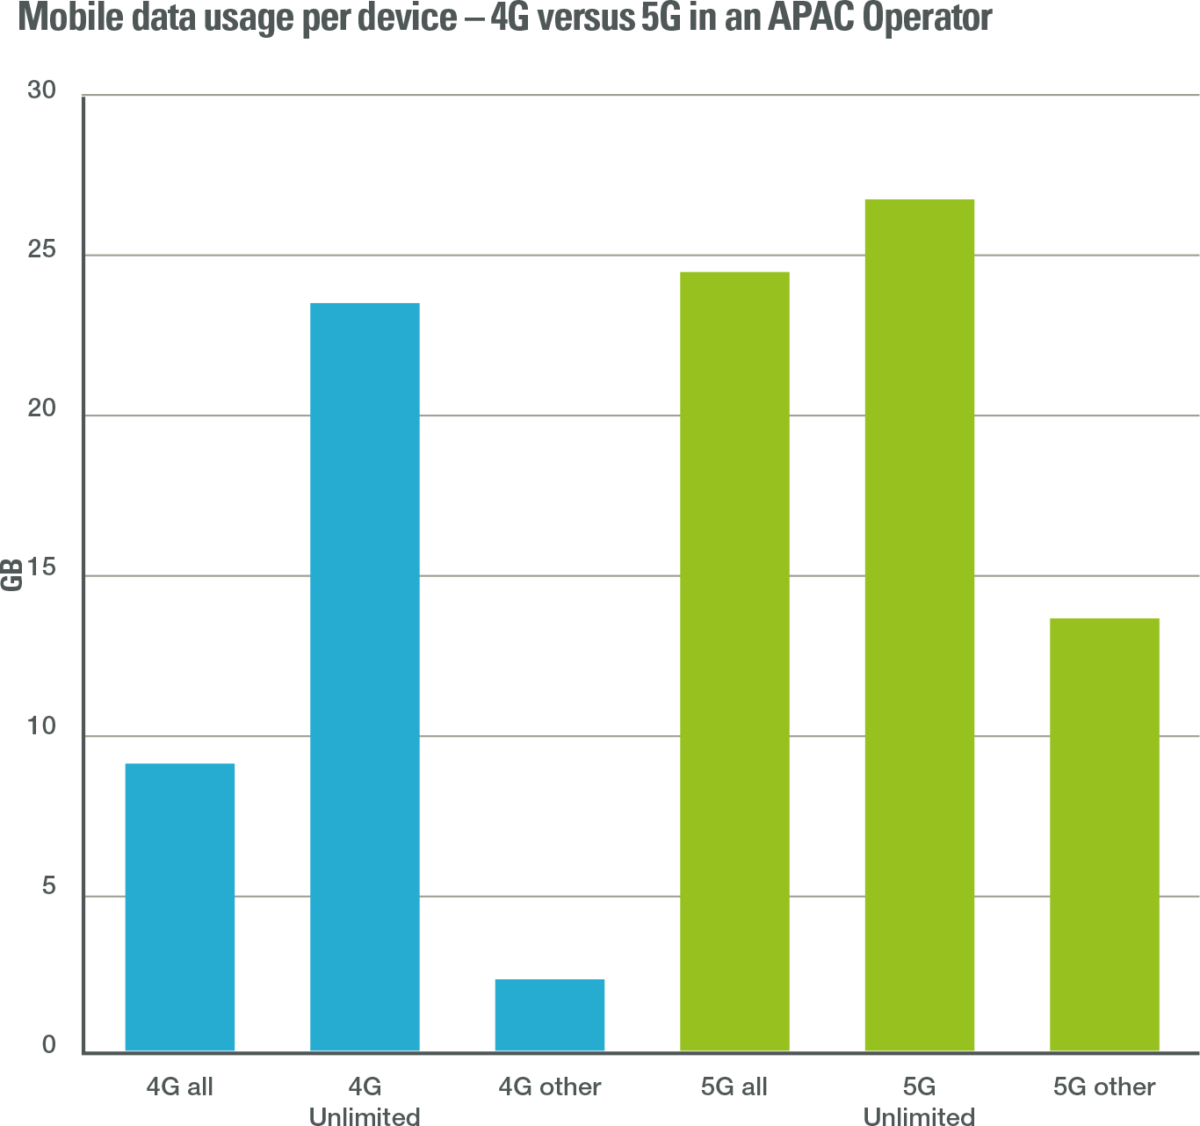
We Are All Becoming Heavy Users
1 Terabyte per Month power users in fixed networks are growing driven by gaming, videoconferencing, and video streaming”
We are all becoming heavy users with growing video content
Video & Social applications drive ~66% of our app data traffic
5G is expected to accelerate heavy terabyte usage in all plan types

Slide 3
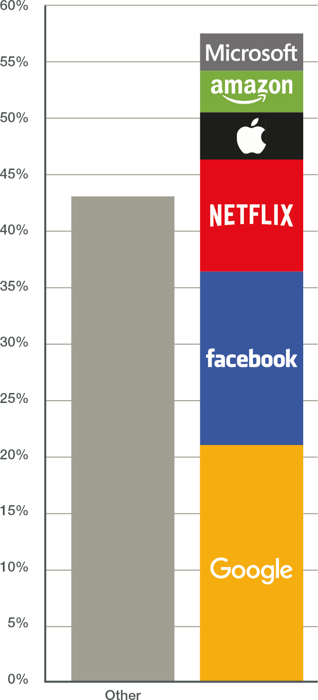
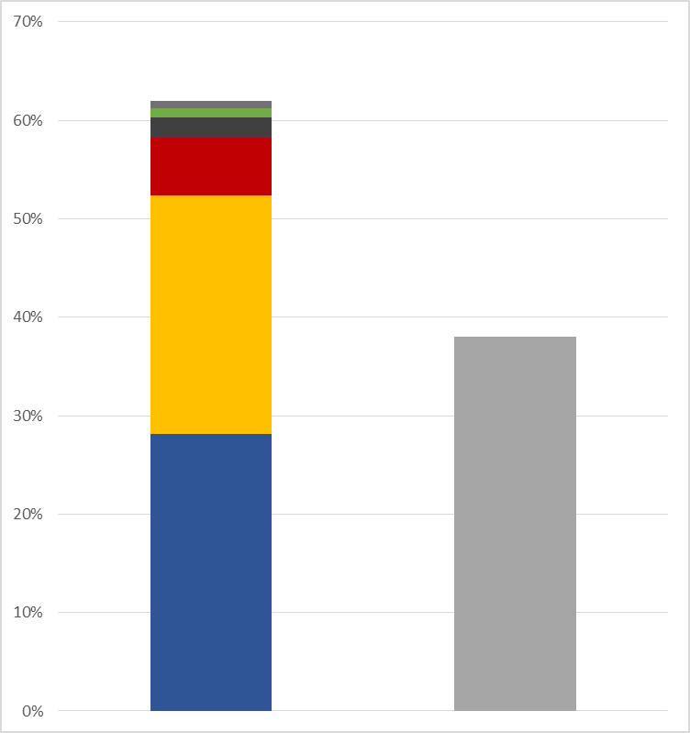
Top 6 Brands Drive the Lion Share of the Internet Traffic
Global
Data
Caribbean
Region
Brands | Global | Caribbean
Google | 20.99% | 24.25%
Facebook | 15.39% | 28.10%
Netflix | 9.39% | 5.94%
Apple | 4.18% | 2.03%
Amazon | 3.68% | 0.94%
Microsoft | 3.32% | 0.75%
TOTAL | 56.96% | 62.00%
Microsoft
Amazon
Microsoft
Apple
Amazon
Apple
Netflix
Netflix
Facebook
Facebook
Other
Google
Google
Google and Facebook’s ecosystems are taking over, driving CSPs to rethink digital-era business models.
Telco chiefs want OTT players to share the burden

Slide 4
Application Quality of Experience is the CSPs’ Brand
Consumers and enterprises care most about how their apps are performing
CSPs must plan and manage network capacity to deliver the expected App QoE

Slide 5
Supporting Material

Slide 6
Sandvine

Slide 7
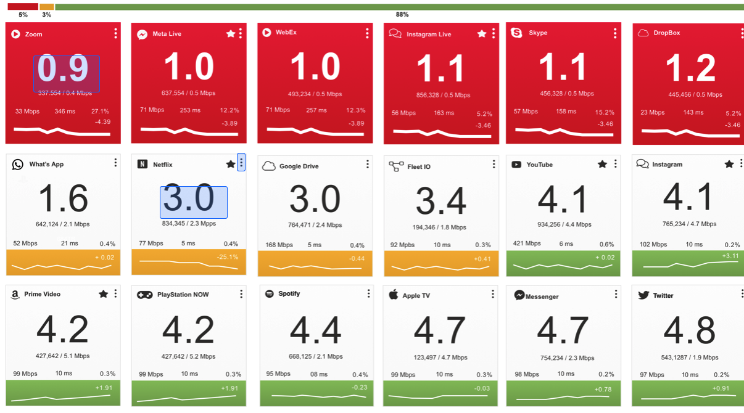
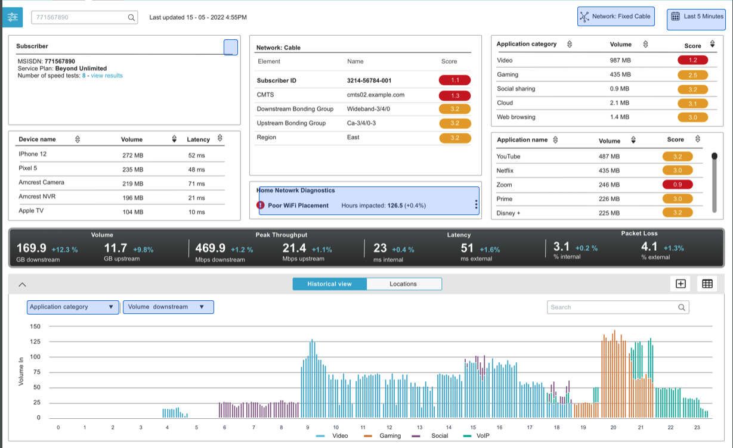
Sandvine’s Unique Value
Uniquely rich, real-time Application and Network Intelligence that provides clarity and visibility that they cannot get from other technologies
Classify over 95% of voice, video, and data traffic across fixed and mobile networks by user, application, device, location, and other parameters
An App QoE Company that delivers actionable insights to help service providers deliver high quality experiences to their consumer and enterprise customers
30+ pre-packaged software use case modules that enable our customers analyze, optimize and monetize the traffic on their networks to improve end subscriber quality of experience
Scalable, ‘cloudified’ platform to enable Application and Network Intelligence in the largest networks
A unique combination of network infrastructure, data management and application solutions that enable cost effective digital transformation
7

Slide 8
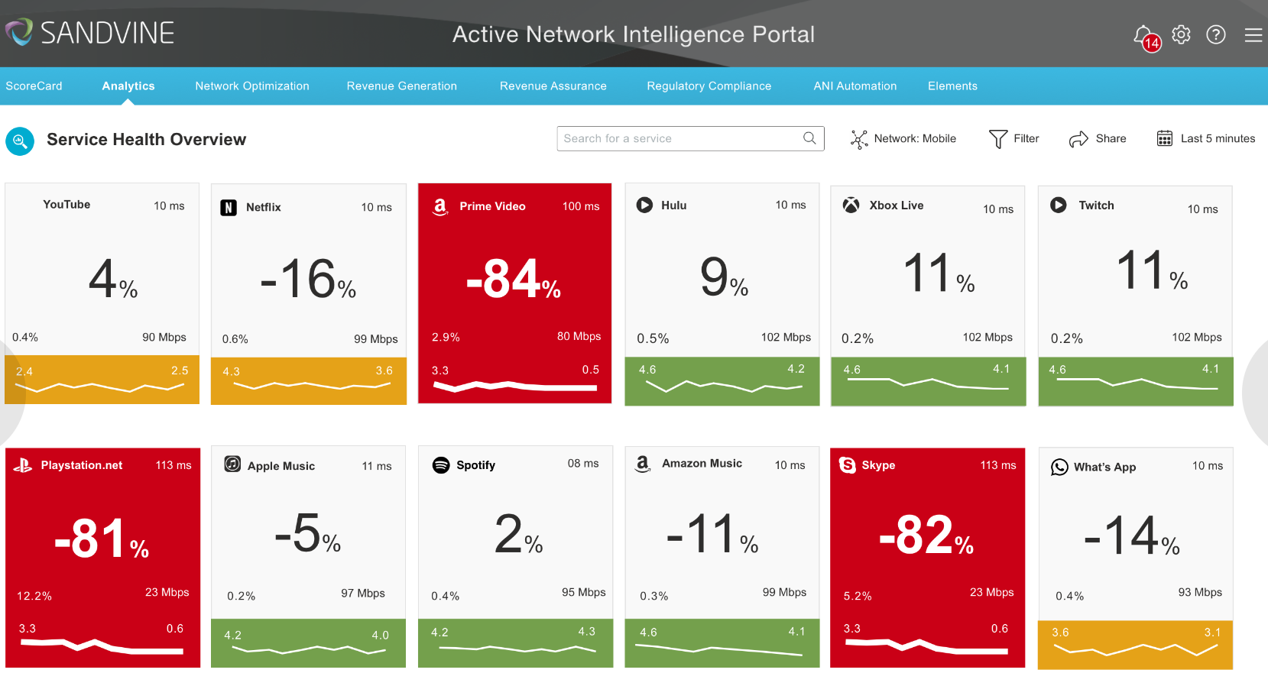
Sandvine at a Glance
Vision / Mission
Vision: To create technology that enables our customers to deliver highest quality application experience over any network
Mission: To be a market leader in App QoE that helps our customers deliver highest quality experiences to consumers and enterprises
Value to Customers
Uniquely rich, real-time App QoE that provides clarity and visibility that they cannot get from other technologies
Classify over 95% of voice, video, and data traffic across fixed and mobile networks by user, application, device, location, and other parameters
30+ pre-packaged software use case modules that enable our customers analyze, optimize and monetize the traffic on their networks to improve end subscriber quality of experience
Scalable, ‘cloudified’ platform to enable App QoE in the largest networks
A unique combination of network infrastructure, data management and application solutions that enable cost effective digital transformation
The best curated network data from any source yielding the highest visibility and accuracy into an operators’ network traffic
Pre-Packaged Software Modules that provide unique insights and guided workflow to ensure Application QOE
8

