Slide 1
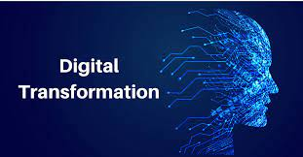
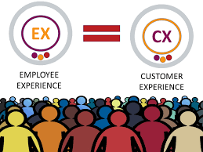
Introduction
Digital transformation → technology, data, innovation, services & products …
Backbone Digital Transformation→ People, Human Capital, Digital talent
Customer experience is Employee experience
Notes:
You would think that digital transformation is all about technology. In essence it is, but that is not the only focus and key success factor.
For the digital transformation to be successful, companies also need to focus on people, the human capital, digital talent…fot it is the backbone of digital transformation.
Your business must understand your customer journey, the customer experience. But we can’t get past the employee experience. Every interaction your employees have with your company is critical. This experience has the potential to build or rupture the customer experience. Without the right talent or without focusing on your employees, your organization will struggle. And your employees should all be on the same page, to push your digital transformation efforts forward.
Digital talent, employee motivation, skills, the proper mindset (attitudes and behavior) are critical for organizational transformations, including digital transformations, to succeed.

Slide 2
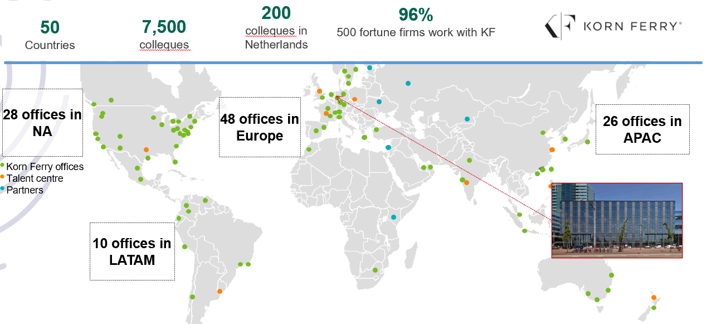
Korn Ferry Hay method and collaboration Korn Ferry
  International HR industry standards
  Knowledge and experience in the Telecom and IT sector
  Experience with other leading Surinamese companies
Notes:
Common methodology within the International Telecom and IT sector and renowned Surinamese companies is the Korn Ferry Hay method, of a globally known and broadly oriented organizational consultancy firm Korn Ferry.
Works in accordance with international HR industry standards (Korn Ferry Hay Method)
Knowledge and experience in the Telecom sector: Vodafone, KPN, Ziggo, Apple, Telefonica
Experience with other Surinamese companies: DSB, Staatsolie etc.

Slide 3
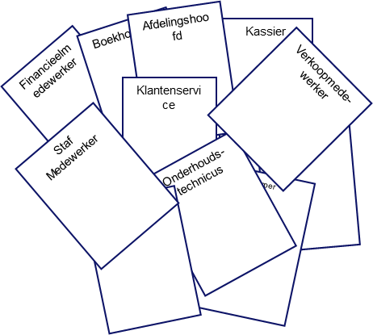
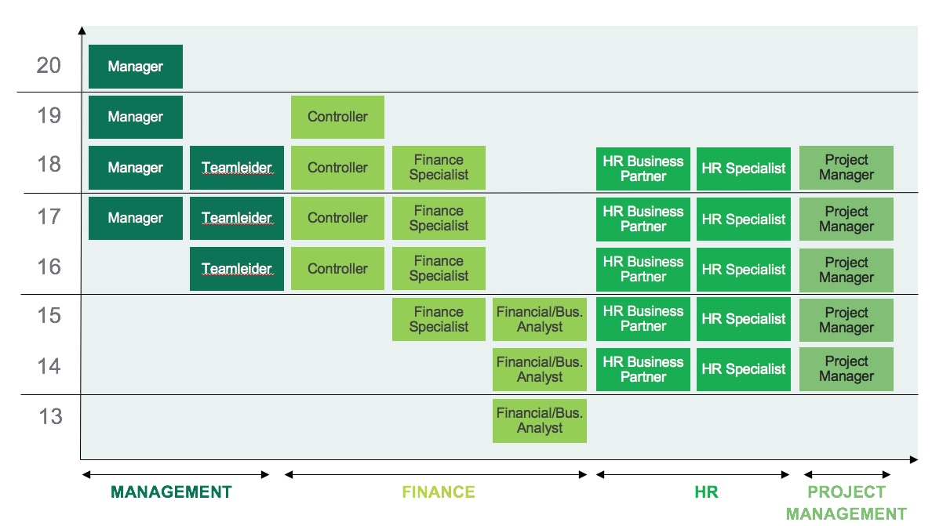
What it was VS What it is now
Outdated job descriptions & unique jobs and job titles
Generic Job families & Job evaluation system
Salary structure & Reward policy
€
...
10
11
...
2000
1
2060
2
2122
3
1
2186
4
2
2252
5
3
2320
4
1
2390
5
2
2462
3
2536
4
2612
5
…...

Slide 4
Enterprise Resource Management
Telesur commenced working with an ERP system (Exact Globe) around 2003
Exact Globe was solely used for:
  Financial administration and Reporting
  To prepare Purchase Orders
  Internal stock requisitions
Exact as a “Financial application”
Notes:
Ladies and Gentlemen, Telesur implemented working with an ERP application around 2003. Back then it was solely used as a financial application, just to administrate lagging data and to produce the monthly and annually internal reports.

Slide 5
Evaluation Enterprise Resource Management
Telesur Board of Directors instructed an evaluation of the Exact Globe usage in 2017
Utilization of the Exact application was approx. 10%
Mandatory to develop and increase further utilization, due to:
  IFRS requirements
  Several management letters from the external auditors
  Manual registration of project materials & goods
4. Dedicated Project Team Exact appointed 2019-Q1

Slide 6
Scope – Project Exact
  To maximize automation of the entire Purchase to Pay process (from purchase requisition to payment execution, including all required approvals)
  Implementation of suggestions of the Zero Measurement Report (30 pages)
  Take into consideration additional requirements based on a company wide approach
  Training, Key/Power users & IT Landscape

Slide 7
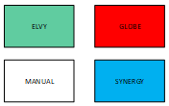
Telesur purchase to pay process: until 2019
Purchase Requisition Proces
Purchase Process
Purchase Approval Flow Process
Purchase Order Distribution Process
Warehouse Receipt Process
Warehouse Inbound Inspection Process
Invoice Processing Process
Authorization Requisition Process
Process Integration: Synergy - Globe
Detailed Budget Overview
Authorization
Approval Signature
Vendor Invoice
Validation Signature
Document Gathering
Validation
Purchase Requisition
Authori-zation
PO Pre Approval Signature
PO Release (e-mail) to Supplier
PO Scanning
PO Return to Purchasing
PO Printing
PO Preparation
Prepare Pay Order
Send to Accounting
Accounts Payable Processing
Pay Order Administrative Release
Validation
Treasury Payment Processing
Pay Order Execution to Bank
Invoice Registration

Slide 8
Deliverables – Project Exact per 2021-Q4
Automation: 9 processes of 10
Reduction of ‘manual handling’ 80% within Purchase to Pay procesflow
Increase utilization Exact application from 10% to 60%
Application and System securities according to industry standards
Maximization of transparency:
Telesur is now live “auditable”

Slide 9
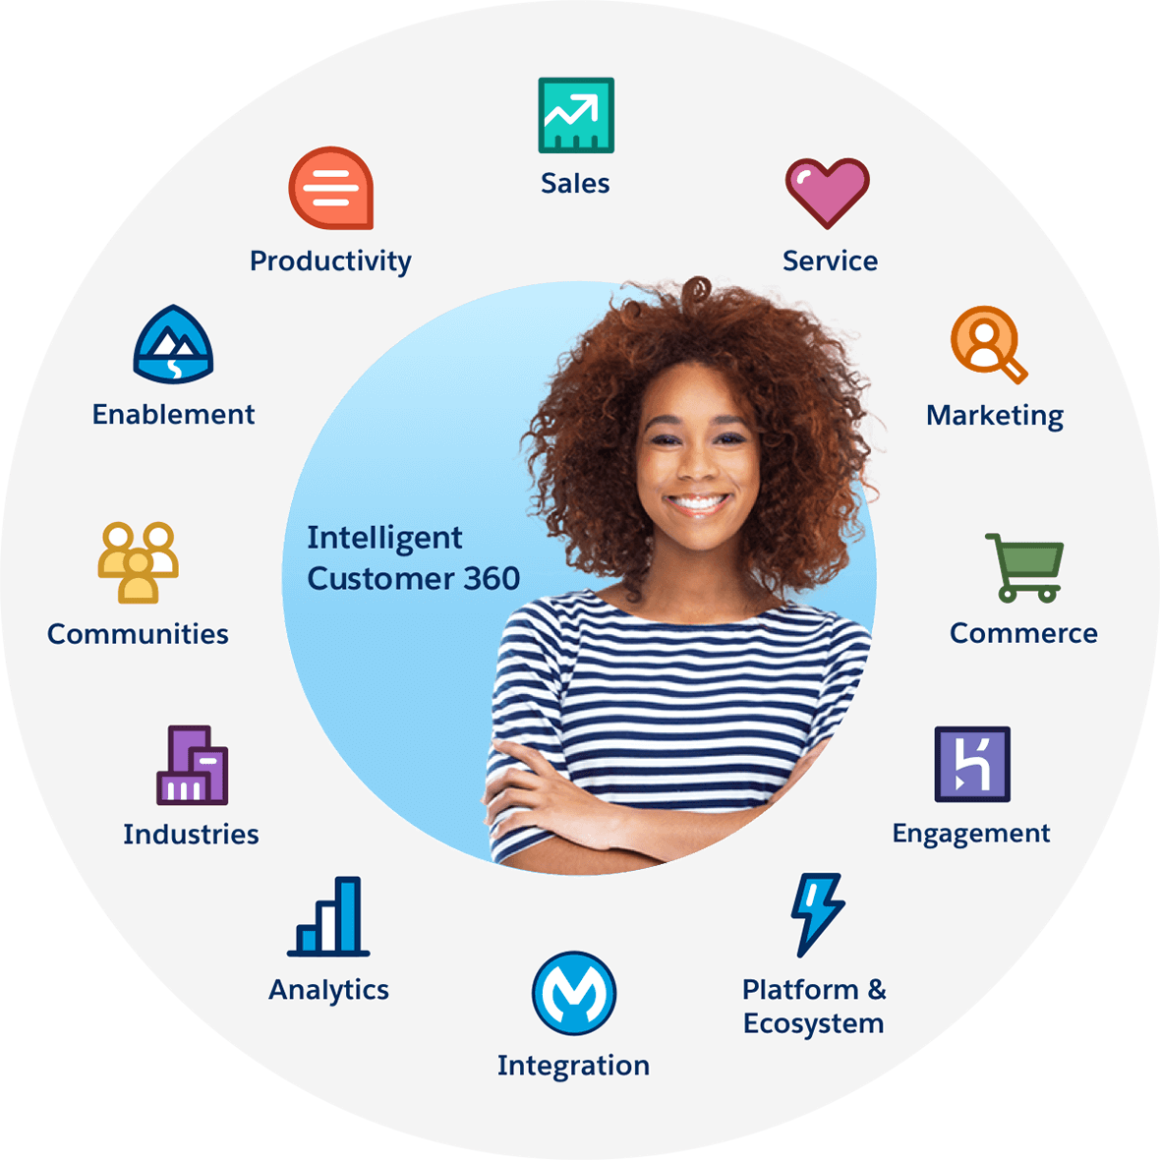

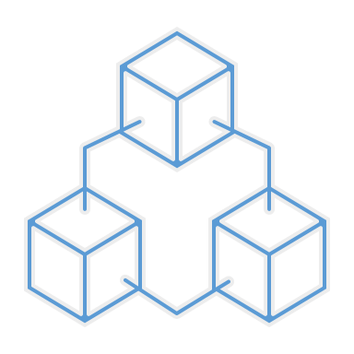
Order 2 pay flow
Current situation
> Outdated ICT equipment and applications
applicaties ( from the 80’s and 90’s). EoL/EoS.
> Front desk: helping the customer with a minimal of 22 applications
> Outdated bill generation process:
- Billing in 4 parts
- Long time to process (3-10 days)
> The prepaid en postpaid services will be managed in separate applications
> Numerous process based manual operations
What will be
Modern intergated ICT system:
> Flexible and efficient set up:
- Easy to link and offer services
- Adjust/ develop products/add-ons/promotions fast
- Automized operations
- Helping te customer through 1 application
> Updated bill generation process
- 1 bill and quicker time to process (8-10h)
> Future proof
> Self Service Portal possibilities

Slide 10






Establishing digital engagement through singular payment channels
In-app notifications
Drive Engagement
Provoking action from a customer
Get Feedback, change behaviour
Be Responsive
Responding to customer initiated contact
Get Feedback, change behaviour
Be Proactive
Buying a new service, upgrading
Proactive fault notification, install & engineering work
Often
Unsolicited contact to the customer not about sales
Report on spending behaviour
Quickly manage refunds, disputes and credits
Commercial offers, promotions,
& campaigns
Queries, complaints, requests, bill payments
Operator
Fault notifications, spending threshold advice, credit notes, refunds and dispute handling

Slide 11
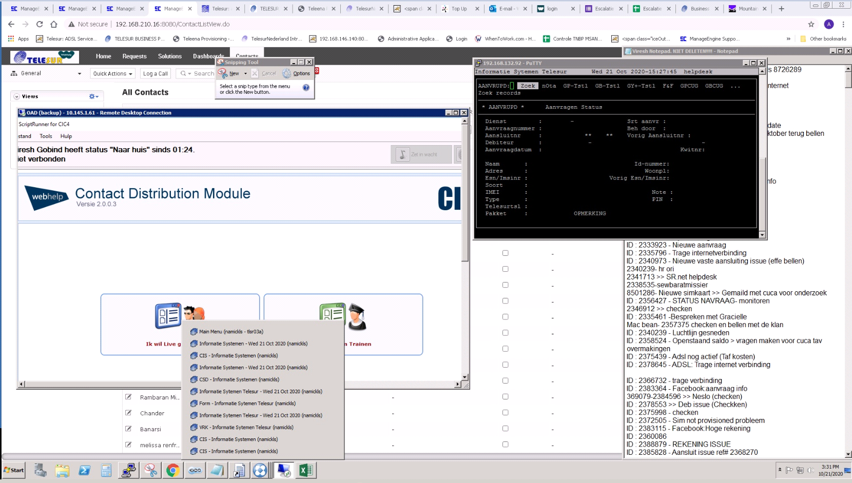
Current status
Customer Service
Customer service
Minimal of 22 (different) applications with which to serve the customer now
Consequences
Longer waiting period
High chance of human error
No standardization in customer service
No flexibility in i.e. adaptions, additional sales

Slide 12
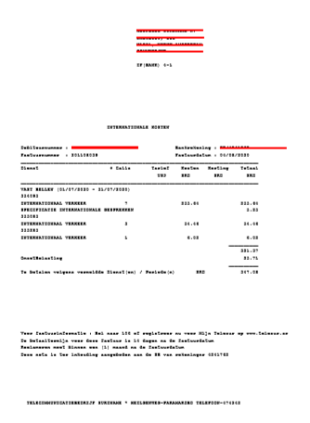
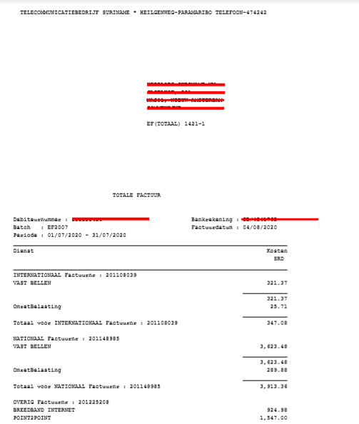
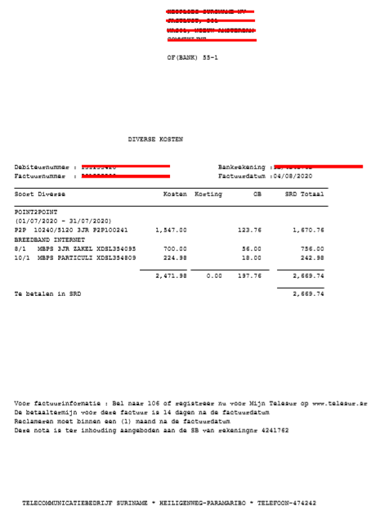
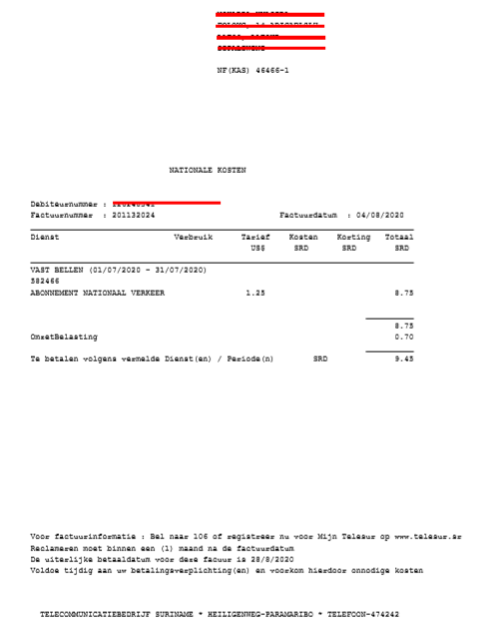
Current
Customer Service
3 bills NF, IF and OF and EF
Consequences
Unclear and confusing for the customer
No modern view of rendered services i.e. Logo
Long time to process (3-10 days)
No flexibility
When changes occur there is a high chance of errors
IF
(Internationale factuur)
EF
( E.. factuur)
OF
(overige factuur)
NF
(Nationaal factuur)

Slide 13

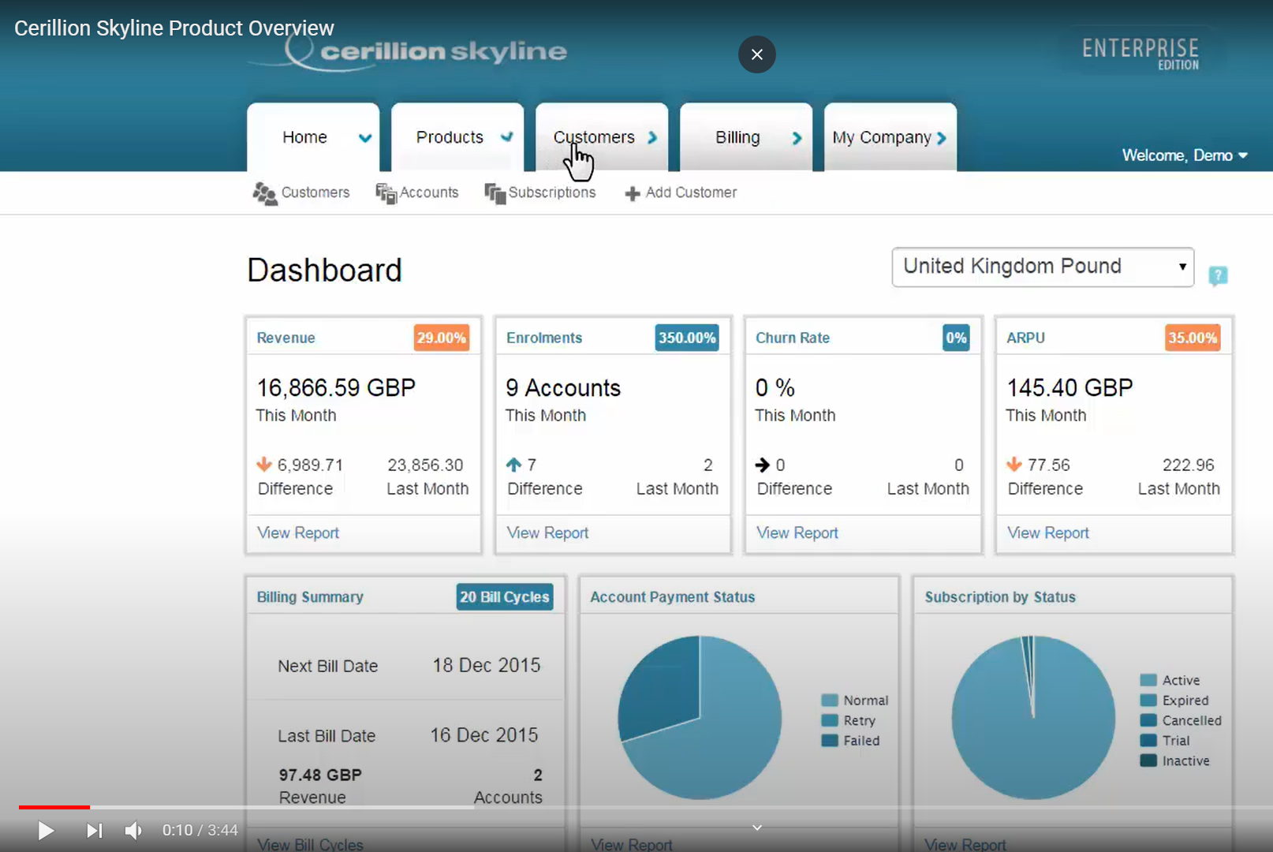
What will be
1 application for optimal customer service
360 degree customer view
> Optimal customer knowledge
> Quickly respond to customer needs
> i.e. Analysis of customer behaviour for discovering, product lifecycle management etc.

Slide 14
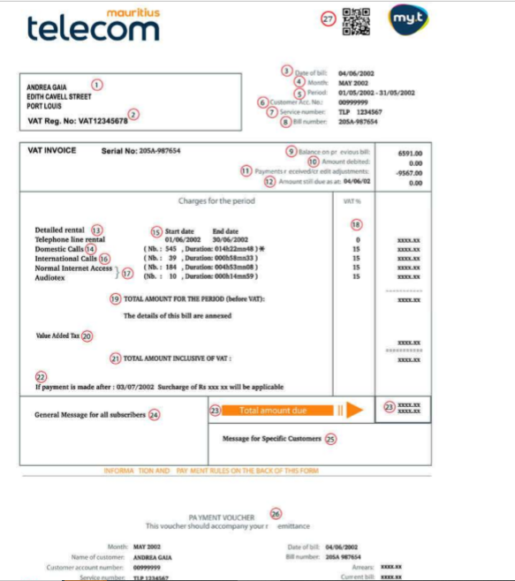
Gewenste situatie
What will be
1 modern and convenient bill
Recognizable – LOGO display
Easy to apply changes
Possibility to add QR code - #27
Scan & pay
Self service possibility for the customer
#Securing the digital future

Slide 15
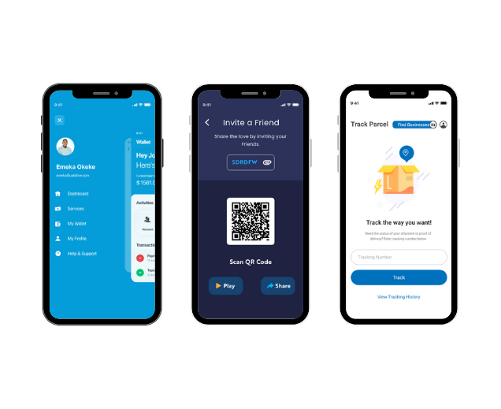
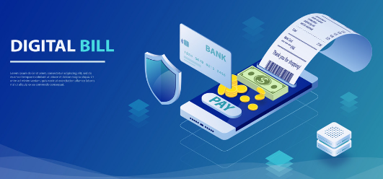
Digital bill
What will be
Mobile app

Slide 16
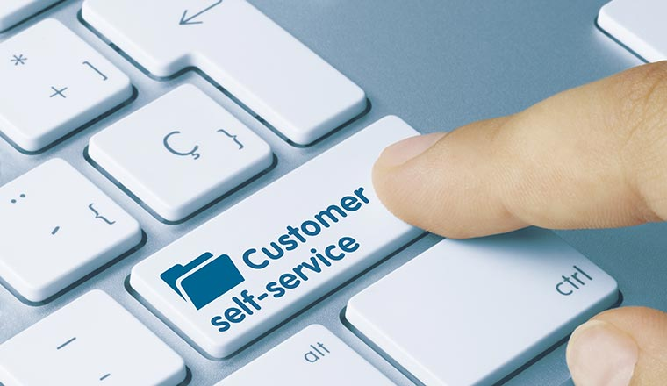
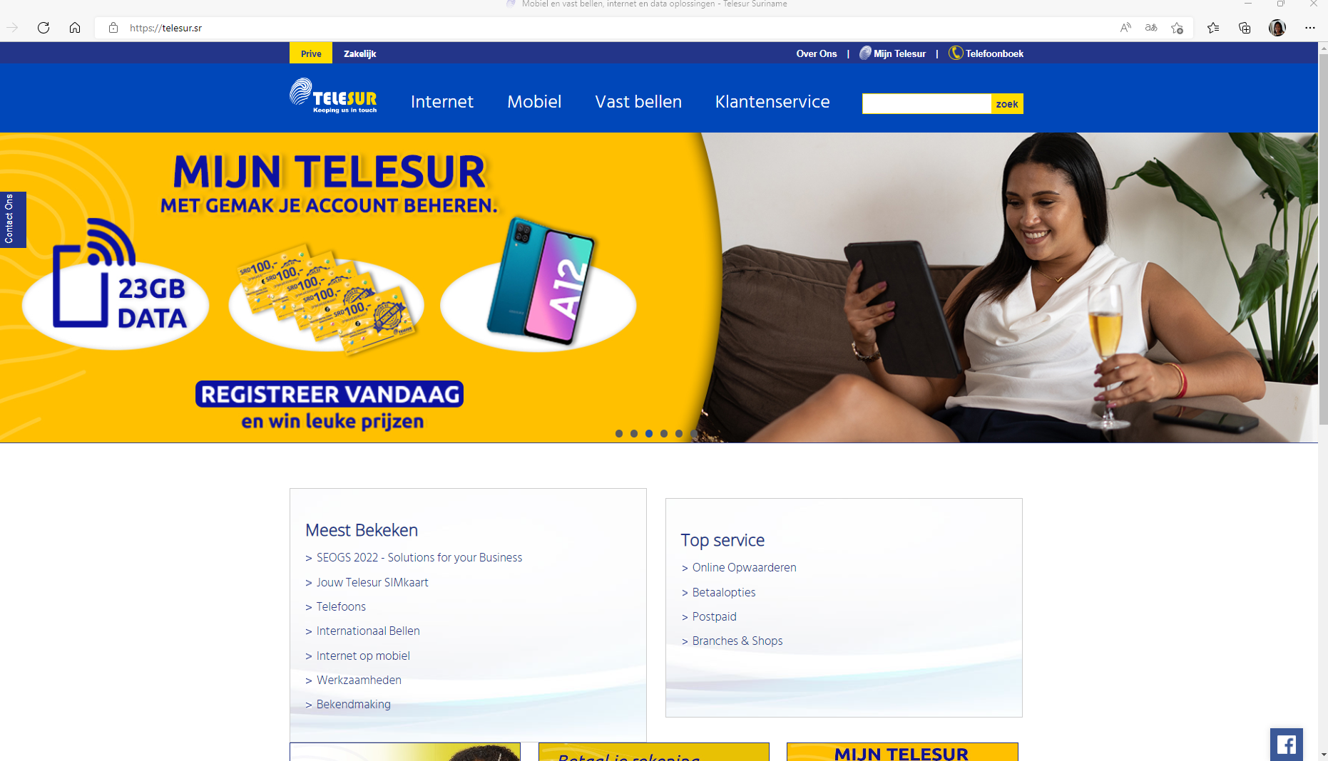
Customer Self service
Payments and direct data capacity upgrade
What will be
Payments &
Direct data capacity upgrade

