Slide 1

Not Quite Over: Reflections on the Covid Pandemic and Beyond
Erik Whitlock
37th Annual Conference and Trade Exhibition
18 July 2022

Slide 2
Agenda
1. Caribbean Context
2. Impact on Telecommunications Industry
3. Coming Challenges and Key Findings

Slide 3
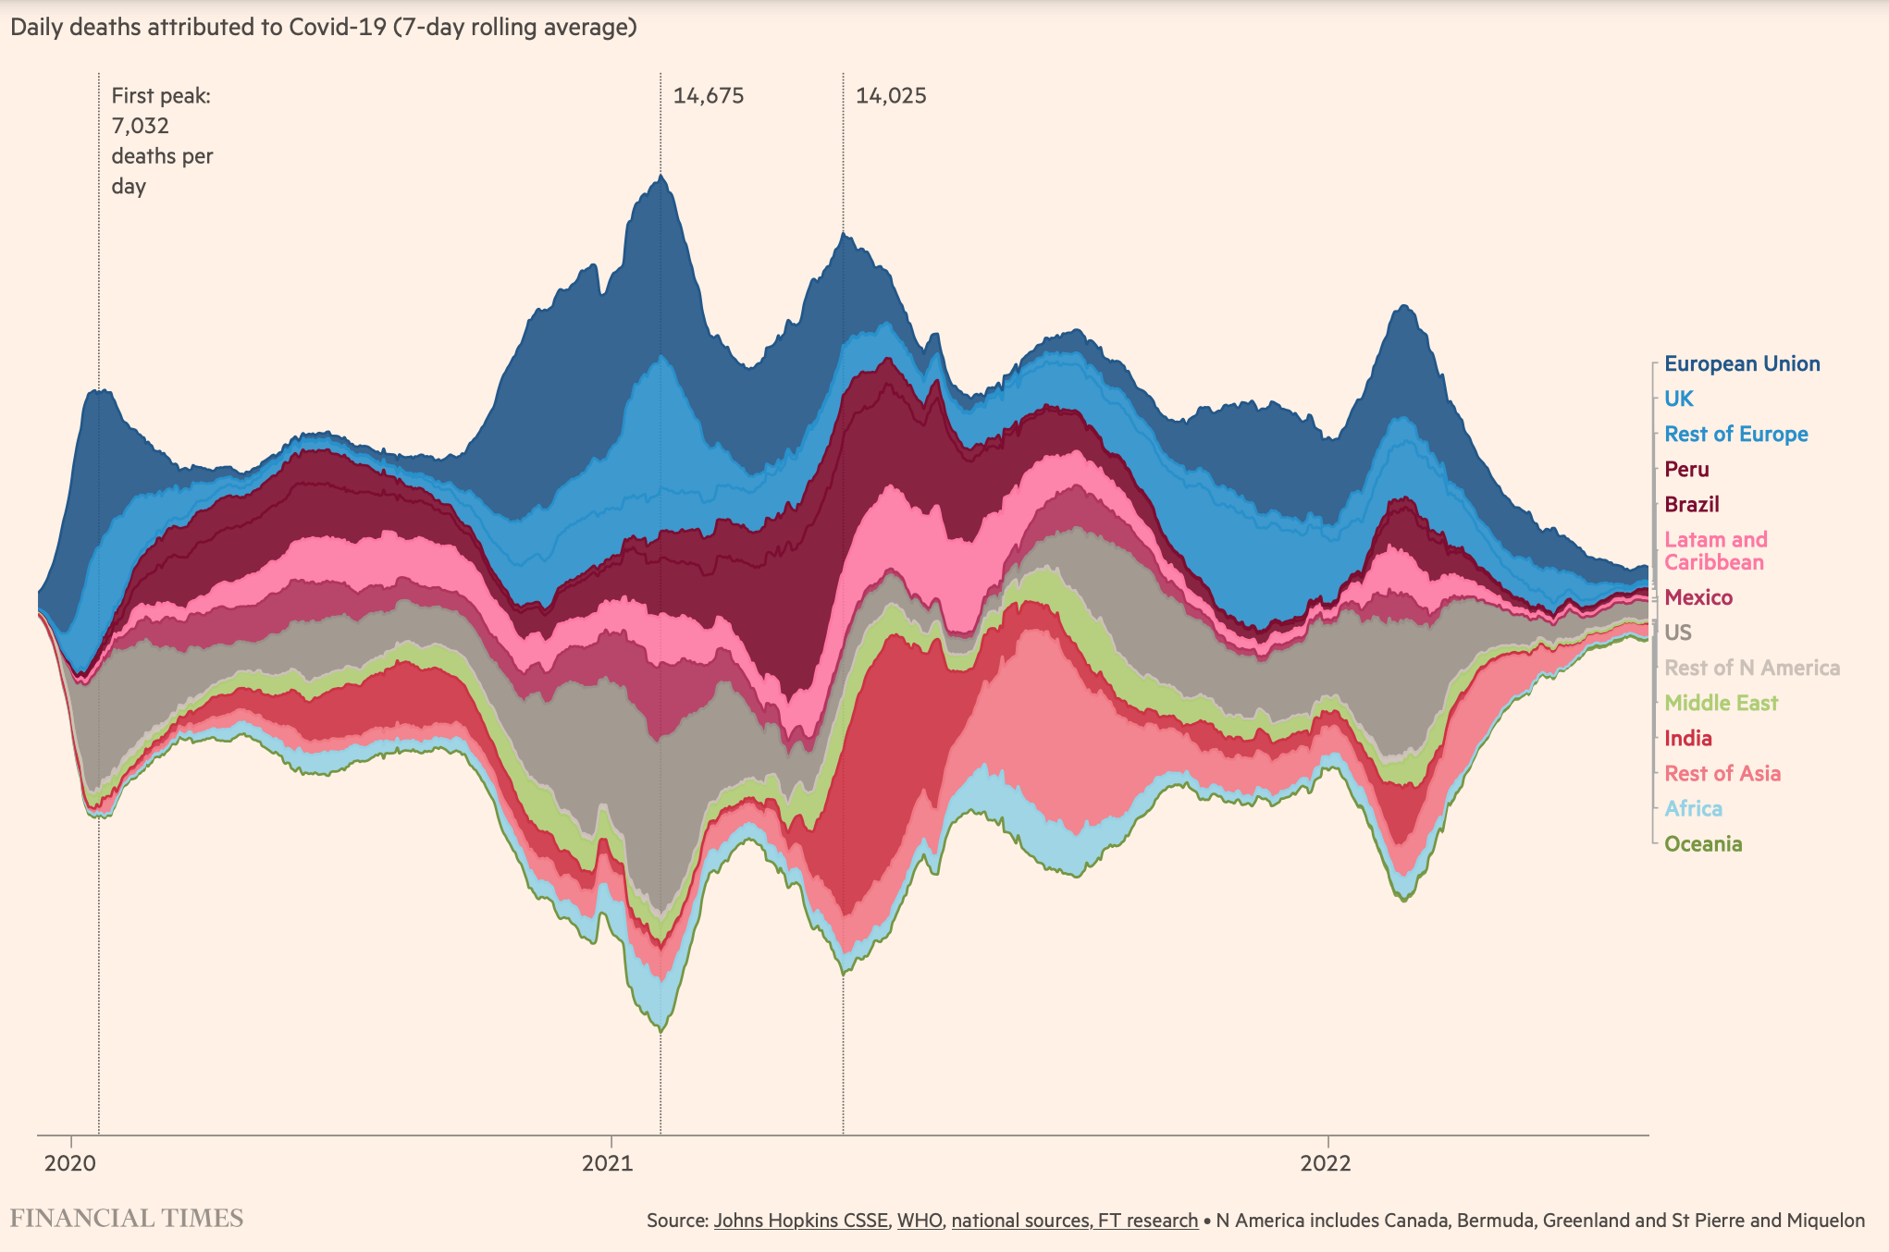
Regional Context
The timeframe
10,987
1,338: 13 June 2022

Slide 4
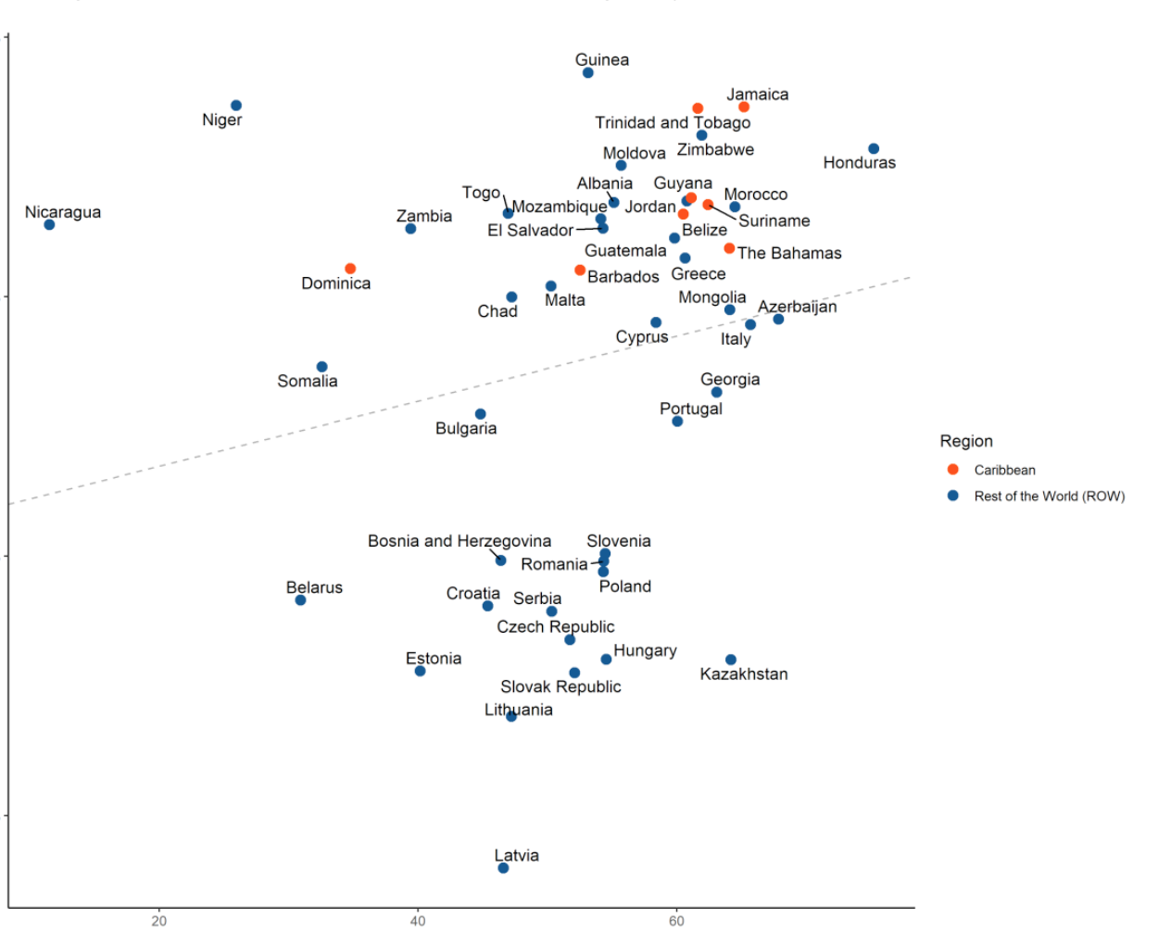
Regional Context
Covid Pandemic Impact the Caribbean
Stringency of Lockdowns and Impact on firms
100%
Reported Cases per Thousand pop
80%
% of firms reporting a decline in sales
60%
Source: Worldometer at 15 July 2022
40%
Oxford lockdown stringency index
Source: IDB Invest, Caribbean after the pandemic, 2021

Slide 5
Regional Context
Disproportionately Impacts
GDP decline in Caribbean vs other regions, %, 2019, 2020
US tourists to Caribbean 2019-Apr 2022
North America
Europe & Central Asia
Mid East & North Africa
Sub-Saharan Africa
South Asia
East Asia & Pacific
2.6% to -3.5%:
1.82% to -5.5%
1.5% to -3.9%
2.6% to -2%
3.9% to -5.2%
4% to -0.18%
Source: Tourism analytics; CCG
Source: World Bank; CCG

Slide 6
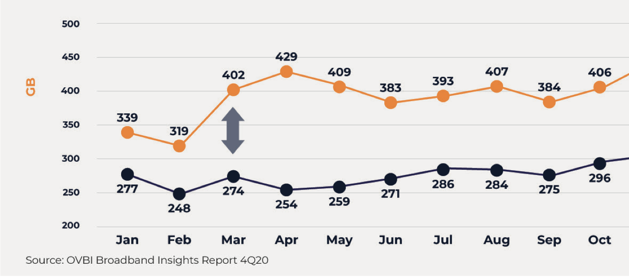

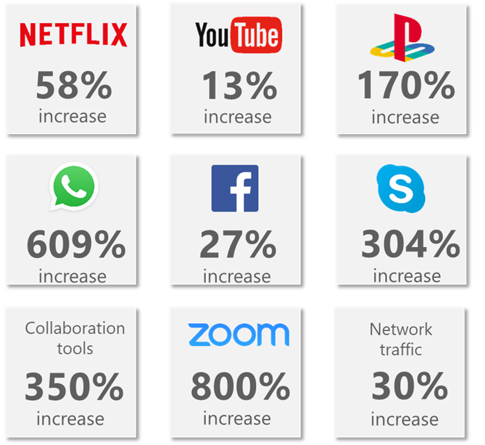
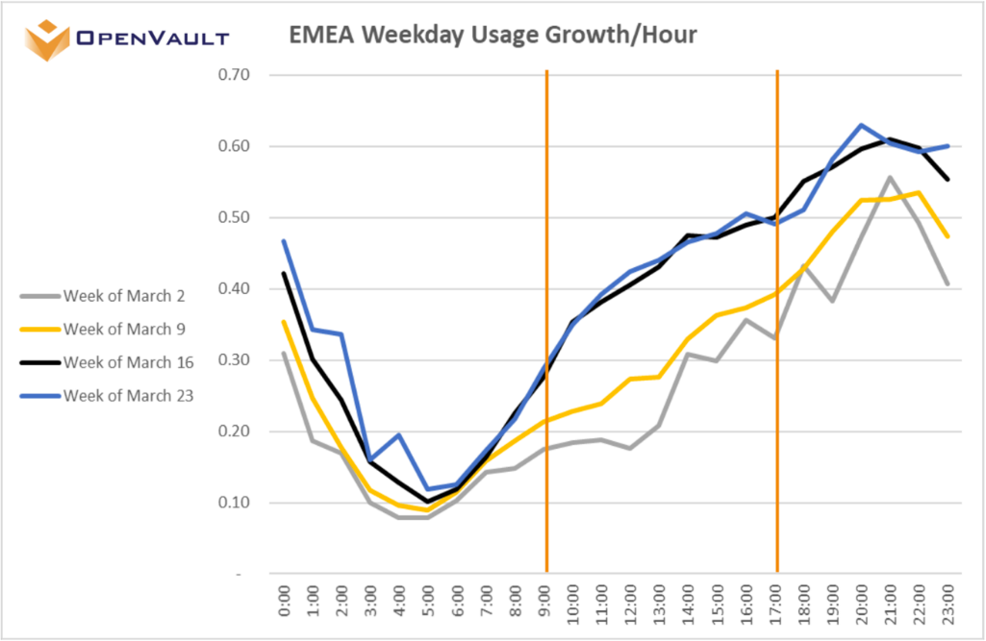
Covid’s Stimulative Effect on Telecommunications
Unprecedented increase in traffic growth, particularly off-peak
Source: Salience Consulting
Source:
OpenVault

Slide 7
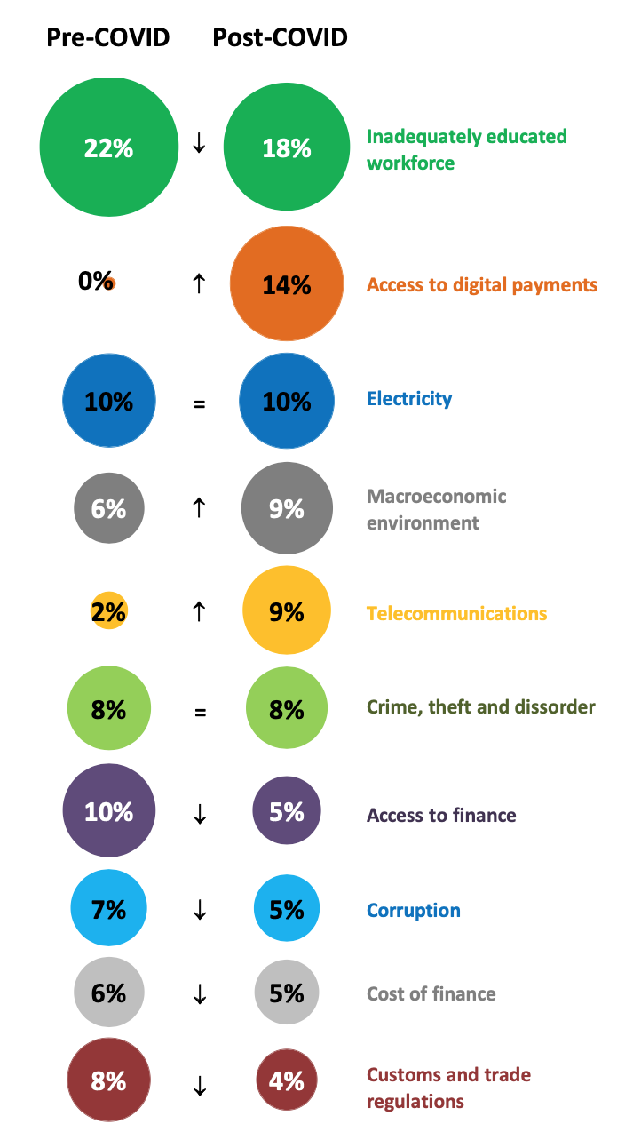
Covid’s Stimulative Effect on Telecommunications
Private Sector Demand and Public Interest Initiatives for Broadband Service Expansion and Resilience
Obstacles to doing business, pre and post COVID
Joint Industry and Public Sector Activity
Policy and regulatory actions to temporarily relieve network capacity constraints and keep networks running and operational (including by decreasing taxes and fees, temporarily freeing up additional spectrum that can be immediately deployed, sharing infrastructure, using existing resources from the Universal Service Fund, etc.).
Streamline customs procedures and classify network equipment as essential infrastructure to ensure supply chain continuity.
Provide guidance to consumers in areas that including child online safety, data protection, and cybersecurity.
Support learning institutions to conduct distance classes, take actions to foster media and information literacy.
Short-run agenda
Acceleration and implementation of digital cooperation, strategies and policies regarding emergency health responses
Adoption of strategies aimed at promoting universal, affordable broadband connectivity by mobilizing public and private investment
Emphasizing and promoting on-going connectivity for education, access to information and online user empowerment through media and information literacy
Identifying major partners for public financing of connectivity of vital services including schools and undertake actions to attract institutional finance investors looking for a compelling market opportunity.
Medium-run agenda
Source: IDB Invest, 2021
Source: Broadband Commission

Slide 8





Net Effects on Industry Revenue
The top line impact was not favorable…
Regional Telecommunications Service Revenues
US billions
Selected Caribbean Telecommunications Market Revenues
US millions
Region | 2019 | 2020 | Growth
Americas | $624 | $574 | -0.7%
AsiaPac | $480 | $494 | -0.6%
EMEA | $477 | $474 | -2.0%
Total | $1,582 | $1,542 | -1.1%
Country | 2019 | 2020 | Growth
Bermuda | $199.1 | $183.4 | -7.9%
Cayman Islands | $174.64 | $173.20 | -0.8%
Costa Rica | $1295.28 | $1245.99 | -3.8%
ECTEL Member States | $237.78 | $231.85 | -2.5%
Jamaica | $726.62 | $693.76 | -4.5%
Trinidad & Tobago | $603.85 | $570.81 | -5.5%
Source: IDC
Source: Regulatory Authorities

Slide 9
Other Short-term Covid Profitability Impacts
Most of these effects have come and gone with the initial traffic surges and lockdowns
Effect | Description | Impact
Network usage increase | Customers are spending more time at home for work and leisure, and using much higher amounts of data | May require additional capex and opex to expand capacity
Network quality measures | Where capacity increases have not been possible in the short-run to accommodate demand, operator may be forced unilaterally or by government to undertake other measures to maintain certain level of quality, such as programs to lower the bit rate of video transmissions, reassign existing capacity, etc. | May require additional resource to implement these measures
Increased resources to customer care | Implementing staff expansions, remote and virtual agent strategies to deliver increased customer care amid escalating traffic to contact centers. | Increased opex
Internal initiatives to keep workforce running | Like other businesses, operators may face additional expense of making it possible for employees to work at home, pay without work, etc. | Increase in opex
Ad-hoc Promotions | Providing increased usage allowance, free time, waiving overdue payment fines, etc. to enable customers to use service more in time of need | Foregone revenue and/or increased cost with no return
Closing of Points of Sale (PoS) | Closing of PoS may mean a drop in device sales, top-up, and other revenue generating activity | Drop in profit
Data tracking initiatives | As governments expand their capacity to fight the spread of the virus, they may require operators to assist in tracking certain sets consumers | Increase in capex and opex, possibly without compensation
Short-term COVID 19 related investment | Operators may voluntarily or by mandate provide additional facilities for healthcare sector (base stations at hospitals) to assist in battle against virus | Increase in capex without return
Other COVID 19-specific damage | There may be a variety of other impacts experienced in markets that have arisen specifically due to COVID 19. The attack on cell sites due to spurious connection with 5G is an example | Remedial capex and opex and foregone revenue

Slide 10
Longer-term Covid Profitability Impacts
We have yet to see these to abate fully
Effect | Description | Impact
Supply chain disruptions | Operators may face increased costs or shortages in the face of equipment and labor supply volatility | Increased capex, opex or foregone revenue
Device sales cycle may be delayed | If new device introduction represents uplift in sales, then the delay will have negative financial impact | Lower NPV of sales
General business turn-down | There will be short-, medium- and potentially long-run revenue implications of the virus | Profit may fall due to lower economic activity
Disproportionately harmed sector turn-down | COVID 19 will impact certain sectors more than others and therefore certain revenue streams disproportionately, e.g., roaming | Profit loss in roaming, etc.
Cash-flow financing | There may be specific costs associated with measures undertaken cope with cash-flow issues | Increased finance costs to overcome cash-flow issues
Loss of advertising revenue | Some operators that have certain types of media offerings may be deprived of advertising revenue | Reduction in revenue
Delay of return on planned investments | For a variety of reasons investment plans may be delayed resulting in the lowering of NPV of return | NPV deltas of delayed investment
Increased policy initiatives | Any given policy initiative, which are relevant to operators, may require additional public policy resource | Increase in opex without compensation

Slide 11
Light and Dark on the horizon
While the industry is generally recovering, there are a couple things to keep in mind…
Telecommunications Service Revenues (US billions)
Region | 2019 | 2020 | Growth | 2021 | Growth
Americas | $624 | $574 | -8.0% | $582 | 1.39%
AsiaPac | $480 | $494 | 2.9% | $505 | 2.23%
EMEA | $477 | $474 | -0.6% | $479 | 1.05%
Total | $1,581 | $1,542 | -2.5% | $1,566 | 1.56%
Cayman Islands | $0.17 | $0.17 | -0.8% | $0.18 | 4.2%
Costa Rica | $1.30 | $1.25 | -3.8% | $1.17 | -5.9%
Jamaica | $0.73 | $0.69 | -4.5% | $0.71 | 2.7%
Output volatility has a negative impact on longer-term growth– an impact that is stronger for less-developed nations.
Concomitant effects such as increased unemployment and increased public sector debt also increased over this period and tend to be more persistent.
Small states are more vulnerable to external shocks, of which Covid is just one example.
Source: IDC; Regulatory Authorities

Slide 12
Light and Dark on the horizon
But inflation is on the increase…
USA and Caribbean inflation 2019 – 2021, 2022 forecasts
The Ps and Qs of Inflation Impact:
P
Capex
Opex
CoS
Cost of Capital increases (cost of debt, equity and country risk)
Revenue pressures (economic, competitive and regulatory constraints)
Q
Replacement requirements, technological demands
P
Particularly energy and labor
Q
Largely fixed
P
Mixed bag…. More likely expressed a less of a decline
Q
Volume dependent
Source: IMF; CCG

Slide 13
Light and Dark on the horizon
Impact of increasing oil prices
Caribbean nations are disproportionately impacted by increases in oil prices.
10% increase in real oil prices leads to (in non-oil producing) Caribbean nations:
  0.3% increase in inflation (Parlak et al. 2021)
West Texas Intermediate Crude Price 1991-June 2022
Russia invades Ukraine
0.5% decrease in real GDP over five years (McIntyre et al. (2016)
Covid first surge
Source: U.S. Energy Information Administration, Crude Oil Prices: West Texas Intermediate (WTI) - Cushing, Oklahoma

Slide 14
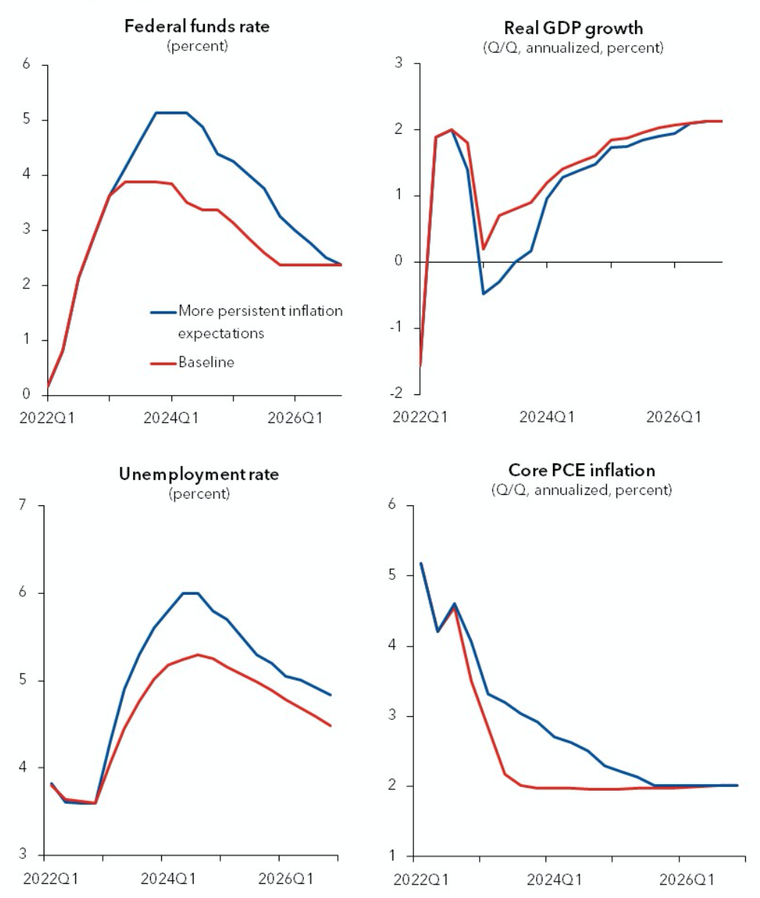
Light and Dark on the horizon
Because inflation has significant demand and supply drivers, relief is some way off and not without pain
IMF’s latest forecasts for the US
Source: IMF

Slide 15















Light and Dark on the horizon
Emerging Technologies will offer opportunities but significant challenges to operators
Connectivity
Technologies
Platform
Technologies
Service
Technologies
Disruption: OTT experience shows that telcos do not necessarily benefit from all innovation
Cost of Innovation: Where the opportunity for the operator is in play, capex will be significant
Beyond Finances: Cybersecurity, privacy and other consumer protection issues will increasingly come to the fore.
5G/6G
LEO Satellites
Quantum communication (photons)
Artificial Intelligence
Blockchain
Big Data
VR/AR/Metaverse
Quantum computing
Edge Cloud
OTT
FinTech
IoT
Source: Salience Consulting; CCG

Slide 16

Key takeaways
Coming up for air…
While many of the immediate Covid impacts on the industry are lessening…
The Caribbean is still in recovery mode;
The pandemic has contributed to the rising inflation and looming forex issues;
The threat of global recession is increasing;
All this sits against a backdrop of inexorable, long-run technological challenge.

