Slide 1
Mobile Money and Sustainable Development
Ian Durant
Director, Economics Department
Caribbean Development Bank

Slide 2
Presentation Outline
What is Mobile Money?
The Growth of Mobile Money
Key Impacts/Benefits
Mobile Money in the Caribbean
Challenges

Slide 3
Mobile money refers to financial transactions and services that can be carried out using a mobile device such as a mobile phone or tablet. These services may or may not be linked directly to a bank account, (ITU).
Mobile money enables mobile phone owners to deposit, transfer, and withdraw funds without owning a bank account. It is therefore distinct from mobile banking, which allows access to one’s existing bank account via a mobile phone, (Suri: 2017, Annual Review of Economics).
What is
Mobile Money?

Slide 4
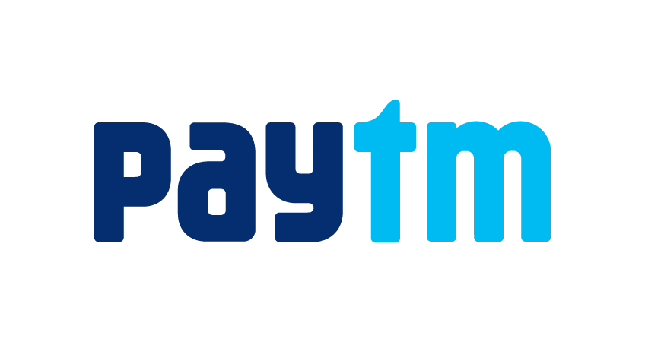
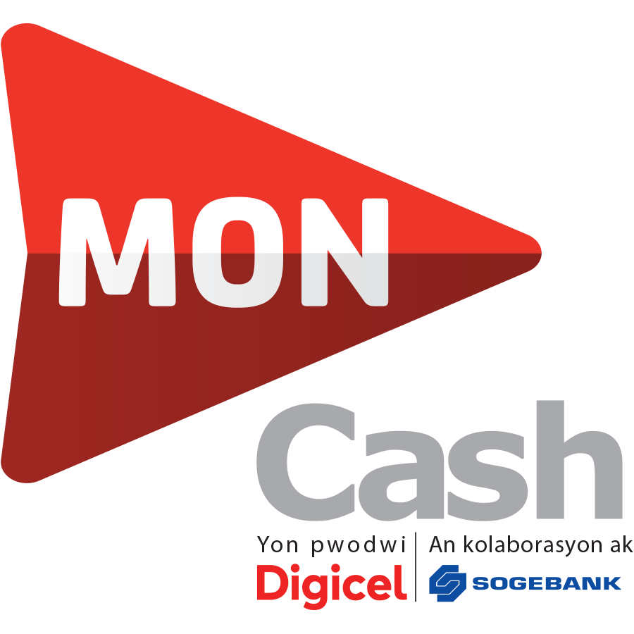
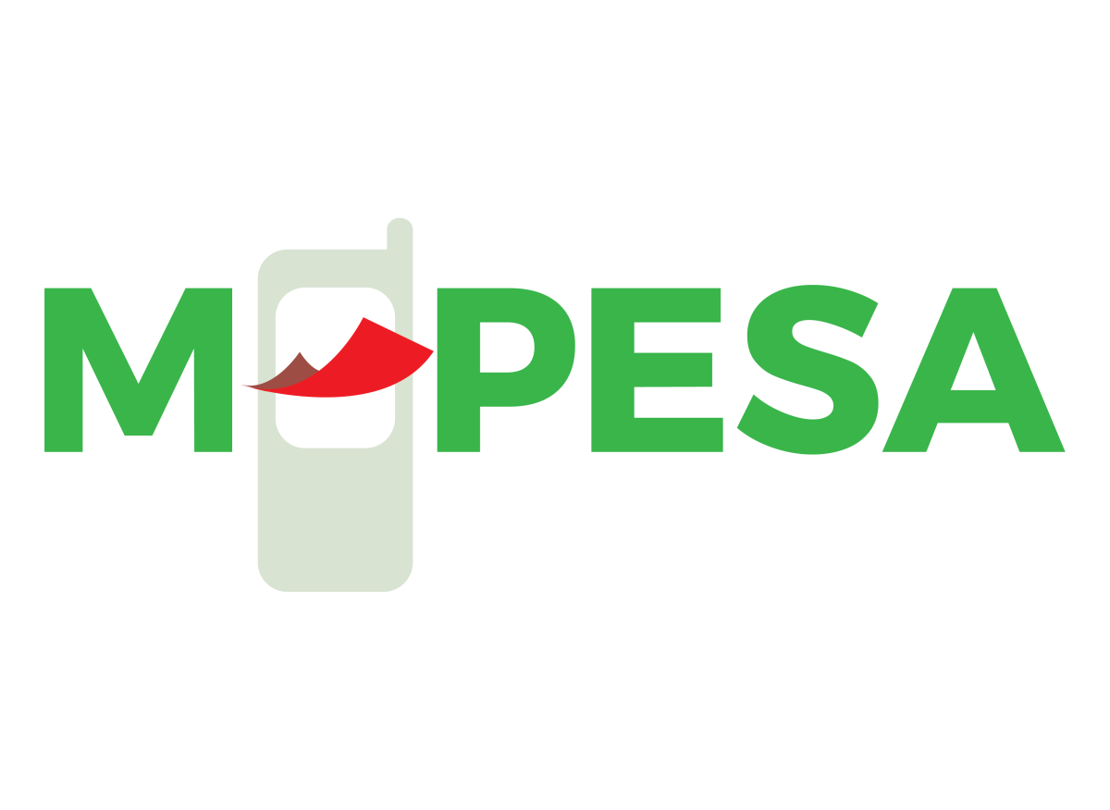
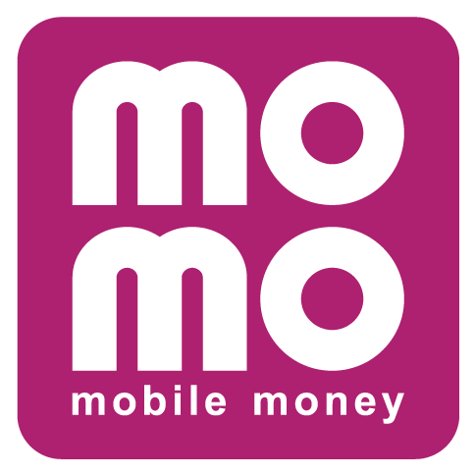
(INDIA 2017)
(HAITI 2010)
Examples of
Mobile Money Platforms
(HONDURAS 2011)
(KENYA 2007; CONGO 2012; LESOTHO 2013; MOZAMBIQUE 2013)
(VIETNAM 2010)
(GUINEA-BISSAU 2017)

Slide 5
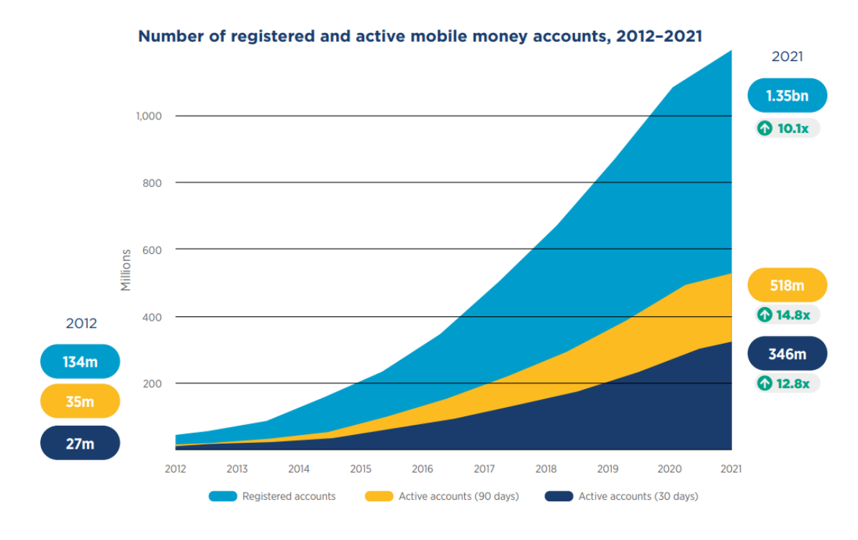
Mobile Money
Growth
Registered Mobile Money accounts have grown to 1.35bn in 2021, with around US$1 trillion in transactions taking place.
Source: GSMA 2022

Slide 6
Registered Mobile Money Accounts
GLOBAL
1.35 bn
Europe and Central Asia:
22m
East Asia and Pacific: 328m
LAC:
49m
South Asia:
283m
Africa:
621m
Source: GSMA 2022

Slide 7
Key Benefits/Impacts
Financial Sector
Mobile money has had a profound impact on the financial sector landscape in low-and middle-income economies, providing traditionally unbanked populations with secure and convenient means to carry out financial transactions and furthering financial inclusion (IMF, 2019a; Espinosa-Vega et al., 2020).

Slide 8
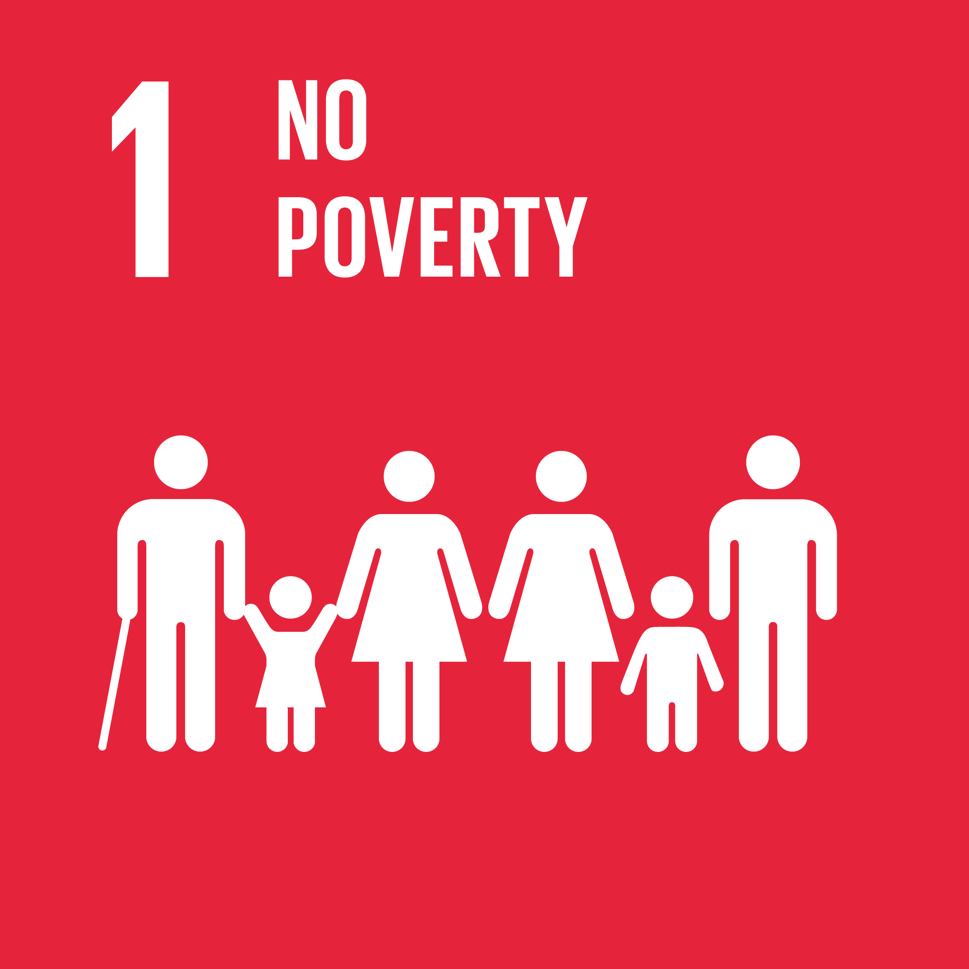
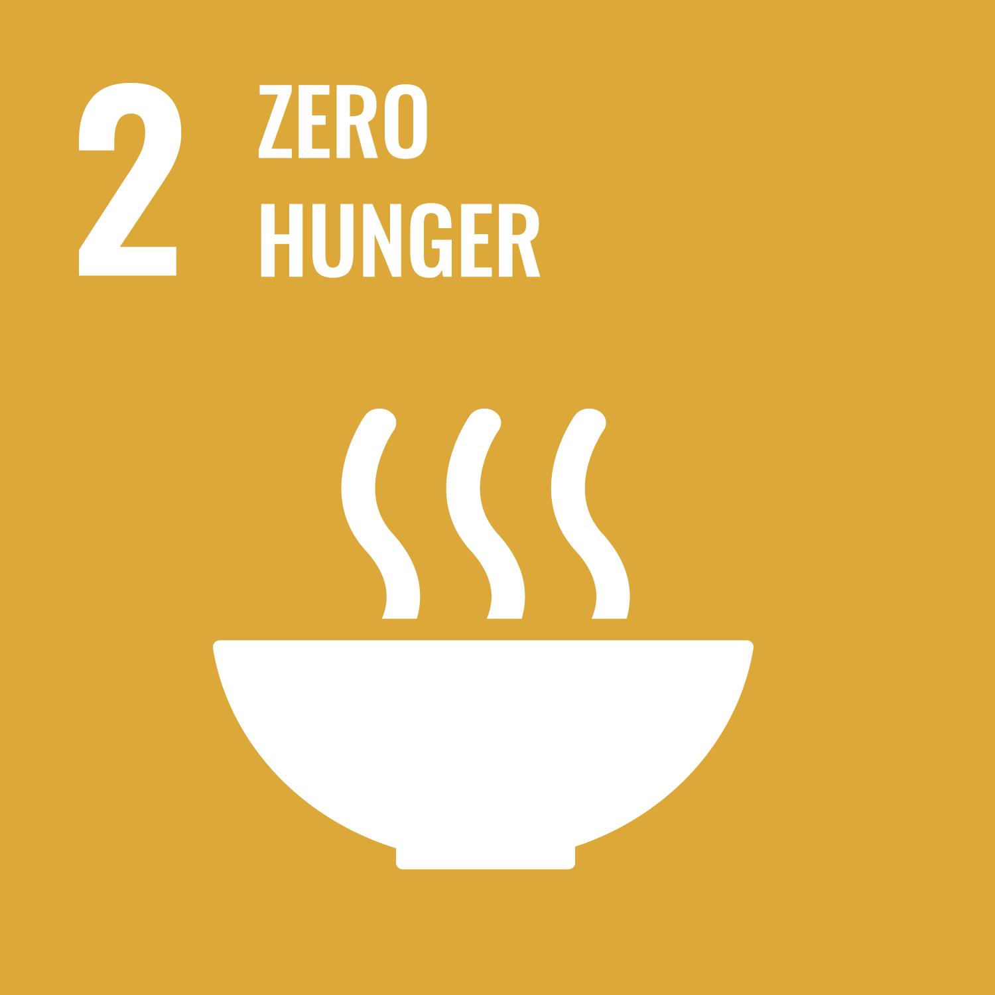
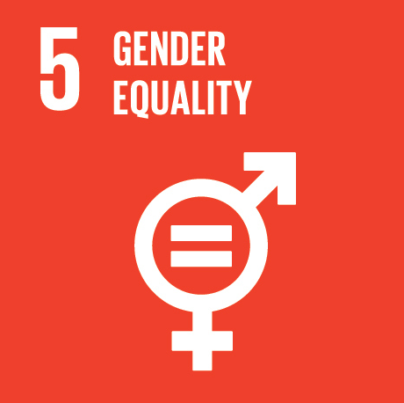
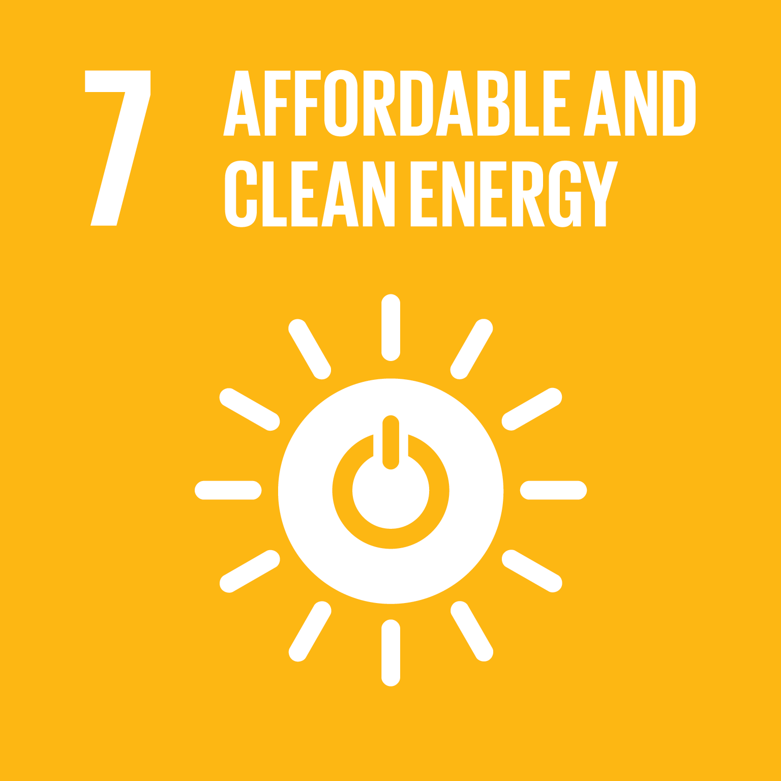
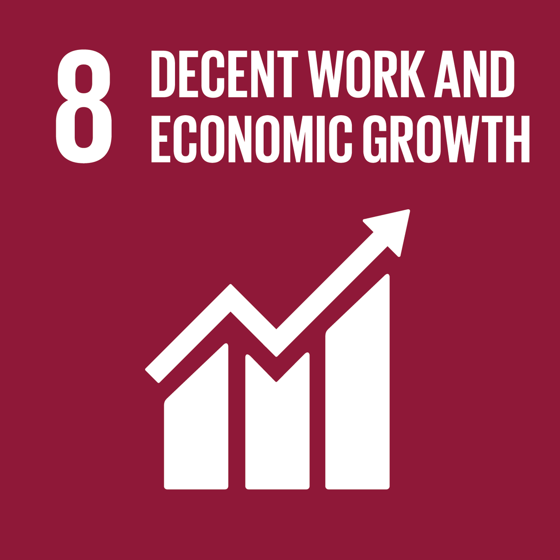
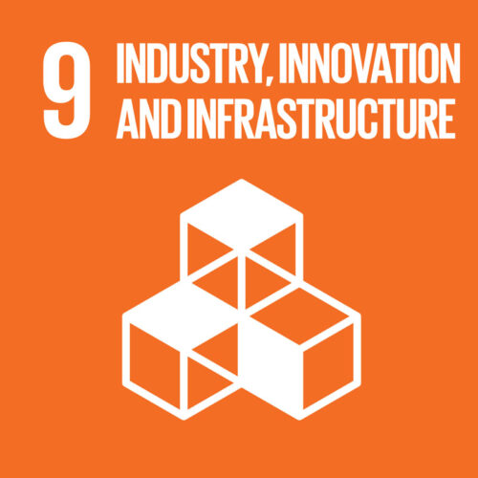
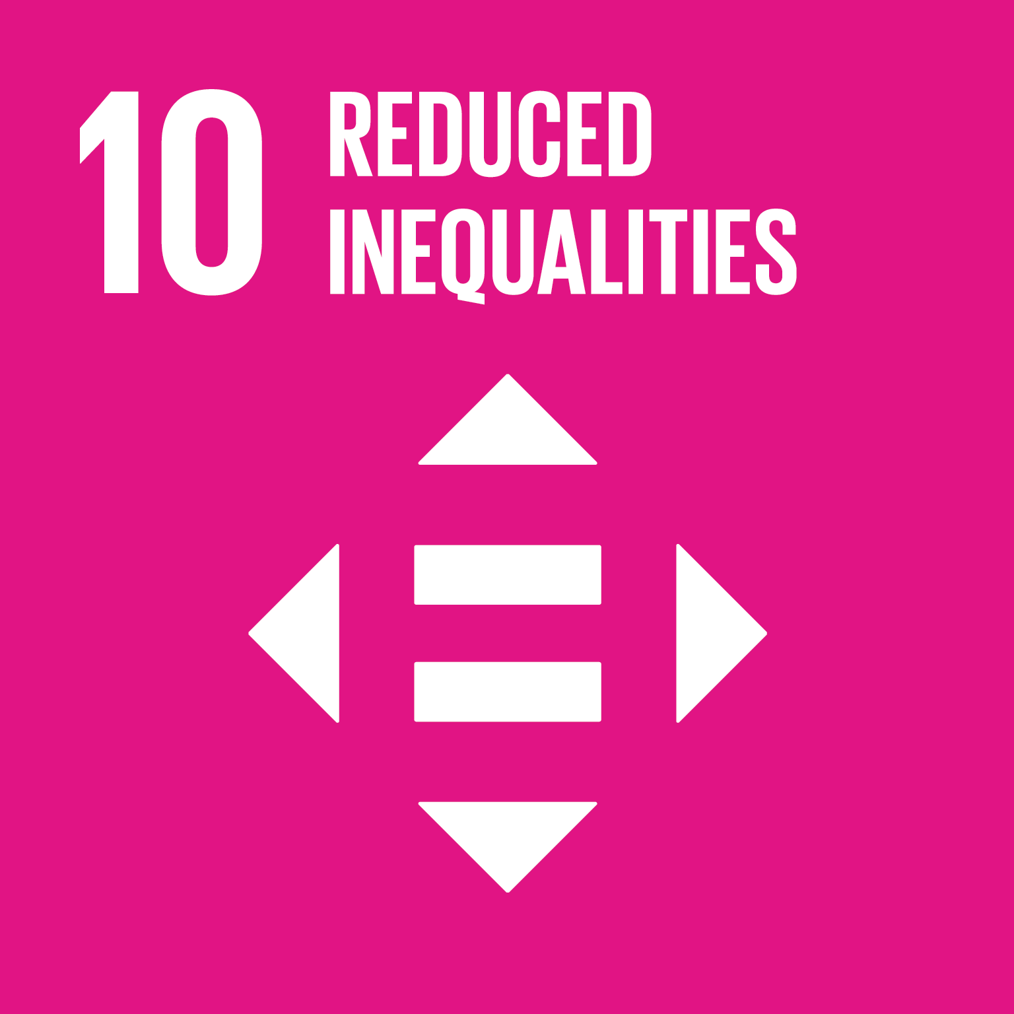
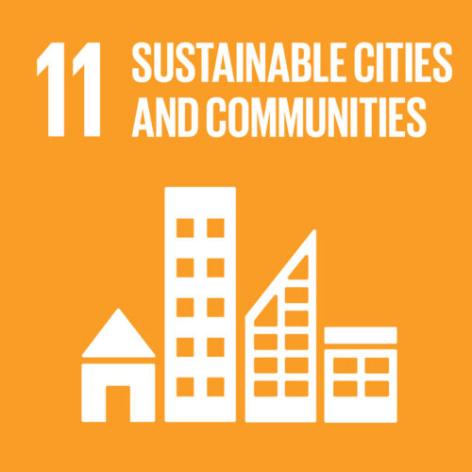
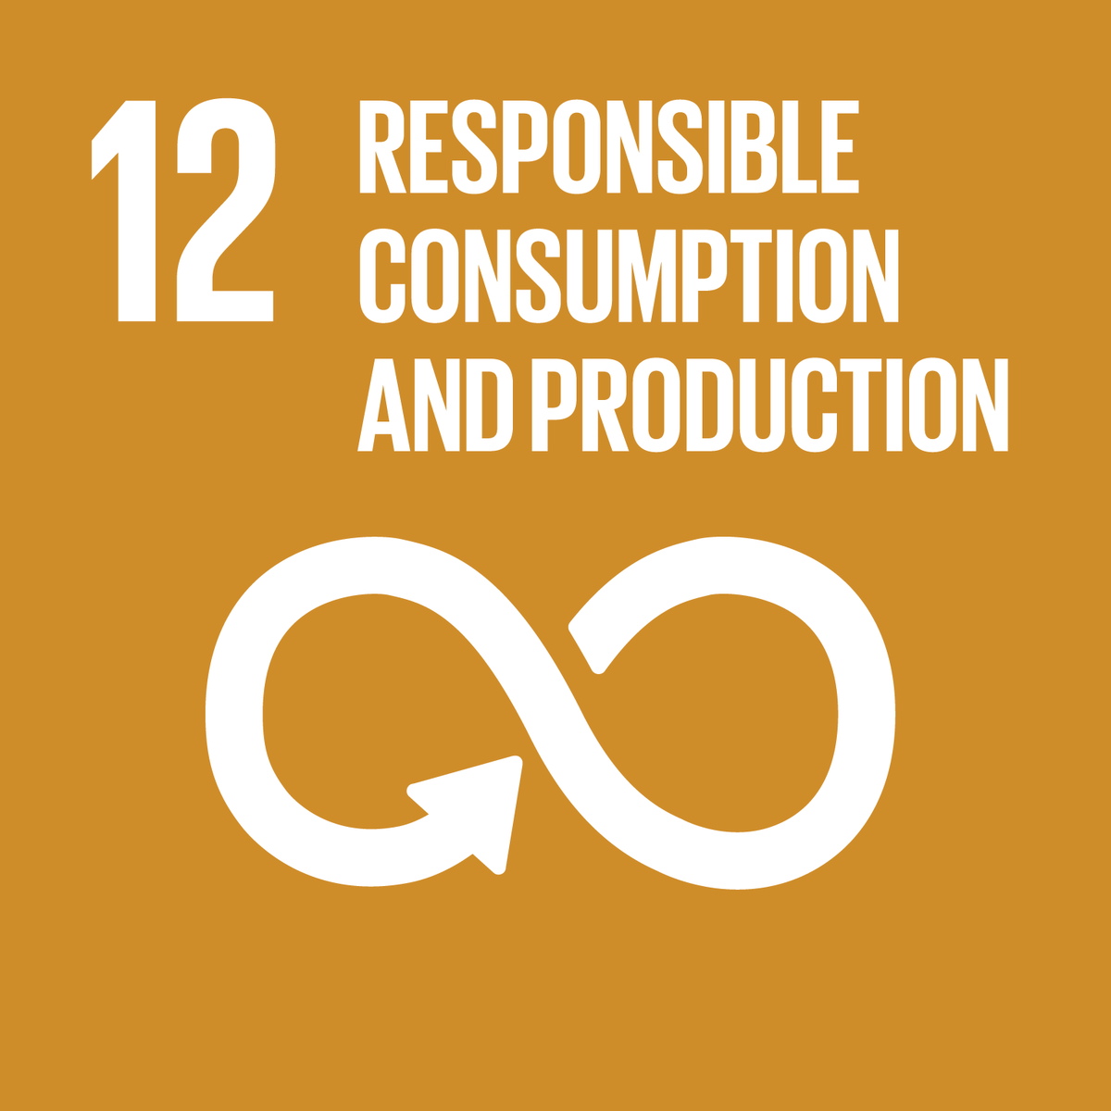
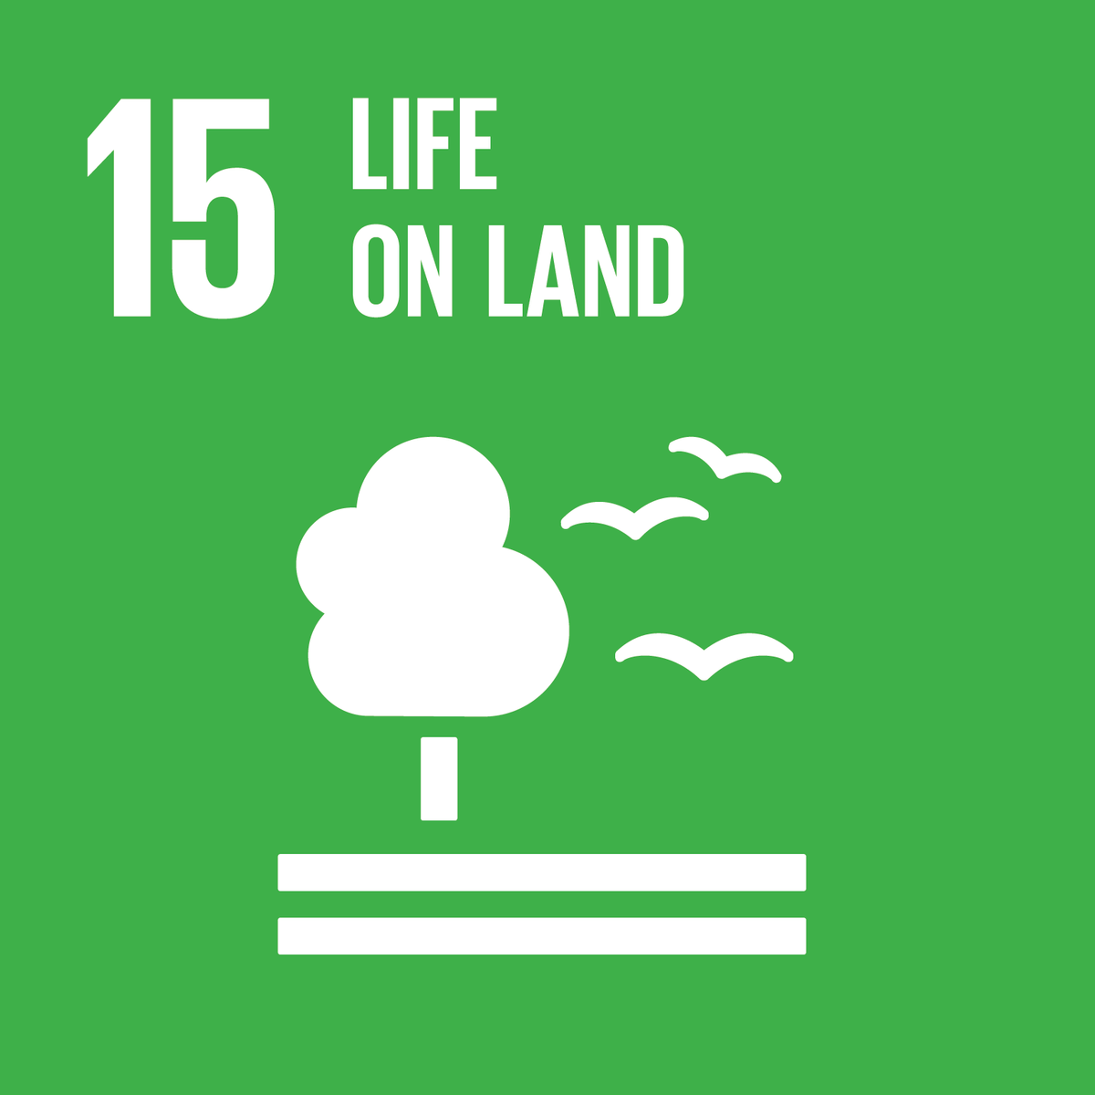
Mobile Money and the SDGs

Slide 9
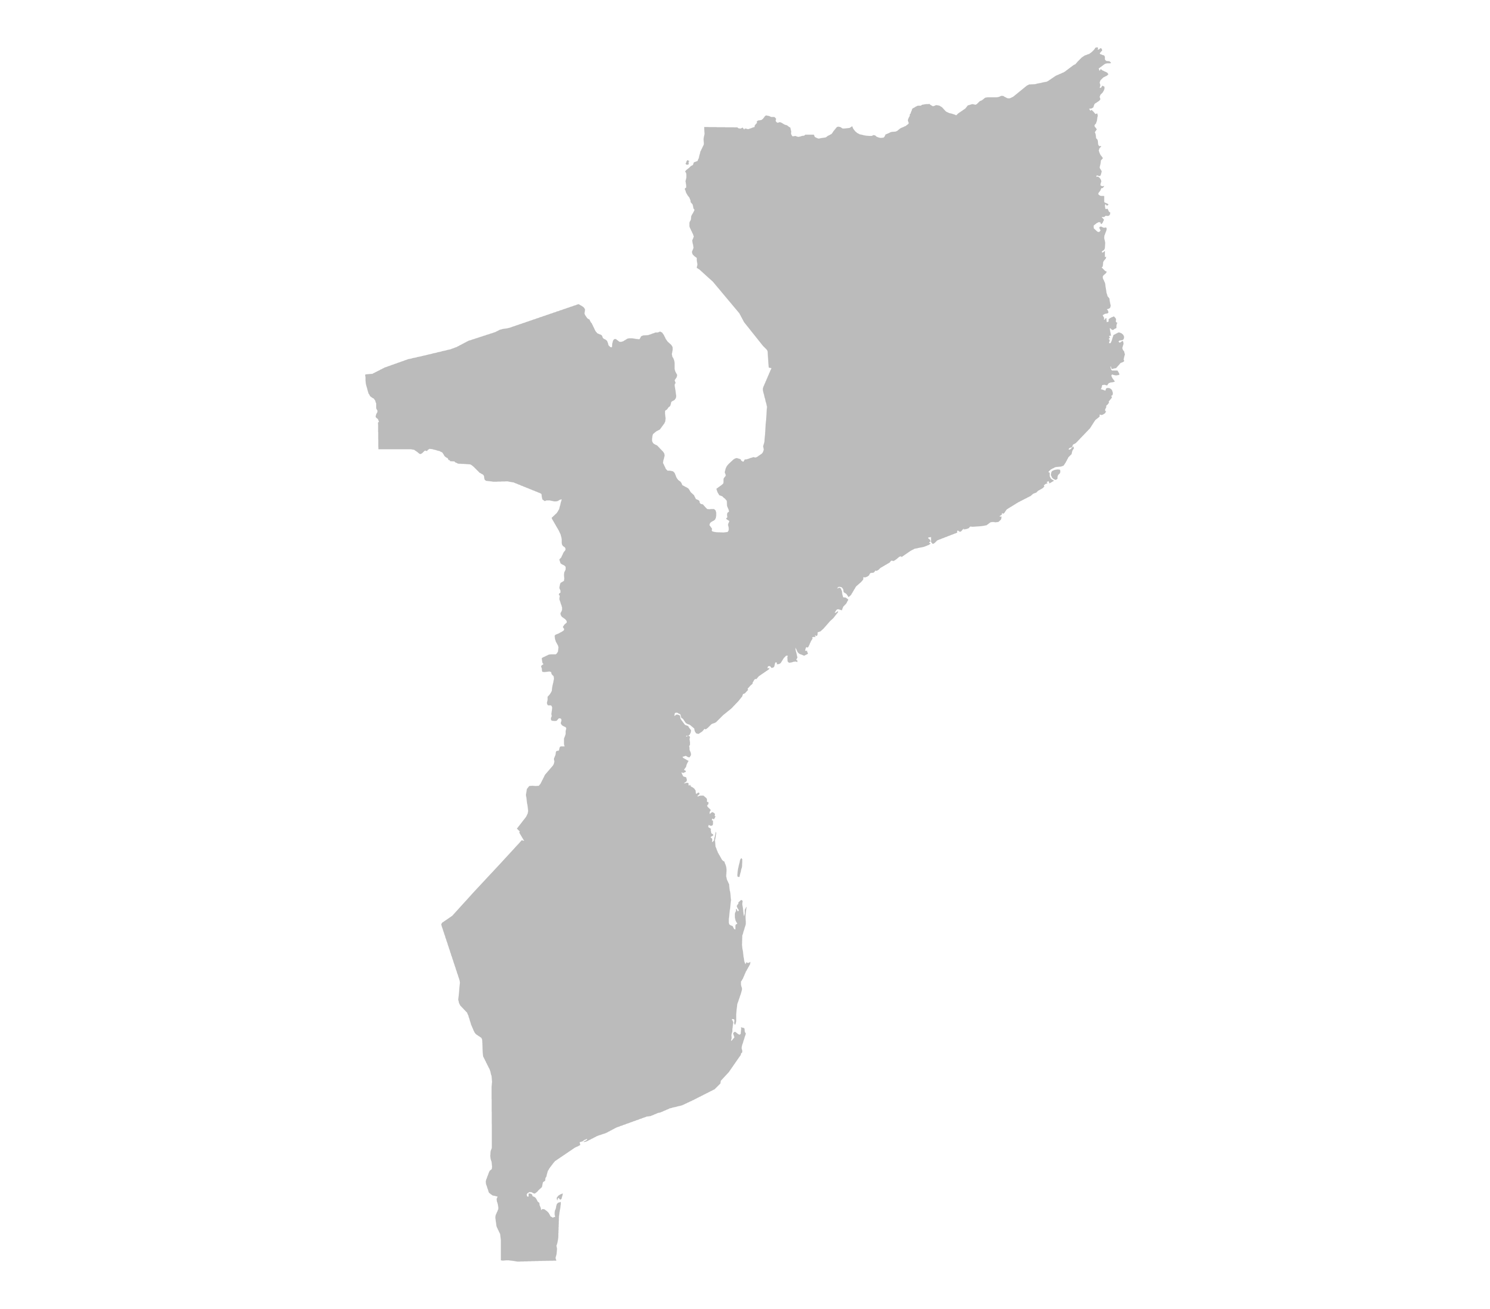
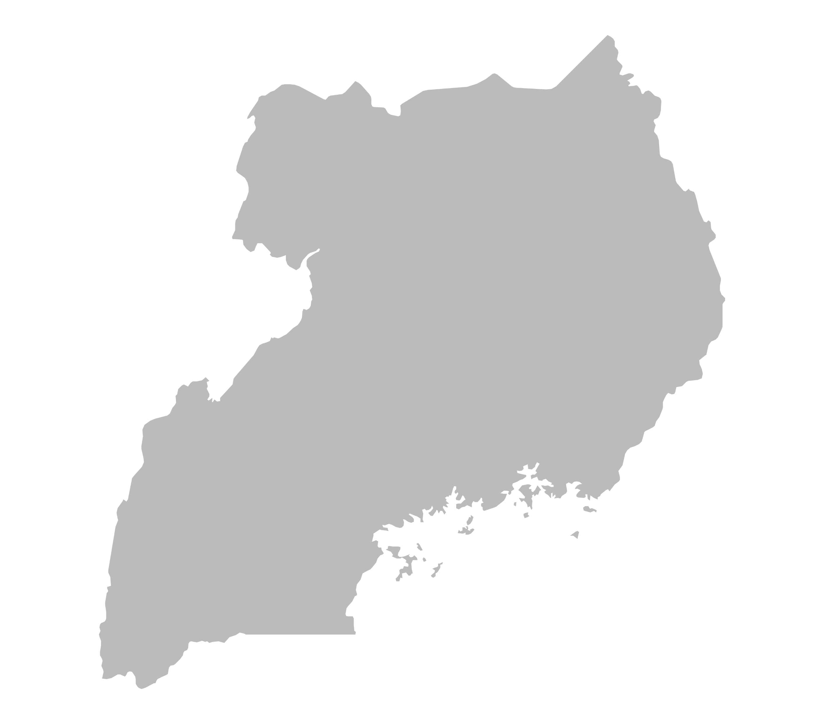
Key Benefits/Impacts Cont’d
Consumption, Risk Sharing & Poverty
Mozambique
Mobile money facilitated an increase in consumption expenditure by 44% following a natural hazard event (flooding).
(Batista and Vicente, 2020)
Bangladesh
Preliminary research shows remittances from the urban communities, via mobile money led an increase in daily per capita consumption by 8% and reduced the extreme poverty index by 42% in rural communities.
(Lee et al., 2021)
Northern Uganda
Mobile money increased food security by 45% for households that lived far away from bank branches.
(Weiser et al., 2019)
Kenya
The evidence shows that in areas where there were many M-Pesa agents, female-headed households increased their long-run consumption by 8.5%.
(Suri and Jack, 2016)

Slide 10
Eliminates the cost of travel.
Eliminates standing in queues.
Eliminates coordination costs between transactors.
Reduces the opportunity cost of lost money.
Mobile money reduces transaction costs

Slide 11
Creates a record.
Algorithmic credit scores can be calculated.
Protects against theft, fraud and misinformation.
Builds trust.
Facilitates international remittances.
Mobile money reduces asymmetric information and improves transparency

Slide 12
Unbanked poor suffer financial frictions.
Forms of saving are risky and prone to loss.
Mobile money offers a safe mode of saving.
Allows privacy.
Increases savings through digital means

Slide 13
Allows the formation of informal insurance networks to mitigate the impact of communal or idiosyncratic shocks.
Formal insurance schemes have also been created within mobile network operations
Mobile money allows risk sharing and insurance

Slide 14
Facilitates the shift of workers into more productive occupations and encourages firms to invest in fixed assets
Instantaneous mobile payments facilitates business planning and investment.
Access to credit can improve investment decisions.
Ease of transfer can increase family income by improving allocation of labor.
Mobile money improves aspects of economic efficiency

Slide 15
Bill Payments;
Bulk Disbursements;
Merchant Payments; and
Remittances.
Mobile Money Ecosystem Transactions
Notes:
A decade of growth in active accounts and transaction values has shown that mobile money is playing an increasingly important role in the daily lives of people in LMICs.
It is also diversifying its value proposition. Beyond P2P transfers and cash-in/cash-out transactions, the growth of partnership driven “ecosystem transactions”, such as bill payments, bulk disbursements, merchant payments and international remittances, together with interoperable transactions, are accounting for a greater share of the global mobile money transaction mix.
While money traditionally leaves the mobile money system by being cashed out, digital transactions such as mobile-to-bank (M2B) or bill payments now constitute almost half of outgoing flows.
A strong upward trend in merchant payments continued in 2021, reaching what could be considered a tipping point. The value of merchant payments, including proximity and online payments, almost doubled, reaching an average of $5.5 billion in transactions per month, up from $2.8 billion on average in 2020.
Consistent with this trend is a considerable increase in the number of businesses accepting and actively using mobile money as a payment method. According to the 2021 Global Adoption Survey, between September 2020 and June 2021 there was a 47 per cent increase in the number of active merchants that had accepted a mobile money payment in the last 30 days. This growth may be driven in part by a significant proportion of MSMEs moving from the P2P channel to merchant payments.
Mobile money-enabled bulk disbursements reached $65.8 billion at the end of 2021. This growth can be attributed to an uptick in salary payments via mobile money as a larger proportion of employers in LMICs are turning to digital to pay their employees.
Mobile money providers that responded to the Global Adoption Survey reported that the number of account holders receiving their salary via mobile money grew by close to 150 per cent between September 2020 and June 2021.
Social and humanitarian cash transfers, including for pandemic relief, also play an important role in this growth. Based on responses to the 2021 Global Adoption Survey, more than half of mobile money providers stated that they helped disburse COVID-19 relief funds and, between September 2020 and June 2021, the number of unique customer accounts receiving government-to-person (G2P) payments grew by more than 50 per cent. This could be an indication that governments and NGOs are interested in sustaining their new partnerships with mobile money providers and ensuring that both they and their recipients continue to benefit from the proven and efficient mobile money channel.
Bill payments: Like other ecosystem transactions, the number of bill payments processed via mobile money leapt in 2021, exceeding $5 billion in transactions per month. For customers, the appeal of digitisation is becoming clear. In addition to offering more practical ways to pay for services, mobile money-enabled bill payments can unlock access to a range of new services, such as off-grid energy, and help low-income users build economic identities. For government agencies and utility companies, mobile money-enabled bill paymentscan make revenue collection more efficient and cost-effective, strengthen financial transparency and circumvent fraud.
Mobile money customers are also using mobile money more consistently to pay their bills. Based on responses to the 2021 Global Adoption Survey, the number of unique customer accounts that performed bill payments in the past 30 days grew by about a third between September 2020 and June 2021

Slide 16
Facilitates Remittance Flows
On average it costs less to send money via Mobile Money in comparison to traditional means.
Source: GSMA 2022

Slide 17
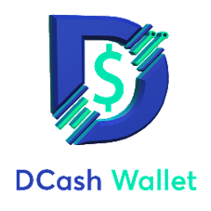
State of the Caribbean – Mobile Money penetration

Slide 18
Challenges
Financial Development Index
Source: IMF 2022

Slide 19
Barriers in mobile money adoption in LMIC and the Caribbean include:
Mobile phone ownership (particularly vulnerable groups and women);
Lack of digital skills;
Lack of access due to cost and unreliable mobile networks;
Preference for cash, and a lack of trust in the system;
Lack of proper identification (ID)
Lack of awareness of mobile money services.
Gaps in
Mobile Money Penetration
Source: GSMA Consumer Survey conducted in 10 LMICs in 2021

Slide 20
Policy and regulatory interventions, from taxes on transactions to poorly implemented instant payment solutions and costly data localisation mandates.
The high cost of compliance is shared by mobile money providers and customers alike with potentially negative consequences on future investments in, and customer usage of, mobile money services.
Dialogue between policy makers, regulators and industry leaders is of paramount importance in order to prevent adverse policy and regulatory interventions.
Regulatory and Institutional Challenges Persist

