Slide 1
Jump
Digital Inclusion Together

Slide 2
BARRIERS TO USE & ADOPTION
LACK OF AWARENESS
AFFORDABILITY
Across the Caribbean, broadband penetration rates remain below 50%.
LACK OF DIGITAL SKILLS
LACK OF INFRASTRUCTURE

Slide 3
Together...
We can close this gap within 3-5 years.

Slide 4
DIGITAL INCLUSION

Slide 5
UNITED STATES
Emergency Broadband Benefit
3.75M
Eligible households subscribed to broadband in first two months

Slide 6
MONTSERRAT Project Lightspeed
2K
Eligible households connected with Government subsidies

Slide 7
COSTA RICA
National Telecommunications
(FONATEL)
3X
Broadband subscriptions more than tripled from 2008-2010

Slide 8
DOMINICAN REPUBLIC
2K
Low-income households to be connected through the country’s social safety net program Supérate

Slide 9
Together...
Public-private partnerships can have transformational impacts.

Slide 10
DIGITAL INCLUSION CHANGES LIVES AND COUNTRIES.
Expanded virtual learning opportunities
Enhanced telehealth services
Improved graduation rates
More efficient job market
Increased labour force productivity
Improved efficiency of businesses across the economy
More desirable destination for international corporations
To name a few...

Slide 11
C&W IS UNIQUELY POSITIONED TO BRIDGE THE DIGITAL DIVIDE.
OUR HISTORY
OUR INFRASTRUCTURE
OUR RELATIONSHIPS

Slide 12
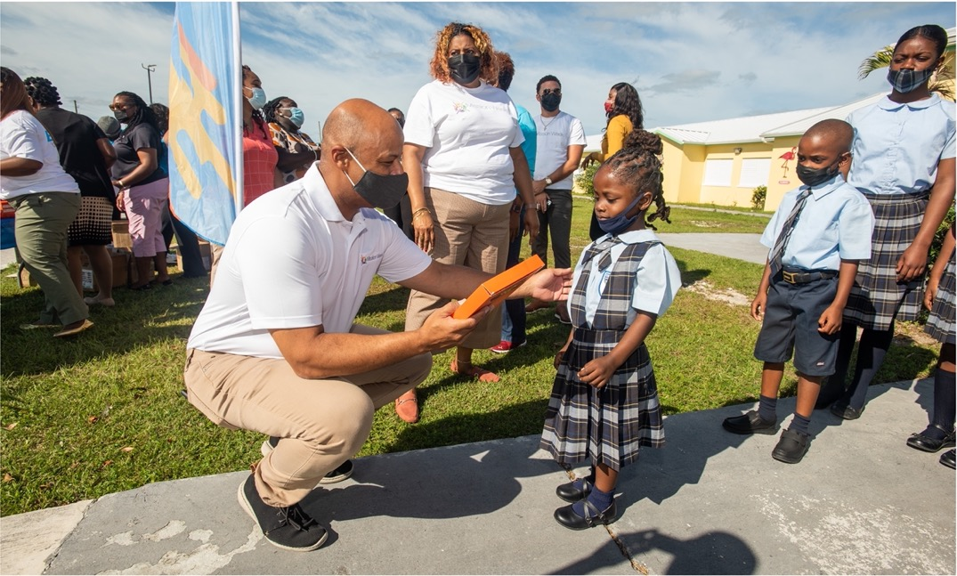
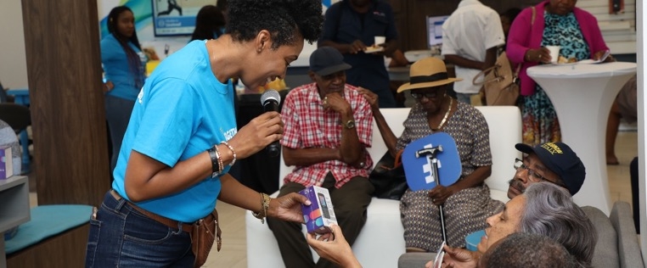
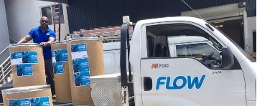
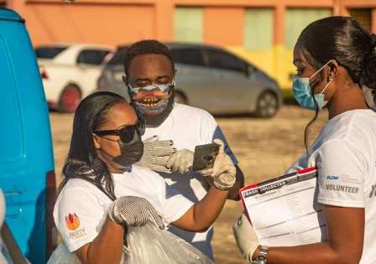
C&W WORK IN THE REGION

Slide 13
Together...
We can help our people Jump to a better future.

Slide 14
JUMP IS OUR NEW PROGRAM TO BRIDGE
THE DIGITAL DIVIDE ACROSS THE CARIBBEAN.

Slide 15
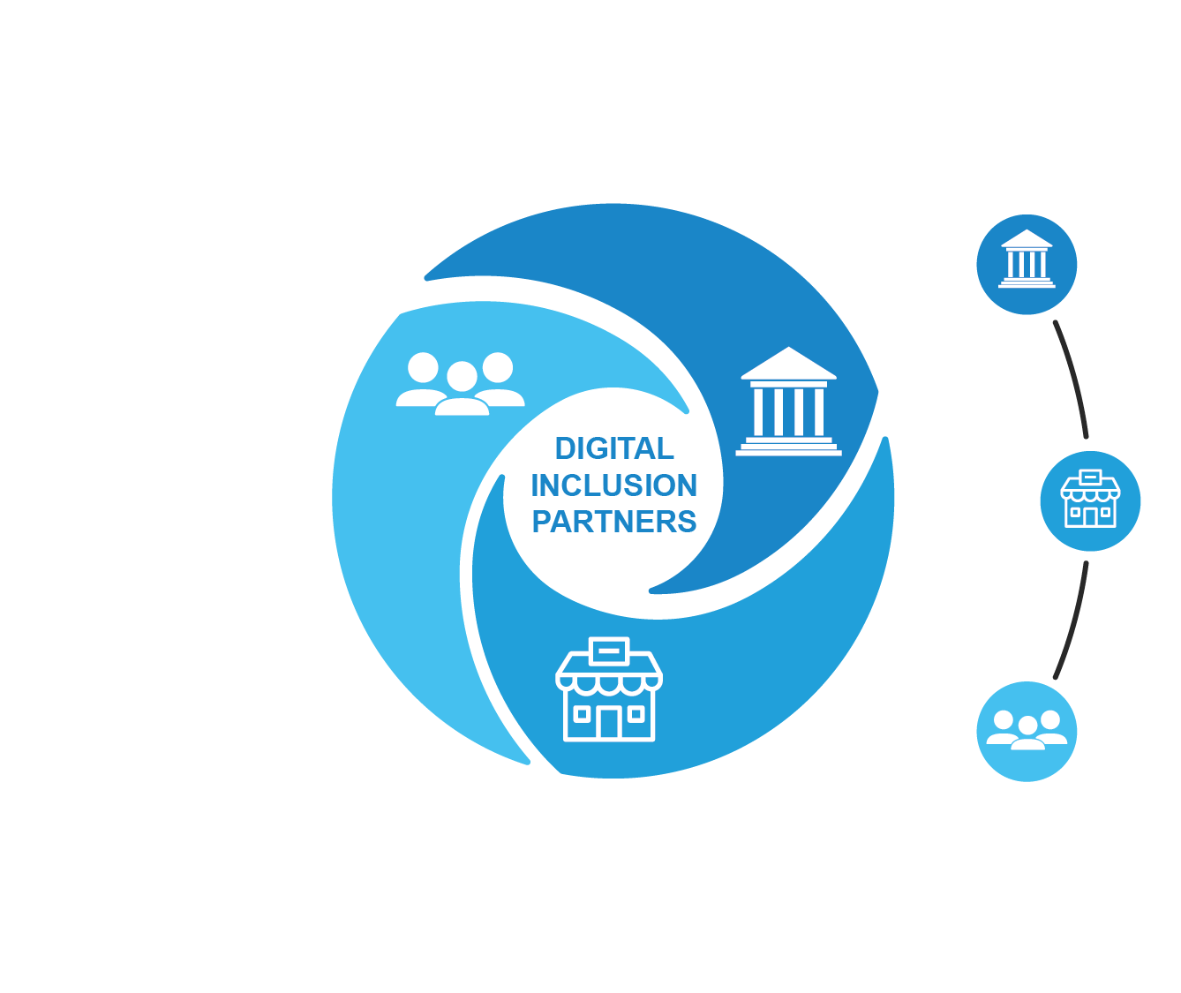
WE NEED YOU. THEY NEED US. LET’S FIND A SOLUTION TOGETHER.
PUBLIC
SECTOR
PRIVATE
SECTOR
COMMUNITY
ORGS

Slide 16
Together...
We can provide an indispensable lifeline to our people.
LET’S JUMP!

Slide 17
Thank You!

