Slide 1

Connecting the unconnected
July 2022

Slide 2
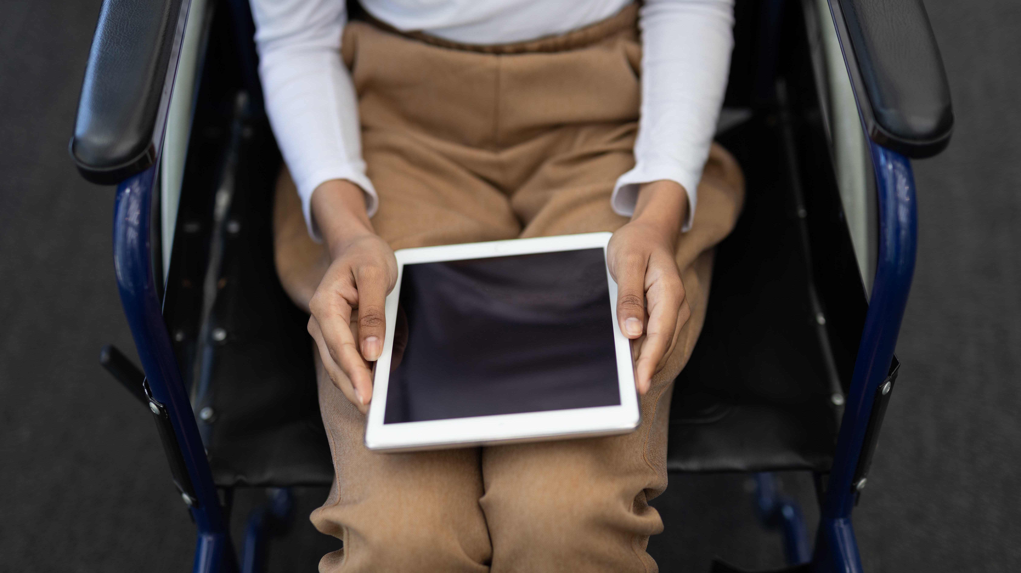


WHY MEASURE DIGITAL INCLUSION?
What is not measured, quickly becomes invisible.
What is invisible is lost.
and what is lost, cannot be acted on or remedied.
Connect the Unconnected | Telecommunications Authority of Trinidad and Tobago

Slide 3
Methodology – Sampling Design
1
  DIS 2021 was a cross-sectional survey, using a multi-stage, stratified random probability sample methodology designed to produce estimates at the national, municipal and community levels.
  Questionnaire based on indicators prescribed by the International Telecommunications Union.
  Administered the survey to over 6000+ households or approx. 17,000 persons throughout Trinidad and Tobago over 3mths.
2
3
  To measure the digital divide, we used the internationally recognised ICT Development Index (IDI) created by the ITU. The IDI ranges from 1 to 10 with 10 signifying that there is no digital divide exists.
Connect the Unconnected | Telecommunications Authority of Trinidad and Tobago

Slide 4

4
FINDINGS - IDI
8.13
8.06
8.05
8.01
7.91
7.88
7.86
7.85
7.84
7.82
7.81
IDI Score
7.66
7.63
7.54
7.51
Arima
T&T
Siparia
Penal/Debe
Point Fortin
Princes Town
Diego Martin
Port of Spain
Sangre Grande
San Fernando
Tunapuna/Piarco
Mayaro/Rio Claro
San Juan/Laventille
Chaguanas
Couva/Tabaquite/Talparo
Municipality
Connect the Unconnected | Telecommunications Authority of Trinidad and Tobago

Slide 5
FINDINGS - IDI
0.88
Index Score
0.73
0.71
0.66
0.67
0.40
ICT ACCESS
ICT USE
ICT SKILLS
Sub Index
2013
2021
Connect the Unconnected | Telecommunications Authority of Trinidad and Tobago

Slide 6


INFRASTRUCTURE & ACCESS
Network Coverage
Population covered by a mobile-cellular network (2020)
Population covered by at least a 3G mobile network (2020)
Population covered by at least a 4G mobile network (2020)
100%
75%
100%
number of women
number of men
Mobile Phone Ownership
Female mobile phone ownership as a % of total female population (2021)
Individuals owning a
mobile phone (2021)
85%
83%
83.9%
Male mobile phone ownership as a % of total male population (2021)
Connect the Unconnected | Telecommunications Authority of Trinidad and Tobago

Slide 7


INFRASTRUCTURE & ACCESS
ICT Access at Home
Households with Internet access at home, rural (2021)
60%
81%
79%
Households with Internet access at home (2021)
Households with computer access at home (2021)
Households with Internet access at home, urban (2021)
83%
Connect the Unconnected | Telecommunications Authority of Trinidad and Tobago

Slide 8


Mobile and Fixed
TELEPHONE
SUBSCRIPTIONS
25%
Mobile cellular subscriptions per 100 inhabitants (Q4, 2021)
146
Fixed-telephone subscriptions per 100 inhabitants (Q4, 2021)
Connect the Unconnected | Telecommunications Authority of Trinidad and Tobago

Slide 9

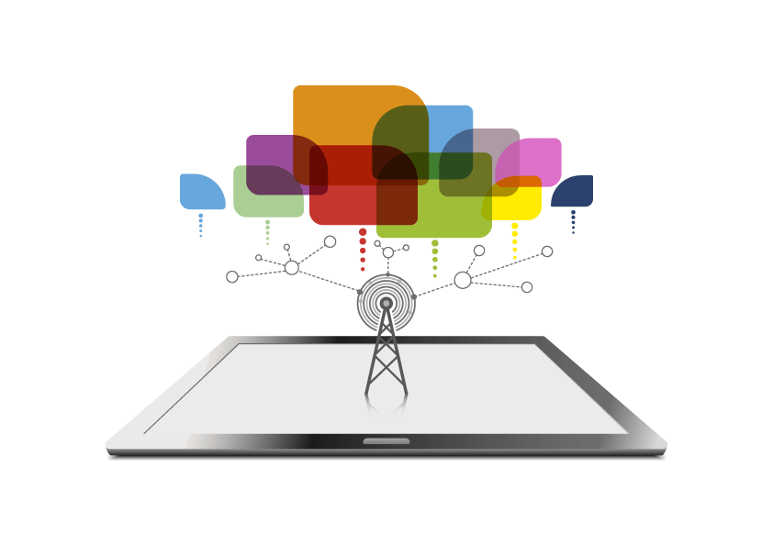

Mobile and Fixed
broadband
SUBSCRIPTIONS
226
Active mobile-broadband subscriptions per 100 inhabitants (Q4, 2021)
International bandwidth per Internet user (kbit/s) (2021)
60
Fixed broadband subscriptions per 100 inhabitants (Q4, 2021)
27
Connect the Unconnected | Telecommunications Authority of Trinidad and Tobago

Slide 10
Fixed BROADBAND
SUBSCRIPTIONS
Total Fixed Broadband Subscriptions (Q4. 2021)
369,100
Fixed Broadband (% of total): 256kbits/s-<2Mbit/s (Q4. 2021)
2%
Fixed Broadband (% of total):
2 to 10Mbit/s (Q4. 2021)
10%
Fixed Broadband (% of total):
>10Mbit/s (Q4. 2021)
88%
Connect the Unconnected | Telecommunications Authority of Trinidad and Tobago

Slide 11



Trinidad and Tobago
Internet use
Percentage of population using internet
<15 years as a % of
all <15 years (2021)
67%
Individuals using the Internet total (2021)
79%
15-24 years as a % of all 15-24 years (2021)
94%
Female Internet use as a % of total female population (2021)
82%
25-74 years as a % of all 25-74 years (2021)
83%
Male Internet use as a % of total male population (2021)
76%
75+ years as a % of all 75+ years (2021)
37%
Broadband traffic
Average monthly fixed broadband Internet traffic per fixed broadband subscription (MB) (2020)
234,074
Average monthly mobile broadband Internet traffic per mobile broadband subscription (MB) (2020)
9039

Slide 12
Enablers & barriers
ICT Prices
ICT Skills
Mobile data and voice basket (low consumption) as a % of GNI p.c.
2.3%
Individual with basic skills
73%
Mobile data and voice basket (high consumption) as a % of GNI p.c.
2.3%
Individual with standard skills
30%
Mobile broadband basket as a % of GNI p.c.
2.3%
Fixed broadband basket as a % of GNI p.c.
Individual with advanced skills
4%
1.5%
Mobile cellular basket as a % of GNI p.c.
1.0%
Connect the Unconnected | Telecommunications Authority of Trinidad and Tobago

Slide 13

PURPose of ttwifi
A GORTT initiative to allow the general public to access “free” quality broadband Internet to be productive, whilst they wait for service at a public location.
TATT is responsible for the roll out of TTWiFi at:
public libraries
public transport hubs
schools without connectivity
public waiting areas in health institutions (hospitals, health centres)
Connect the Unconnected | Telecommunications Authority of Trinidad and Tobago

Slide 14
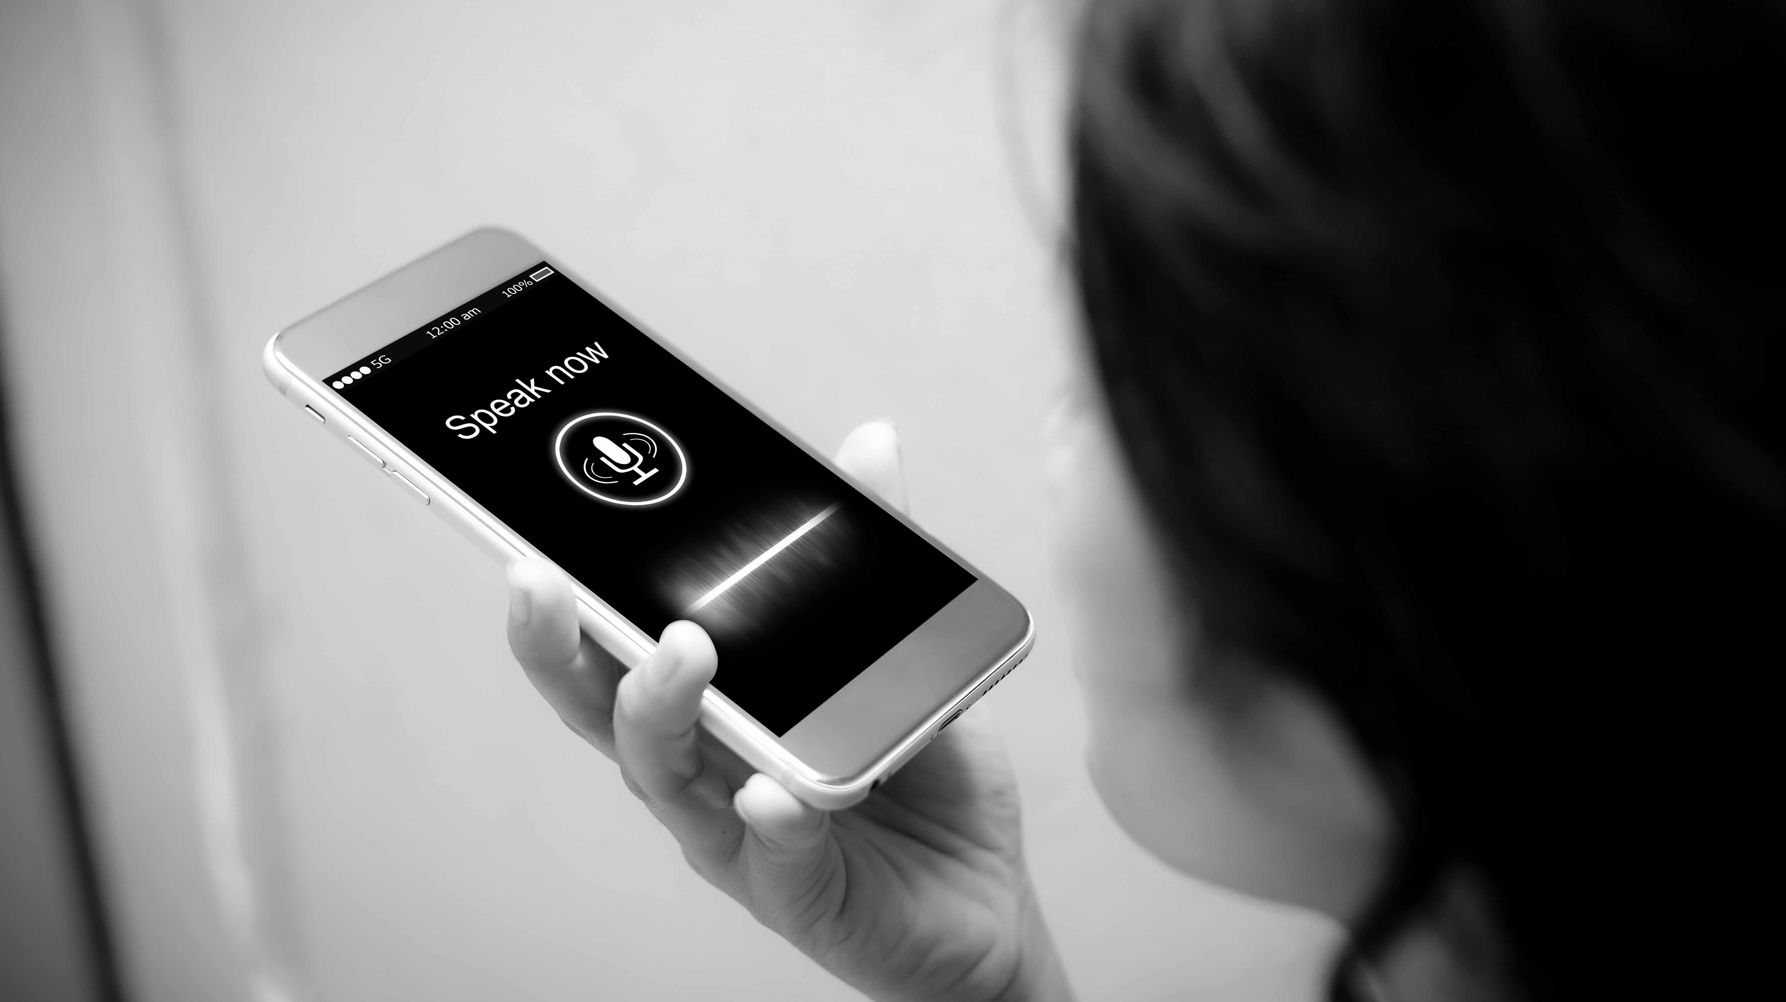
PURPose of PWDs INITIATIVE
This initiative seeks to promote digital inclusion for persons with disabilities in Trinidad and Tobago. It was launched in September 2020.
The goal of this initiative is to provide subsidised mobile phones containing assistive features to persons who are visually and/or hearing impaired or have a disability and in receipt of a disability assistance grant from the Ministry of Social Development and Family Services.
TATT provides a subsidy of TT$600.
Connect the Unconnected | Telecommunications Authority of Trinidad and Tobago

Slide 15
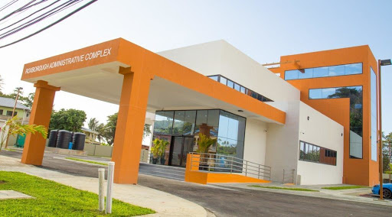
ICT Access Centres
TATT is seeking to implement an ICT access centres as part of the GORTT initiative throughout Trinidad and Tobago

Slide 16
Connecting the unconnected:
High-Level Recommendations
1
Continued development and deployment of a modern, resilient and sustainable broadband telecommunications/ICT infrastructure, with focus on underserved areas at the community level.
3
Enhancement of the digital transformation ecosystem through connectivity projects, promoting active engagement of service providers, industry partners and other relevant stakeholders
2
Promotion of digital literacy and competence to ensure inclusive and trusted use and implementation of new and emerging technologies, applications and services, especially among vulnerable populations.
4
Contribute to the development of a modern and enabling policy and regulatory environment to connect the underserved through available, affordable and accessible ICTs that support the achievement of the SDGs, the ITU Connect 2030 agenda, and Trinidad and Tobago’s Vision 2030.
More detailed recommendations are outlined within the report
Connect the Unconnected | Telecommunications Authority of Trinidad and Tobago

Slide 17
THANK YOU!
www.tatt.org.tt

