Slide 1
Managing Capital Structures
The Telecommunication Landscape
Presented by:
Andrew Boissiere
Head of Origination
Corporate and Investment Banking
ANSA Merchant Bank Limited

Slide 2
Why Are We Here?
Symbiotic Relationship
Similar Emerging Threats
Digital Solutions
Notes:
These are some major causes of cashflow issues.
One major event that led to demand destruction and a sharp global economic contraction in 2020 was the Covid-19 pandemic.
We will explore how this has impacted organizations globally from a cash flow and debt perspective.

Slide 3

Why Are We Here?
Two Fundamental Questions:
How can we drive value?
How can we retain value?
Notes:
These are some major causes of cashflow issues.
One major event that led to demand destruction and a sharp global economic contraction in 2020 was the Covid-19 pandemic.
We will explore how this has impacted organizations globally from a cash flow and debt perspective.

Slide 4







MERCHANT BANKING
INSURANCE SERVICES
via TATIL GROUP
COMMERCIAL BANKING
via ANSA BANK LTD
TREASURY AND FOREIGN EXCHANGE SERVICES
INVESTMENT SERVICES
WEALTH MANAGEMENT

Slide 5


Our Observations
Funding the roll out of large infrastructure projects
Managing threats
Notes:
These are some major causes of cashflow issues.
One major event that led to demand destruction and a sharp global economic contraction in 2020 was the Covid-19 pandemic.
We will explore how this has impacted organizations globally from a cash flow and debt perspective.

Slide 6
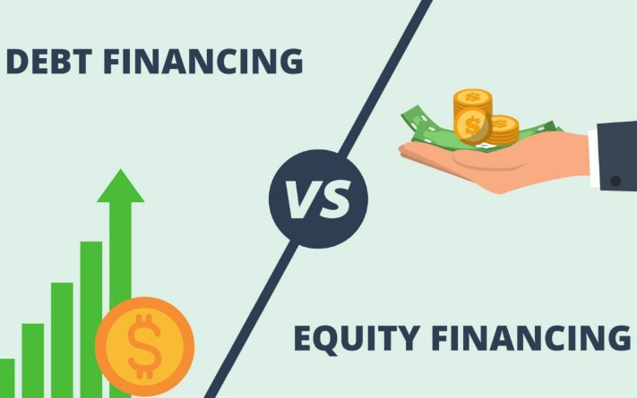
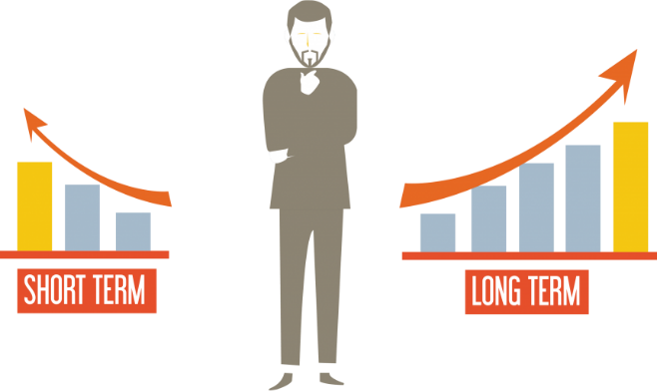

Capital Structure Considerations
How well is the business capitalized?
How is funding matched to business needs?
How liquid is the business?
Notes:
These are some major causes of cashflow issues.
One major event that led to demand destruction and a sharp global economic contraction in 2020 was the Covid-19 pandemic.
We will explore how this has impacted organizations globally from a cash flow and debt perspective.

Slide 7
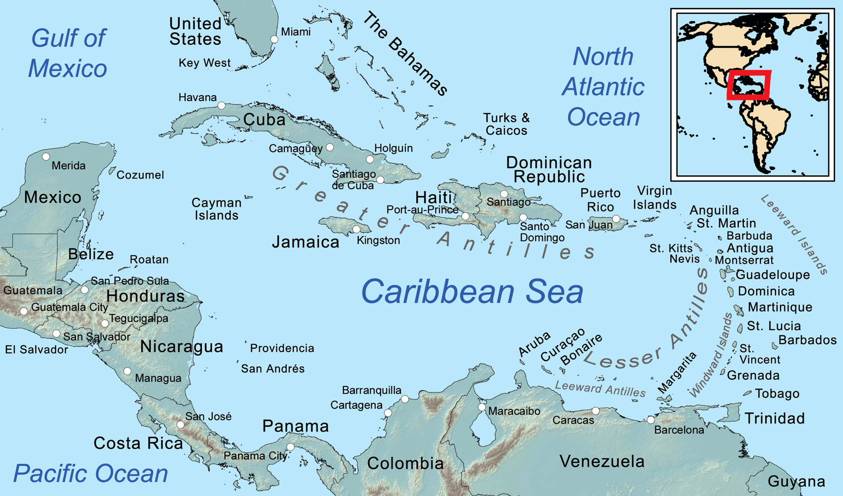




The Caribbean Region
Multiple currencies
State owned carriers
Dynamic of multinationals vs. indigenous carriers
Local currency vs. Foreign currency liquidity
Notes:
These are some major causes of cashflow issues.
One major event that led to demand destruction and a sharp global economic contraction in 2020 was the Covid-19 pandemic.
We will explore how this has impacted organizations globally from a cash flow and debt perspective.

Slide 8
Case Study: Trinidad and Tobago
Notes:
These are some major causes of cashflow issues.
One major event that led to demand destruction and a sharp global economic contraction in 2020 was the Covid-19 pandemic.
We will explore how this has impacted organizations globally from a cash flow and debt perspective.

Slide 9



Considerations for Operators
What assets can be monetized?
Finding the right blend of foreign and local currency funding
Accessing alternative forms of debt capital
Notes:
These are some major causes of cashflow issues.
One major event that led to demand destruction and a sharp global economic contraction in 2020 was the Covid-19 pandemic.
We will explore how this has impacted organizations globally from a cash flow and debt perspective.

Slide 10
THANK YOU!
Andrew Boissiere
Mobile: 1 (868) 291-6522
Email: andrew.boissiere@ansamcal.com
Notes:
These are some major causes of cashflow issues.
One major event that led to demand destruction and a sharp global economic contraction in 2020 was the Covid-19 pandemic.
We will explore how this has impacted organizations globally from a cash flow and debt perspective.

