Slide 1
Wi-Fi Forever

Slide 2
Mi path towards wifi
B2C - Internet
B2C – Video & Internet
B2C - Video
B2C - Fixed
B2C - Mobile
B2B - ITC
“I love complexity and make it simpler for everyone”
https://www.linkedin.com/in/serore/

Slide 3
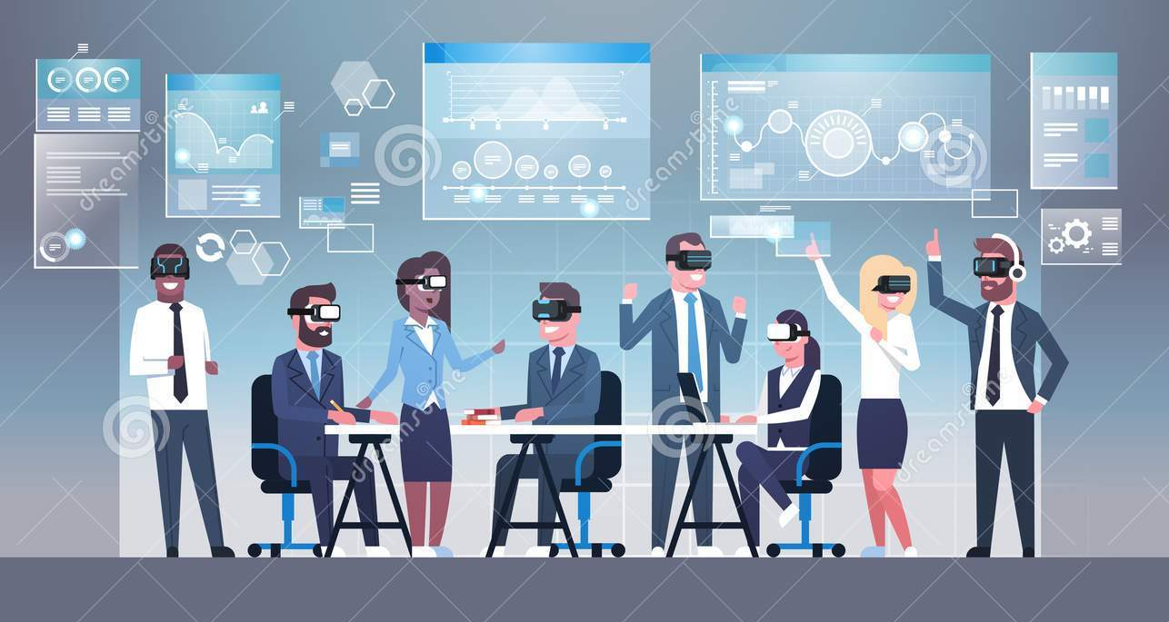
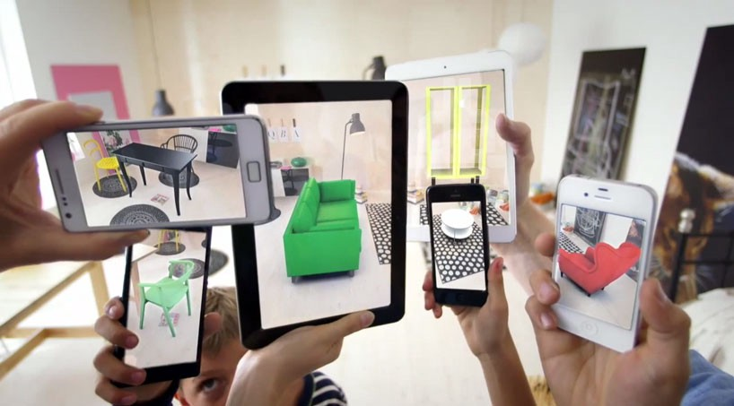
Why wifi matter?
Notes:
Part of the evolution of the industry (from selling access to selling ethernet + wifi)
Part of the ecosystem
Key role to deliver services
how improving Wi-Fi can impact customer experience and also explain a little about why companies like ours are working so hard to provide an end to end Wi-Fi experience in the home that is really perfect. What are the impediments to getting people better Wi-Fi in their homes? Why is it so important to IPSs like us? How will the technology impact that problem, when people complain about the internet but it is actually a problem with congestion or poor signal, etc. What are we doing to combat this for customers, etc?

Slide 4
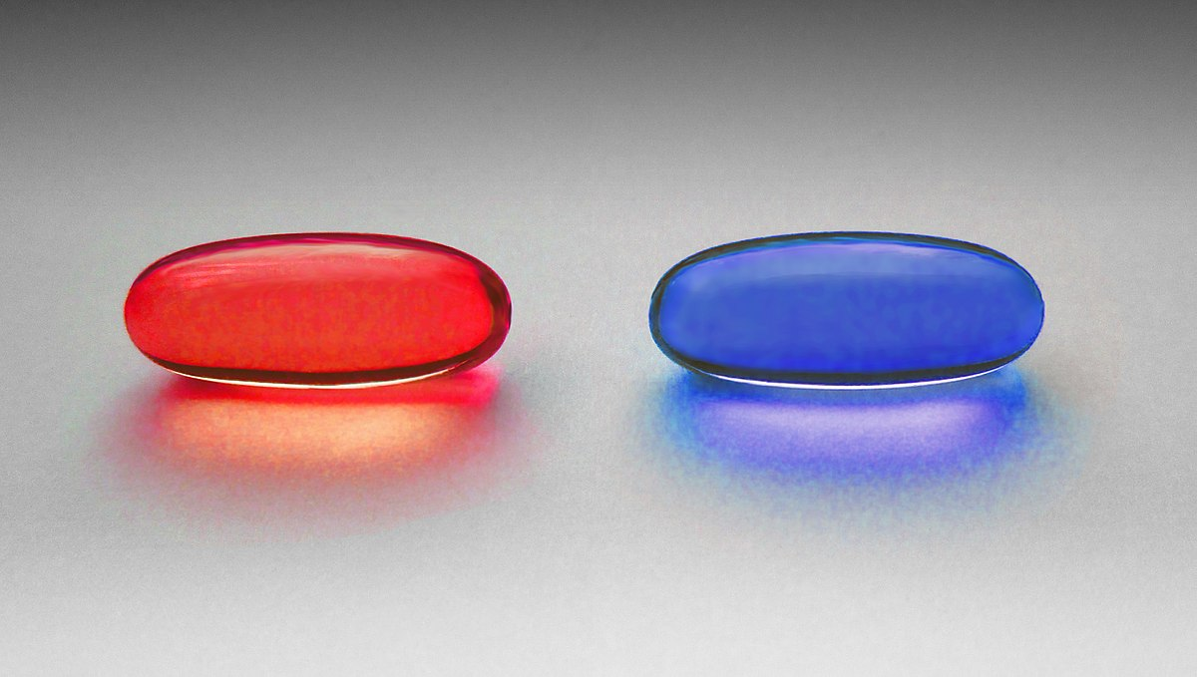
Wifi is a story with 2 sides
Notes:
This is to talk about challenges
how improving Wi-Fi can impact customer experience and also explain a little about why companies like ours are working so hard to provide an end to end Wi-Fi experience in the home that is really perfect. What are the impediments to getting people better Wi-Fi in their homes? Why is it so important to IPSs like us? How will the technology impact that problem, when people complain about the internet but it is actually a problem with congestion or poor signal, etc. What are we doing to combat this for customers, etc?

Slide 5
They expect to be connected

Slide 6
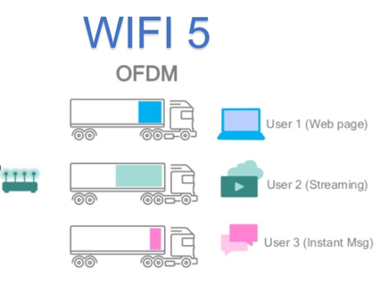
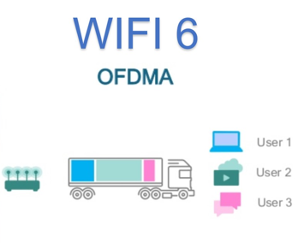
Wifi 6 it’s about efficiency
Notes:
Differences between wifi 5 and wifi 6
3 trucks instead 1 to move traffic
If we see time domain, on the same time we can send data from different users at a time
1024 qam available….but practical sense indicate it’s hard to say when its available
A customer in high density should note this (high density more than 25 devices)
You need at least 2 devices ax

Slide 7
Wifi 6E it’s about wifi perceived speed (more spectrum)
# channels per band & per bandwidht
20 Mhz
40 Mhz
0
80 Mhz
0
160 Mhz
2.4 GHz
5Ghz
6Ghz
Notes:
At the end, more channels available and the possibility to bond them to use more beandwidth

Slide 8
Wifi 7 it’s about better performance
Multilink concept
6 Ghz
5 Ghz
6 Ghz
2,4 Ghz
5 Ghz
2,4 Ghz

Slide 9
Wifi can add extra data layers to existing models
AP location defined at sales moment
Household data enrichment
AP
Competitor 1
AP
Competitor 2
ISP services
AP located in the middle point
2 AP required
Notes:
Use Smart wifi capabities to develop a way to categorize households (people living, income –as you can see devices-, married/couple/kids) / neighbors AP / who is at home
Use Smart wifi + GIS (geography information system), to apply in sales in B2C fixed business (when a customer requires a broadband service, as we know where he lives, we can know its household side, and make a reccommendation on access point needed and where should be located)

Slide 10
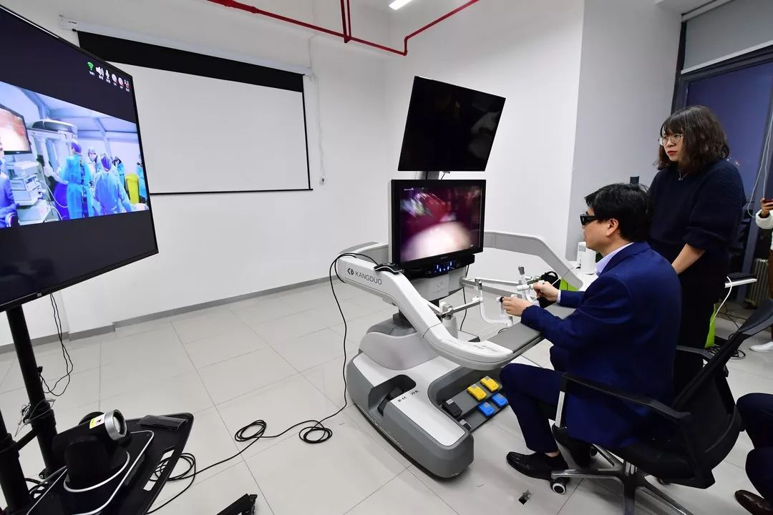
5G & Wifi targeted for different use cases

Slide 11
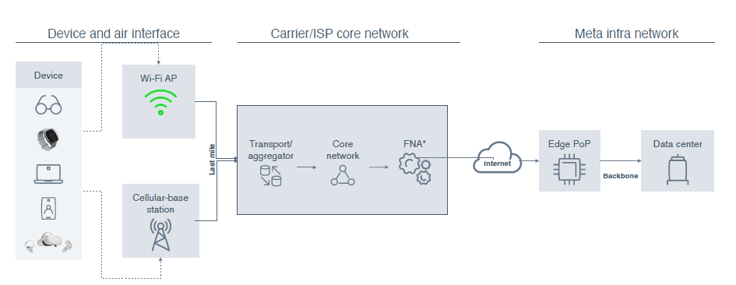
Some implications to telecom players*
Today’s video calling
150 ms (latency)
Tommorow’s Cloud VR
<30 ms
(latency)
(*) Meta vision; expected to change as they collaborate with telecom industry

Slide 12
Final thoughts
ISP & applications
Wifi
Notes:
From ISP
How we can be not the dumb pipeline
From wifi
Can we use wifi to change the pocket perception from our customer? Can we something different than just the internet bill?
From applications
Imagination is the limit

