Slide 1
Cloud strategies for Telcos
Key questions your CFO Will be asking you
Steven Traynor
Telco Account Director
Notes:
Its great to see you all here in beautiful Miami Beach. I’m so happy to be meeting in person after so much time apart. I want to thank CANTO for the opportunity to speak with you today. So, let’s get right into it.
The move to cloud has been a buzzword for some time now, and the benefits of the cloud are obvious especially with the way we’ve been working remotely for nearly 2 years. The pandemic has clearly accelerated the digitalization and cloud migration of many businesses. But the pandemic has been particularly hard on the telecommunications sector, which found itself being one of the most pivotal industries during the pandemic.
One of the benefits of presenting later in any conference is that you can refer to some of the presentations made earlier. So, a couple of takeaways that I see, are that
CSPs have a pivotal role in the social and economic development of the region. “Connecting the unconnected.”
The Digital Transformation is not only happening within the CSP, but within the users as well.
So, CSPs have become a critical component of the region, and throughout the pandemic, have provided the services which have enabled many businesses and individuals continue to work and stay in contact with family and friends. This is their “digital transformation”. The importance of the CSPs cannot be overstated.
The move to cloud is part of this digital transformation and your CFO holds the key to getting this move to cloud off the ground.
The CFO is a key individual which is looking at several factors. Your cloud strategy needs to include these factors when you approach your CFO with your cloud strategy.
So, what keeps your CFO up at night? (Aside from expense reports like mine) the CFO has a veritable tug of war between the growing Opex of a cloud migration, and growing the value of the CSP.

Slide 2
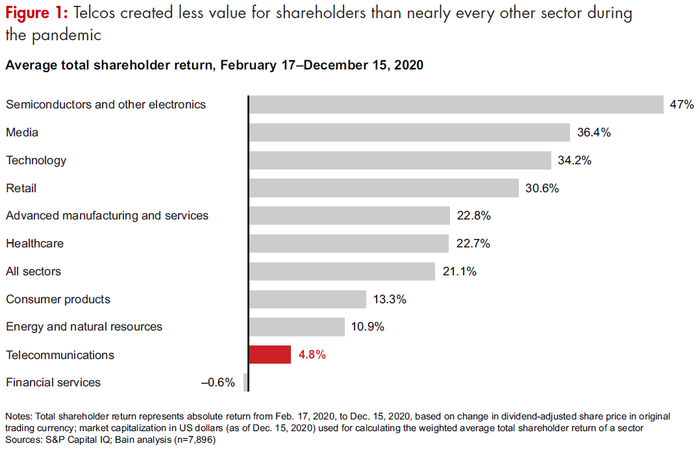
"Despite providing indispensable services during the pandemic, many telecommunications companies created less value for shareholders than nearly every other sector."
"Telcos in 2021: Challenges Are Back with a vengeance", Bain & Company, 2021
Notes:
When I read this, I had to do a double take, because it sounded counterintuitive. But this clearly shows the challenges faced by CSPs today.
Paradoxically, during the same time that CSPs were ensuring continuity in so many lives and businesses, CSPs, not all of them, but a significant number, created less shareholder value than nearly every other sector, the exception being the financial services sector.
Building shareholder value is vitally important to any CFO. So, the efficiencies that a cloud transformation provides, is essential.
Now, the big question, how do we pay for it? This isn’t a simple capex spend that the CFO can depreciate. This is Opex. It directly affects the bottom line revenue and free cash flow. That’s what keeps CFOs up at night.

Slide 3
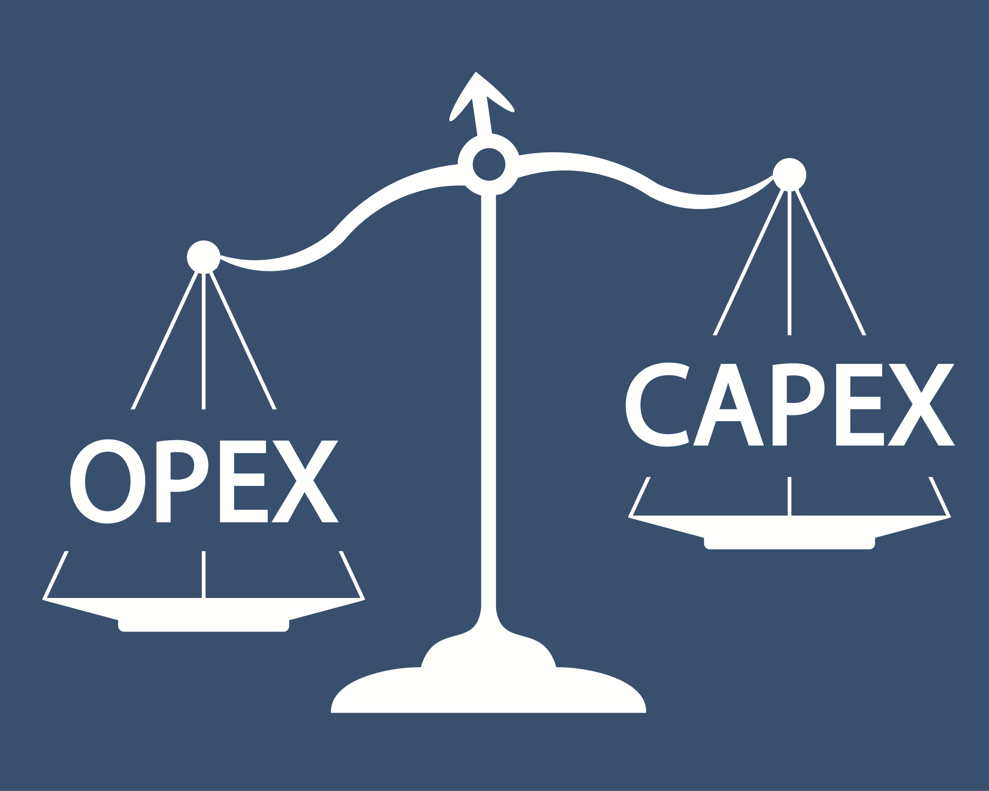
"We believe the most feasible capex funding source over the next decade will be reductions in operating costs."
"Telcos in 2021: Challenges Are Back with a vengeance", Bain & Company, 2021
Notes:
If cloud migration drives Opex, and the most feasible way to fund capex is by opex reduction, how do we make this work?
This is the proverbial tug of war. Your cloud strategy needs to account for both opposing forces, because your CFO is doing just that.
Let’s talk about your CFO, and your cloud strategy. For the sake of this discussion, let’s take the use case of moving your data warehouse from onprem, to the cloud and we are going to pick a name for the CFO that is an unfortunate result of my propensity for “Dad Jokes”. You know, the kind of jokes where you need a broom to sweep up the corn afterwards?

Slide 4
Meet Evan Keel, your CFO
Evan is evaluating your financial justification to move your OnPrem data warehouse to the cloud.
Notes:
Meet Evan Keel, your CFO. As part of your strategy, you recognize that you needed to get him involved from the beginning, so you spent some time to understand what his assumptions and vision are, regarding opex and growing value for your company.
Evan recognizes that just a migration to cloud will not yield the cost optimization that he will need to achieve, so he understands that along with the cloud migration, there will have to be accompanying changes in people and processes as well.
You’ve sat down with Evan and he has explained his vision for the company: minimize risk and grow value. You know that your strategy has to also factor in the changes in process as well.
So let’s talk a bit about process and how it relates to your cloud strategy.

Slide 5
Your cloud strategy is multilingual
Customer Acquisition Cost
Customer Retention Cost
Customer Lifetime Value
Annual Recurring Cost
CFO
Cloud Strategy Team
IT Team
Language of Money
YOU ARE HERE
Translator
Language of Process
MTTR improvement (how much?)
Efficiency - Less resources needed
“XX% reduction in resolution time”. “YY% First Contact Resolution Rate”.
Net Retention Rate (Churn)
“Leading Operational Excellence” – MIT Sloan School of Management, 2021
Notes:
A central part of your strategy is that you are multilingual. You recognize that a move to cloud, is a fundamental change in the processes of your business. As part of any process change, you know that you need to engage all the stakeholders and speak their language. I borrowed this diagram from the MIT Sloan School of business which teaches a course called “leading operational excellence”. It seemed to best visualize you, a process change leader, and how it relates to your strategy.
In essence, you are acting as a “translator” between the Language of Process, and the language of Money. This is essential for the successful implementation of any process change and is a central part of your cloud strategy.
[Click]
You’ve also spent the time necessary to link key metrics to your stakeholders and made your strategy relevant to them. Your strategy includes operations, customer success and operations teams and how they measure success.
You can turn improvements in efficiencies into financial metrics that Evan can analyze. This helps Evan build the value proposition for your cloud migration.

Slide 6
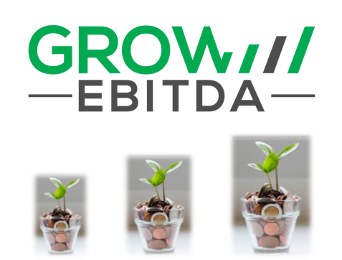
Evan is a skeptic when it comes to spending based on the promise of future savings
“Will this Opex increase be offset by increased efficiency? How?”
“Do the cloud providers have experience working with the Telco industry?”
“Can we leverage our existing OnPrem investment, or do we lose that moving to Cloud?
“Will we have the same features in the Cloud as we do OnPrem, or will there be extra cost?”
“Do we want to have only one cloud solution?”
“What additional revenue can we expect from this investment?”
“Exactly what new strategic capabilities will this cloud investment deliver?”
“What marketplace advantages will new capabilities create?”
“What else does the cloud provider bring along such as AI/ML, Automation, etc.?”
“The CFO Guide to Cloud” – Deloitte, 2019
Notes:
So, these are the key questions Evan has for you.
You’ve found from your discussions that Evan is a skeptic of spending based on the promise of future savings. We’ve all heard the adage “The store has a 50% off sale today, but we need to go now. Well, if we stay home, we save 100%” So, your strategy focuses on two topics that are critical for any CFO: Risk mitigation and Growing Value
Your strategy includes identifying the various risks in moving to cloud. So, first off, you’ve decided that you want to talk to cloud providers that have experience with the telecommunications industry.
Your strategy addresses the need to offset the increase in opex Your strategy outlines what efficiencies can be obtained, and how are they measured. You know Evan will want to understand how much savings can be realized and by when. You have aligned with your process owners and translated their expected metrics into the dollar signs that Evan is looking for.
Your data warehouse has a substantial investment in licensing. Your strategy includes preserving that investment, as well as all the features and customizations you have already paid for. You have cross referenced the capabilities of your cloud providers against the features of your onprem solutions and noted any potential gaps.
Your business uses multiple vendors and has adopted a “best of breed” approach to IT. So your company has also adopted a multi cloud strategy and you are ensuring that there are synergies between the cloud providers you are looking at.
[CLICK]
But reducing the impact of opex is just one part of your strategy. You are also seeking to grow additional revenue with this cloud migration. You have aligned with your B2B stakeholders and identified uses cases for this cloud investment that drives revenue.
You have a clearly defined list of strategic capabilities and marketplace advantages that this migration will provide and aligned with your sales teams to understand how this gives your business an advantage. You have translated this to dollar signs so Evan can evaluate potential revenue gains from this opex spend.
You have made a list of technologies that come along for the ride, such as analytics and automation and corroborated with your IT team to understand how this technology streamlines your internal processes. You will be capturing the KPIs that you have promised to the various stakeholders in the company. You have also worked with your operations teams to leverage machine learning to enhance efficiency, and make it easier for people like me to submit our expense reports on time.

Slide 7
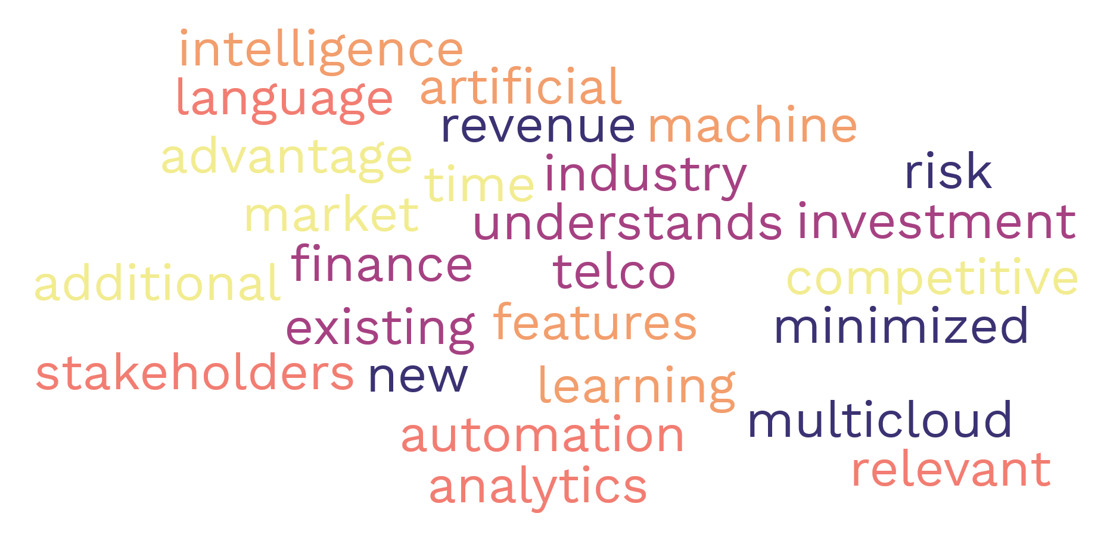
Your Cloud Strategy is successful because…
Notes:
Any successful strategy give finance a seat at the table from the very beginning. You recognized that and sat down with Evan to understand what his vision for Opex is.
You chose a provider that has a long history of telecommunications industry experience
You can bring your own licenses to the cloud.
You can lift your data warehouse and shift to the cloud as is with your customizations.
You can run your data warehouse on one cloud, and the applications on others, aligning with your multicloud strategy.
You have aligned with your B2B product team and identified use cases and customers that you can bring to your cloud solution to drive new revenue.
You have a competitive advantage because you were able to move to the cloud quickly and the use of AI/ML and analytics gives you even more visibility into your data and your business. And yes, Oracle’s Machine Learning Chatbot helps me get my expenses in on time.
Lastly, you can speak the language of process and of money and make it relevant to the various stakeholders. You can translate vital information and metrics between stakeholders.

Slide 8
If you recognize this strategy, then you are probably an Oracle Customer
Oracle Workloads to OCI and offset Opex with Support Rewards
Lift and Shift Oracle applications and customizations. “Oracle runs best on Oracle”.
Bring your own license (BYOL), PaaS, IaaS, Bare metal consumption models
Multi Cloud strategy – Oracle Cloud and Microsoft Azure Interconnect
Got customers running Oracle? Move them into your datacenter with Oracle Cloud@Customer multitenant solutions
Leverage Oracle Analytics, Digital Assistant, AI/ML, all built into Oracle Cloud
Share your Data across all applications and multiple clouds and onprem.
Flex
Notes:
Some of you may recognize this strategy. Well, it’s how Oracle helps you work with your CFO.
Oracle Customers take advantage of our Support Rewards program to help offset Opex by returning a portion of your consumption as a rebate on your support.
Run Exadata in Oracle Cloud faster and more efficient than any other cloud provider, and preserve your features and customizations, like RAC and DataGuard
Have onprem licenses? Bring them to Oracle Cloud. Need licenses? Use our license include PaaS solutions
Of course you have a multi cloud strategy. So does Oracle. We have partnered with Microsoft and offer a direct connection so you can run your Microsoft applications in Azure and keep your Oracle data running at peak efficiency in Oracle Cloud.
Let us put our cloud in your datacenter, and help you drive revenue. We offer a number of Cloud @ Customer solutions, including multitenant solutions where you can offer services such as Disaster Recovery to your customers.
Oracle Cloud builds AI/ML analytics and automation into our cloud offering along with industry standard tools so your IT team doesn’t need to retrain.

Slide 9
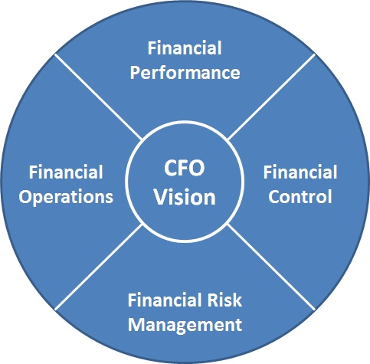
The key to a successful cloud strategy – Sync with your CFO
Notes:
Your CFO holds the key to any successful cloud strategy, so your strategy needs to be closely aligned with your CFO.
Remember, the CFO is under tremendous pressure to mitigate risk and grow value. Your cloud strategy should be focused on both. A cloud strategy cannot be dependent upon the promise of future savings alone. According to Deloitte’s report “The CFO’s guide to the cloud”, The business case might be easy to build, but without accompanying changes in people and processes, it can be challenging to realize. Within those changes in people and process are the new revenue opportunities, potential rebates on consumption or other loyalty rewards, efficiencies in use of existing assets in the cloud, and more.
Ensuring that you are in sync with your CFOs vision is fundamental for any cloud strategy. Your choice of cloud vendor will influence how achieve the CFO’s vision.
Thank you for your time today.

Slide 10
Thank You!
Notes:
Your CFO holds the key to to any successful cloud strategy, so your strategy needs to be closely aligned with your CFO.
Remember, the CFO is under tremendous pressure to mitigate risk and grow value. Your cloud strategy should be focused on both. A cloud strategy cannot be dependent upon the promise of future savings alone. Ensuring that you are in sync with your CFOs vision is fundamental for any cloud strategy.

