Slide 1
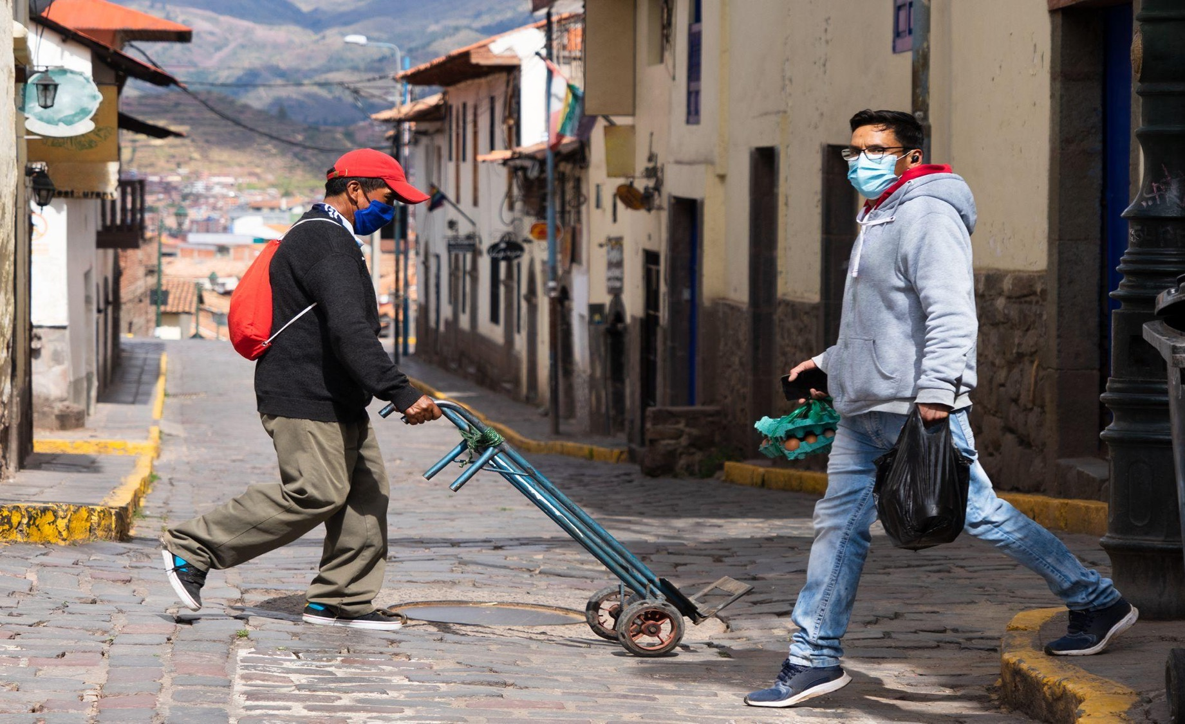
SVP, Government Engagement Latin America & Caribbean
Opportunities for Governments to Combine Digital Transformation & Sustainable Inclusion
Darren Ware

Slide 2
Synopsis
Governments responded
to recent historic challenges
by accelerating digitization.

Slide 3
LAC at a
Crossroads…
Governments in transition
Possible lost decade
Economic issues

Slide 4
Government
trust declined
GDP pc
Democracy
Left or right

Slide 5
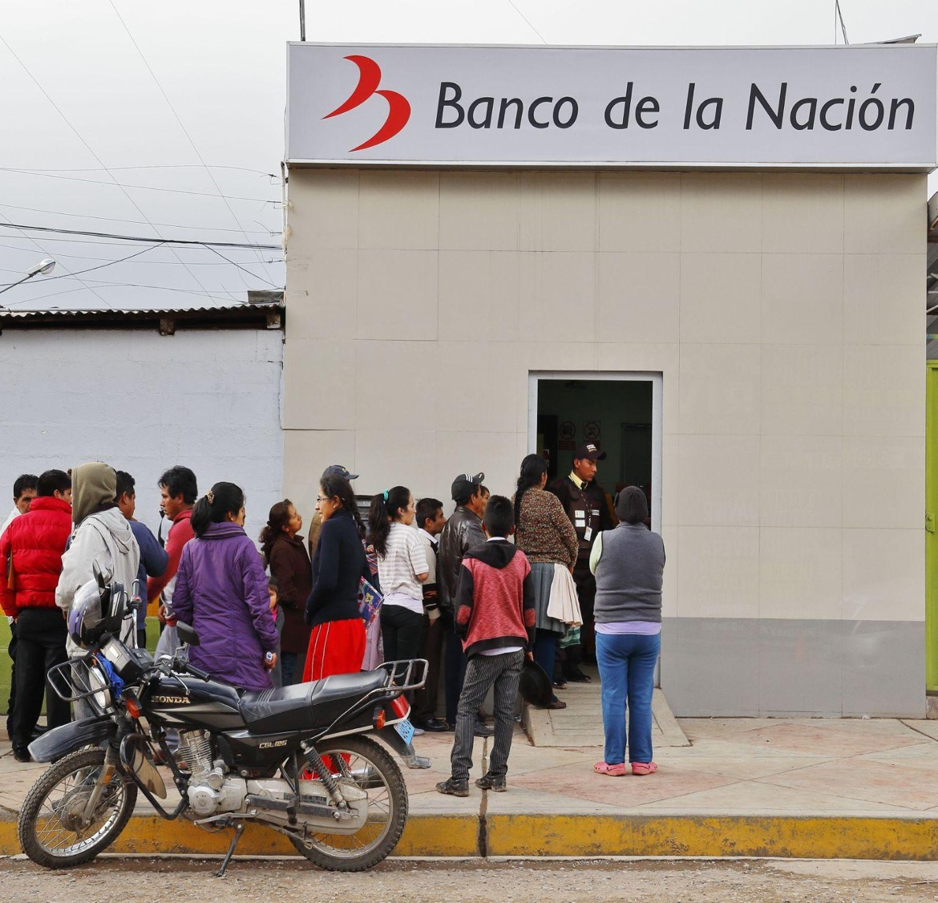
Government Controls
⅓
or more of the
economy

Slide 6
80% of brick and mortar
transactions in cash

Slide 7
Pandemic
hits LAC hard

Slide 8
Governments accelerated digitization
40M
Bankarized during the pandemic

Slide 9
200%
increase in number of businesses going online for the first time

Slide 10
Cases

Slide 11
What happened?
Governments
need citizens
to trust them

Slide 12
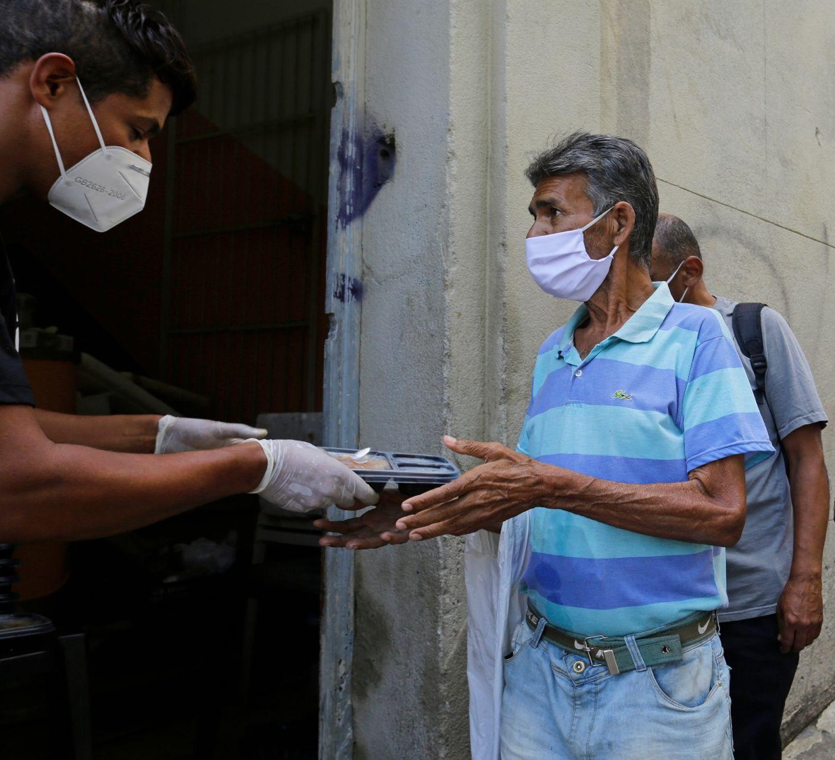
Governments
need assistance
to provide
assistance
A Trust Transfer

Slide 13
Post-pandemic problem solving
Sustain
financial inclusion
and payments modernization
Move Away
from cash to save,
secure and simplify

Slide 14
Governments will continue to digitize
We see
opportunity
emerging from
the pandemic for accelerated digitization

Slide 15
Thank You
darren.ware@mastercard.com

