Slide 1
Connecting the Unconnected:
Strategies and Challenges in connecting Latin America and the Caribbean
Daniel M. Best
Director, Projects Department
Caribbean Development Bank

Slide 2
Addressing the Digital Gap for Inclusive Development

Slide 3
An estimated 4.9 billion people or 63% of the world’s population used the Internet in 2021. (Source ITU)
This represents an increase of 17% since 2019, with 782 million people estimated to have come online during that period.

Slide 4
What are the challenges?
Notes:
Social Vulnerable Populations
Gender
Education
Agriculture and Rural Development

Slide 5
SOCIAL VULNERABLE POPULATIONS
Notes:
Countries in the region lag in providing digitalized social protection services, which has a severe impact on society’s most vulnerable citizens.

Slide 6
Persons with disabilities
remote communities
migrant populations
indigenous people
female-headed households
Are disproportionately affected and in danger of falling further behind on academic targets.
Notes:
Some examples of these vulnerable groups include ……..

Slide 7
Digital Skills Are Essential for Future Jobs
Lack of access to affordable high-speed broadband infrastructure and devices
Limited/lack of basic skills – dispelling the myth that all children and youth are digital natives

Slide 8
Gender
Pre-COVID 19 Unemployment was already high
Mismatch between skills and jobs among graduates of the formal education system
Strong Performance not translated to development of digital-age skills
Women and girls have historically been underrepresented in STEM disciplines.
Women account for 30% of managers at the junior, middle and senior levels, but just 10% of managers in executive roles.

Slide 9
2019 IDB report: - Caribbean residents are required to make repeated visits to state offices to transact business - Over 30% of transactions require 3 or more visits
OECS countries rank low on the OSI Index, which ranks the level of development of digital government services and government portals

Slide 10
Online Services Sub-Index
OECS
Ranked: 93 - 148
of 193 countries

Slide 11
Challenges in the Education Sector
1
Quality and affordability of internet access and infrastructure
2
During the pandemic – an estimated 50% of Jamaican students and 30% of learners across OECS were without devices
3
Inadequate digital competencies is a major barrier to effective use of digital technologies for learning
Notes:
Although internet penetration is high in most Caribbean Countries (excluding Haiti. Quality and affordability of internet access and infrastructure varies greatly and many SIDS and rural areas in larger states lack the population six to incentivize public and private investment in infrastructure.
Beyond access, inadequate digital competencies present a major barrier to effective use of digital technologies for learning.

Slide 12
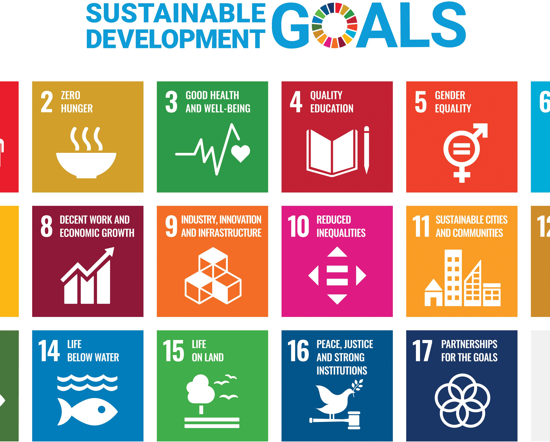
3 principles outlined in the 2021 Rewired Global Declaration on Connectivity in Education to ensure that digital transformation advances progress toward 2030 Agenda for Sustainable Development
Centre the most marginalized to ensure inclusive access to digital learning opportunities for all
Expand Investments in free, public high quality digital learning
Develop pedagogical capacity to maximize the benefits of digital learning

Slide 13
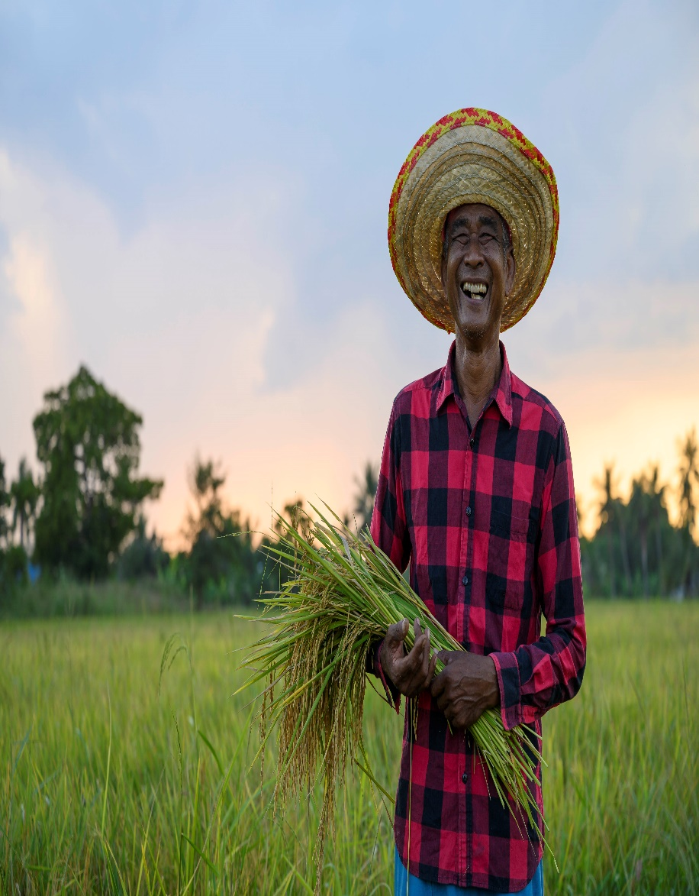
Challenges in the Agriculture Sector
Low Productivity, weak markets linkages and high vulnerability to natural hazards including climate change

Slide 14
How do we get there?
Where do we need to be? Why the need for urgency?

Slide 15
STRATEGIES
Standards
Investment
Standardised approach to measurement of digital exclusion and appropriate tools for regular identification of students needs
Greater investment in digital literacy/skills for vulnerable groups
Assessments
Digital Transformation
Support for regular assessments of countries’ labour market/skills requirements and recommendations for lifelong learning policy decisions
Whole of society approach to digital transformation. One that promotes the creation of inclusive digital ecosystems for the region.

Slide 16
STRATEGIES
Support for Governments
Citizen Participation
Governments must be supported in establishing emergency response security teams
Leverage the participation of citizens and promotion of citizen-centred and government-led digital transformation projects
Data
Create a data drive culture in the public service to inform decision-making and ensure greater transparency, openness and inclusiveness of government
Establish effective organisational and governance frameworks to coordinate the implementation of the digital strategy.

Slide 17
STRATEGIES
Education
Teachers
Investing in digital transformation within the education and training system is central to building social resilience and promoting learning
Capacity building for teachers to accelerate learning and effective distributed teaching/learning
ICT
Equitable provision of ICT devices and access to adequate and affordable bandwidth.
Subsidized internet cost
Negotiated with telecoms providers as part of the universal access standards
Closing the digital access gap between the Caribbean and the more advanced economies could increase the region’s GDP by 6 to 12% over the medium term and provide a strong boost to a post-COVID-19 recovery
6-12%

Slide 18
Regional Learning Recovery and Enhancement Programme
(Let's REAP)
DIAGNOSTICS
DIFFERENTIATION
DIALOGUE
DIALOGUE
Mainstreaming diagnostic assessment of all students to identify the areas of focus for teaching in each subject;
Using the diagnostic data to plan instruction, engage in teaching and conduct assessment to determine the level of mastery of each child.
Organising teaching to focus on the learning needs of the child
Providing the report to the parent/home of each learner’s mastery of specific learning outcome
Community of Practice and Teacher which focus on quality instruction, monitoring student progress and supporting teachers through professional development

Slide 19
Agriculture
A focus on initiatives that demonstrate a strong potential for scale, which could be replicated or scaled up by CDB and public/private sector partners
1
2
3
4
Digital, internet and mobile technologies to improve the speed and efficiency of information exchange between farmers and service providers
Precision agriculture and related satellite technologies in aid of planning and monitoring of agricultural production and building climate resilience
Climate-smart technologies including big data for the design of irrigation, drainage and flood control systems to improve system efficiency
Crop traceability systems – as an aid in food safety management systems and enhancing consumer experience

Slide 20
Thank you!

