Slide 1

Marketing Committee
CHAIR – Melissa Harris, CEO & Chief Learning Officer, Telecom Training Corporation
VICE CHAIR – Julio Izique, Director Business Development Telecom and WiFi Associations, Plume Design
FEBRUARY 4-5, 2023

Slide 2
Core Committee Members
Melissa Harris – Telecom Training Corporation
Julio Izique – Formerly with Plume Design
Desha Clifford – Digicel - Board of Directors Marketing Committee Champion
Teresa Wankin – CANTO
Nicole Freakley – CANTO
Shyanne Williams – CANTO

Slide 3
Summary of Major Successes In 2022
Business Development at 50 Industry Conferences Using CANTO Flyer
ACATE* Sponsored Summits
  CMO/CSMO
  CTO/CIO/Engineering
Welcome/Networking Sessions at ACATE (and AGM 2023)
$37,000 Revenues for ACATE 2022
17+ Potential Prospects Generated For 2023
* ACATE – Annual Conference and Trade Exhibition

Slide 4

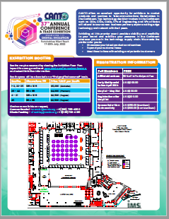
Business Development at 50 Industry Conferences Using CANTO Flyer

Slide 5
ACATE Sponsored Summits
CANTO Summits on Sunday afternoon brings together C-level executives from leading communications service providers, regulators, user groups and vendors from world-wide markets to share their experiences and market insights in a single world class forum.
  Chief Marketing/Sales Officers Summit (Sponsored by ORACLE)
  Chief Technical/Information/Engineering/Network Ops Officers Summits (Sponsored by CELPLAN)
Summit Agendas (1 hour each):
  Company Sponsored Presentation
  Discussion Challenges
  Group Prioritization Activity
  Peer to Peer Breakouts
  Group Discussion on Solutions
  Group Presentations

Slide 6
Welcome / Networking Sessions
Offered highly interactive welcome/networking sessions “Mix ‘N Mingle” Sunday afternoons at ACATE 2022 (and AGM 2023 and many previous years)
Need sponsors starting with ACATE 2023
Supports one of the top benefits of CANTO – networking
  Provides a structured, fun, and highly interactive way to meet new contacts
  Overcomes the challenge of penetrating “CANTO cliques”

Slide 7
$37,000 Revenues for ACATE 2022
NEW BUSINESS | SPONSORSHIP / EXHIBITOR | MEMBERSHIP | CMO - CTO SUMMIT
AIRWAY TECHNOLOGIES | $3,500
CELPLAN | $10,500 |  | $7,000
GALOOLI | $3,500
ORACLE |  |  | $7,000
RINA WIRELESS | $3,500 | $2,000
TOTAL | $21,000 | $2,000 | $14,000
Grand Total of Revenues Generated by the Marketing Committee | $37,000 USD

Slide 8
17* Potential Prospects Generated For 2023
Amor
Awarex
Ciena
Consult Axion
Ghosteck.Com
Interop Tech
Neustar
Open X-change
Paymentus
Unicom
Upduo
UPN Fiber
Skypeak Technologies
Strand
Tata Communications
Tower Systems
Zillion Technologies
* Nicole has a total of 136 new companies to contact in 2023

Slide 9
Revenue Generating Projects for 2023
Continue business development at 20+ industry conferences using a 2023 CANTO flyer
Exceed 2022 revenues generated by the marketing committee for ACATE 2023 and AGM 2024
  Exceed 2022 potential sponsors, exhibitors, and members generated for ACATE
  Facilitate sponsored ACATE Sunday afternoon Executive Summits
    CMO/CSMO
    CTO/CIO/Engineering
  Obtain Welcome Session sponsorship for 2023 ACATE (and 2024 AGM)
  Obtain CANTO Conversations marketing panel presentation sponsorship

Slide 10
Additional Plans For 2023
Research ACATE 2022 and AGM 2023 attendees to identify major functional areas
Develop list of HR executives that CANTO can use as key contacts (WICT Committee also needs this info)
Plan a sponsored virtual CANTO Conversations C-Level panel presentation similar to our 2022 Event
Offer sponsored post-ACATE multi-day workshop(s) on topics such as Leadership, WICT, HR/Training and Marketing/Sales
Increase committee members by contacting C-Level Executives for their designated leaders to join the marketing committee
Develop a bi-monthly committee schedule
Analyze CANTO website to develop a list of updates
Submit CANCION articles for each quarterly publication in 2023 – need to receive CANTO notices for when these are due
Recommend to the Board of Directors for CANTO rebranding (CANTO/Caribbean Broadband & ICT Association) and one leader to work with all committees to leverage project synergies

Slide 11
Summary of Proposed Revenue-Generating Sponsored Events
AGM 2023 – Mix ‘N Mingle welcome/networking session
  Will be sponsored in 2024
CANTO Conversations – Marketing Executive Panel Presentation
ACATE
  Welcome/Networking Session
  CIO and CMO Summits
  Pre- or Post-Event Workshops (e.g., Leadership, Marketing/Sales, HR)

Slide 12


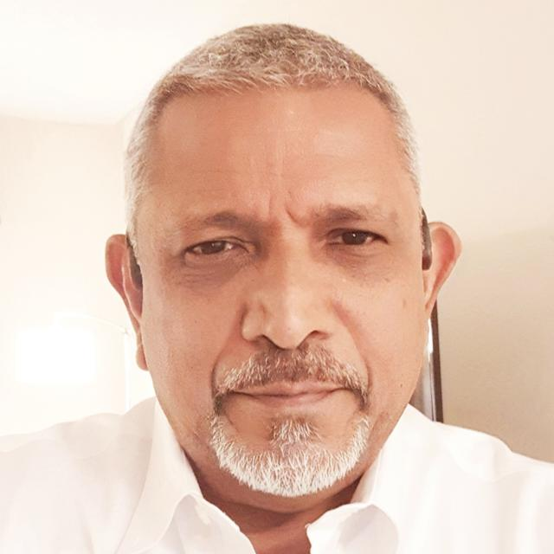



VENDORS AND SUPPLIERS COMMITTEE
CHAIRPERSON- SHAIKH HOSEIN

Slide 13



CORE MEMBERS
KIMBERLY KOCH (VICE CHAIR) – Inactive
MARTYN FRICKER - Inactive
HELLE FRIIS – Inactive
RICHARD REDEKOP - Inactive
GERAUME BOR – Very Active
LUCRETIA WILLIAMS – Very Active
VINCENT KENSWIL – Active
CHRIS LUCAS KHALEEL – Inactive
KHALEEL ALI – Very Active but no longer a member
MAURICIO MIRANDA – Inactive
VICTOR KHOLI – Inactive
KEVIN WYNNE - Inactive

Slide 14

OUR PURPOSE
To develop a bi-directional value proposition between Suppliers/Vendors, Affiliates and main members of the CANTO Organization

Slide 15

MAJOR ACHIEVEMENTS IN 2022
Working Committee- Registration of Members (Ongoing)
Meetings- Participated in several meetings throughout the year 2022, focused on implementing the eMarket Software as a Service Platform.
Developed ideas with the CANTO Secretariat on Marketing Plans subsequent to the eMarket launch.
The Launch of CANTO eMarket at this year’s 38th AGM

Slide 16
From This
In 2021

Slide 17

CHALLENGES TO TELECOMS BUSINESS IN 2022
Residual impact of COVID-19 & downstream Strains continued to impact productivity
RDOF - Rural Digital Opportunity Fund continued to Soak up Supplies
CHIPSET – Continues to be in short supply although it seems to be improving
Container Shortages out of China is still an issue but improving
Increased Shipping Costs seems to have stabilized for now.
Lead Times continues to be very long for certain product lines however manufacturers have invested heavily to increase capacities which are expected to reduce lead time issues in later half of 2023.
FOREX unavailability for Caribbean and LATAM continues.
Low Earth Orbit (LEO) Operators continues to grow their satellite networks unabated. SpaceX’s Starlink already acquired licenses and Spectrum in some Caribbean and LATAM countries already.

Slide 18
ACTIVITIES FOR 2023
* 38TH ANNUAL AGM CONFERENCE
Immediately following the 2023 AGM and official Launch of Canto’s eMarket Platform, begin Marketing Road Show to at least six member countries to educate and onboard Operators.
Sell participation slots (Maximum Six) to Vendors & Suppliers for the Road Shows
Sign up as many Operators as possible to the eMarket Platform – Target 100%.
Without the engagement of the Operators & Services Providers eMarket would not have a product to sell to potential bidders (Vendors & Suppliers). The success of eMarket relies upon the Service Providers and Operators posting their Project Tenders on the Platform.
Promote eMarket Platform heavily to Vendors & Suppliers to grow Affiliate Membership and Supplier Base of the eMarket Platform. The success of eMarket also relies upon the Vendors & Suppliers purchasing Tender Packages posted by our Service Providers and Operators.
Active participation by both the Operators and Vendor & Suppliers is critical

Slide 19

ACTIVITIES FOR 2023 CONT’D
Ideas for 2023:
Webinar slots on CANTO CONVERSATIONS to Suppliers & Vendors (one per month)
Weekly or Monthly Supplier/ Vendor spotlight to send to operators
Networking event at Annual Conference & Trade Exhibition 2023
Work on expanding the eMarket Platform to an everyday online technology store.
Create a Reference List of all approved Vendors, Suppliers, Products, Services, Solutions on CANTO
Members Networks. Only paid-up Vendors/Suppliers members will be listed.
Discounted Advertising Space, Preferential Access to Webinar & WebEx Slots at CANTO’s various forums for presenting new and innovative technologies, Free Speaking Slots for Affiliate Members at ‘Focus on Suppliers’ forum of the Conference & Trade Exhibitions.
CANTO Secretariat must encourage its members to preferentially patronize the business of the Vendors & Suppliers who are members of CANTO

Slide 20
HIGH LEVEL BENEFITS
Canto Suppliers/Vendors - Get real opportunity, preference and advantage from their Canto investment.
Canto Operators - Get access to a wider base of Vendors & Suppliers thus benefitting from greater competitive offers and preferential rates from CANTO Vendors & Suppliers
Canto – Enters into the Digital World of generating financial benefits by creating a dynamic Digital Environment for Supply Chain facilitating both Operators & Services Providers and Vendor & Suppliers Members.
For All – A Strong Symbiotic Relationship

Slide 21
Thank you!
QUESTIONS?

Slide 22
CORPORATE SOCIAL RESPONSIBILITY (CSR) Committee
JENNIS ASFRAF
WHITNEY DE RIJP
FEBRUARY 4TH & 5TH, 2023
PARAMARIBO, SURINAME

Slide 23
CORE MEMBERS
Jennis Asraf
Whitney Douglas- de Rijp
Lianne Dieffenthaler
Xiomara Wittenberg
Priscilla Graanoogst

Slide 24
MAJOR SUCCESS IN 2022
GOALS | OBJECTIVES | ACTIVITIES | KPI | Q1 Update | Q2 Update | Q3 Update | Q4 Update
Contributing to the self-imposed responsibility of Canto member companies to the society's, especially in the Caribbean Region and the Americas in areas such as the environment, the economy, employee well-being, and competition ethics. | Actively contribute to increase the general knowledge of e-Waste (management) for the society starting in Suriname and then expanding to Caribbean Region and the Americas | Launch e-waste initiative – June 22, 2022 In collaboration with two community centers | Launch first project in June 2022 | 70% | 100% | n/a | n/a
 |  | Get more stakeholders involved in Suriname | At least 5 stakeholders on board | n/a | n/a | 50% | 70%
 |  | Looking into e-learning options with ISOC | At least 3 initiatives | n/a | n/a | 20% | 50%
 |  | Recruiting members July 2022 conference | At least 2 new members | n/a | n/a | 50% | 50%
KPI realization 2022 |  |  | ±70%

Slide 25
ACTIVITIES FOR 2023
GOALS | OBJECTIVES | ACTIVITIES | KPI | Q1 Update | Q2 Update | Q3 Update | Q4 Update
Contributing to the self-imposed responsibility of Canto member companies to the society's, especially in the Caribbean Region and the Americas with the focus on the SDG goals good health and well-being, quality education, decent work and economic growth and industry innovation and infrastructure | Actively contribute to increase the general knowledge of e-Waste (management) and e-learning for the society starting in Suriname and then expanding to Caribbean Region and the Americas | Expanding the e-waste project with additional locations such as Nassy Brouwerschool (Private School) | At least 2 new locations in August 2023 | 20%
 |  | Get more stakeholders involved in Suriname | At least 3 stakeholders on board by December 2023 | 10%
 |  | Start awareness campaign for the first e-Waste community (Lelydorp) | 50% less coarse waste in the e-Waste barrels | 0%
 |  | Submit a paper for the Canto board for e-Waste initiatives | May 2023 | 50%

Slide 26
ACTIVITIES FOR 2023
GOALS | OBJECTIVES | ACTIVITIES | KPI | Q1 Update | Q2 Update | Q3 Update | Q4 Update
Contributing to the self-imposed responsibility of Canto member companies to the society's, especially in the Caribbean Region and the Americas with the focus on the SDG goals good health and well-being, quality education, decent work and economic growth and industry innovation and infrastructure | Actively contribute to increase the general knowledge of e-Waste (management) and e-learning for the society starting in Suriname and then expanding to Caribbean Region and the Americas | Collaboration with Partners Plus Consultancy, Suriname for e-Learning project | Launch first project by the end of 2023 | 10%
 |  | Looking into e-learning options with ISOC | At least 3 initiatives | 50%
 |  | Collaboration with UCC Suriname for SDG awareness poster campaign at schools | At least 5 schools included | 10%
 |  | Recruiting members July 2023 conference (Caribbean Region and the Americas) | At least 2 new members | 0%
KPI realization 2023 |  |  | ±20%

Slide 27

SDG goals focus CRS Committee

Slide 28
Disaster Risk Management Committee
Presented by Chair Keniesha Brown Plunkett – Flow Jamaica
February 5-7th 2023
Royal Torarica, Suriname

Slide 29
CORE MEMBERS
Shernon Osepa - Internet Society - Vice Chair
Courtney King - CDEMA
Karen Piper - CARILEC
Thomas Sullivan - FCC
Aggrey Marsh - DSL
Carmen Lake-Reyes - Telem
Shadira Lont - Telem
Mandela Christian - NEOC- Dominica
James Richardson - Consultant
Nigel Wilkinson - Jamaica Amateur Radio Association (JARA)
Devika Flemming - CANTO Secretariat

Slide 30
SCOPE
To determine a strategy for advancing cooperation among members in disaster preparedness by:
Collating and sharing information on the best practices adopted by members across the Region.
Maintaining an updated data base with contact information.
Developing a business continuity plan.

Slide 31
MAJOR SUCCESS IN 2022
  Hosted the Pacific region on lessons learnt on Tongo disaster event.
  Advance agenda for improved communication during disasters with support of Amateur Radio Operators in Caribbean.
  Monthly meetings to host DRM Stakeholders.
  Continuous collaboration and support of regional entities: CDEMA, CARILEC. , FCC.
  Agreement with the Jamaica Amateur Radio Association

Slide 32

TOP ACTIVITIES FOR
REVIEW NAME AND SCOPE OF THE COMMITTEE FROM DRM TO BCM
COMPLETE A SURVEY / MEMBERSHIP DRIVE
MANDATORY ROAMING AGREEMENT

Slide 33

Q&A
We welcome disaster risk and business continuity management experts to become a part of this dynamic team.
“If you fail to plan, you have already planned to fail!”

Slide 34


Slide 35
FINANCIAL ADVISORY COMMITTEE
CHAIR – Denelle Richards
Champion Director– Helma Etnel
FEBRUARY 4TH & 5TH

Slide 36
CORE MEMBERS
Denelle Richards – APUA
Helma Etnel – TelEm Group
Jimmy Rodrigues – CANTO

Slide 37
MAJOR SUCCESS IN 2022
Stabilization of Canto’s Financial Position by way of:
  Increase in income of $495,786 ( 2022 – $1,162,034, 2021 - $666,248, 2020 - $582,181, 2019 - $1,105,742, 2018 - $1,033,324)
  Increase in Expenditures of $506,350. (2022 - $1,111,642, 2021 - $605,292, 2020 - $902,562, 2019 - $1,068,112, 2018 - $1,294,841)
  Slight decrease in profit from 2021 to 2022 ($10,749)
  Devaluation loss on land and building in 2022 = $36,262.

Slide 38
ACTIVITIES FOR 2023
Debt Collections Policy
  Creation of an Accounts Receivables Policy Document to assist the secretariat with collections. ($280,000 in receivables)
  Engaging the services of a debt collection agency to assist Canto with past due accounts along with debts 2 years past due.
    Strategy will include Canto aggressively trying to collect on accounts within the first two years.
    Year 2-3, the debt collection agency services will be solicited
    After year 3 and no success, full provisioning of the outstanding receivables.

Slide 39
CONCLUSION
Balance Sheet :
Collection of accounts receivable needs continued attention along with the creation of a Policy Document
The organization has no long term liabilities
Income statement
Continuous monitoring of Exhibitor’s Income and the consideration of new alternative revenue streams.
Continuous maintenance of expense control is of the greatest importance
  Revenue Generation Opportunities through collaborative efforts with other committees.

Slide 40
REGULATORY COMMITTEE
DELREO NEWMAN
CHRISTA LEITH
FEBRUARY 4TH & 5TH

Slide 41
CORE MEMBERS
Andrea Francis – CANTO
Felicity Johnson Cable Bahamas, Bahamas
Mark Reynolds GT&T, Guyana
Melesia Sutherland Flow, Antigua
Opal Neil Cable & Wireless Communications

Slide 42
MAJOR SUCCESSES IN 2022
  Completed
    Tax paper policy brief
  Drafted and Circulated for Approval
    Digital Vulnerabilities - White Paper
    Is The Telecommunications Sector Rising to the Challenges of Innovation, Disruption, & Changing Expectations – Position Paper
  Ongoing
    Satellite-based Broadband Services – White Paper (1st Draft being revised)
    Universal Service Fund – Questionnaire & Position Paper (Questionnaire circulated for approval )

Slide 43
ACTIVITIES FOR 2023
Q1
  Membership Drive & Strategic Planning
Q2
  Digital Vulnerabilities - White Paper
  Is The Telecommunications Sector Rising to the Challenges of Innovation, Disruption, & Changing Expectations – Position Paper
Q3
  Universal Service Fund – Questionnaire & Position Paper
  Satellite-based Broadband Services – White Paper
Q4
  TBA

Slide 44
TECHNOLOGY TRENDS
Acting CHAIR person ; V.R. Kenswil
VICE CHAIR
FEBRUARY 4TH 2023
Notes:
First of all I would like to excuse our chairman mr Vincent Kenswil. Vincent has some family matters to attend to this week and asked me to represent him.

Slide 45
CORE MEMBERS
VINCENT KENSWIL (Creative Tech Hub Caribbean)
GERAUME BOHR (ICTUAL)
ALBERT DANIELS (ICANN)
ACHMED NEIJHORST (Blu Dots Technology)
ANIL SADHOERAM
SHAIKH HOSEIN (Power & Telephone Supply)
SHYANNE WILLIAMS (CANTO SECRETARIAT)
Notes:
Our committee has not been that active recently. Party because of Covid and partly because some team members dropped out due to busy schedule or new jobs. These are the core members tat are in our team

Slide 46
Milestones in 2022
Meeting during AGM in Trinidad (no other meetings held)
Virtual Training in collaboration with ICANN, Albert Daniel
Unfortunately, the implementation of The Collaboration Platform is still pending

Slide 47
ACTIVITIES FOR 2023
Implement our Collaboration Platform
Trends and Technology members will work closely with the secretariat and members of all Working Committees to make this platform a success.
Development of new White videos (at least 4)
Continue to make white videos and share this information via "Canto conversations“
Recruit new Members
Collaborate closely with the Secretariat
Recommend topics of interest to Members for consideration in the Annual Conference Program

Slide 48


GENDER DIVERSITY IN CYBER SECURITY
2023 CANTO CONFERENCE

Slide 49


CANTO’S 39TH AGM | OVERVIEW
WE HOSTED THE FIRST PANEL SESSION AT THE 2022 AGM!
LOCATION: Torarica, Suriname
AUDIENCE: 200+ attendees include regional telecom operators, vendors, policymakers, regulators, technologists, academia, and civil society.
AGENDA: The agenda will focus on the regional digital ecosystem with a strong focus on promoting safe universal connectivity, inclusion, and policy frameworks that enable growth and innovation and a data-sphere that is both resilient and secure, through cybersecurity and exposure management.

Slide 50
OUR 2023 SESSION PROPOSAL
THEME
The importance of prioritizing Gender Diversity In Cyber Security
FORMAT
45-minute fireside chat with two industry/regional development experts, with 15 minutes of audience questions
OBJECTIVES
Contextualize the experience of women online and outline the ways in which their experience is gendered
Highlight the ways in which gender intersects with cyber security in the region and the impact it can have on our region
Make recommendations to stakeholders in the ecosystem (governments/state agencies, ISPs, regulators, suppliers, etc.) about inclusive and sustainable practices
OUTPUT
Publish a white paper on the topic in the Q1 2023 CANTO CANCION magazine
Distribute regional Press Release following the session
Develop media pitch for regional journalists to interview panelists about the topic
Publish post AGM session update across all CANTO’s social media platforms

Slide 51
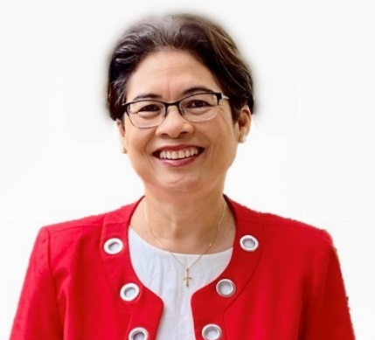
CANTO’S 39TH AGM | OUR 2023 SESSION PROPOSAL
OUR SPEAKERS
Kim Mallalieu is a CWICT Committee member and a senior lecturer and Leader of the Communication Systems Group in the Department of Electrical and Computer Engineering at The University of the West Indies, St. Augustine. She previously held the position of Head of Department and led the development of the Master’s in Telecommunications Regulation and Policy, MRP (Telecommunications), coordinating its delivery to participants from over thirty developing countries around the world. As Principal Investigator of the Caribbean ICT Research Programme (CIRP), she leads and conducts multidisciplinary action research on context-appropriate strategies for the purposeful application of information and communications technologies (ICT) for human good; with an emphasis on building the resilience of underserved populations.
As a keen advocate for gender equality for development, Kim’s works include the ITU/ETC report on Women, ICT and emergency telecommunications; and she is Vice Chair of the Advisory Board for the global Network of Women (NOW) for the World Telecommunication Development Conference (WTDC).
SPEAKER PROFILE
ICT Professional
Ally of diversity in ICT, particularly women in ICT
Knowledgeable about gender disparities in ICT and passionate about closing the gender gap and making the field more equitable
Strong knowledge of cyber security
Understands the unique complexities of the Caribbean region

Slide 52
CANTO’S 39TH AGM | HOW YOU CAN GET INVOLVED
SPONSORSHIP OF THE COMMITTEE’S PANEL
RETURN ON YOUR INVESTMENT
$10,000 USD
Session speaker – will join our Committee member for the fireside chat
Co-branding of the AGM session in all promotional materials
Inclusion in the article in the CANCION magazine
Speaker quote in regional press release
Social media mention in pre and post updates

Slide 53
ABOUT
US

Slide 54
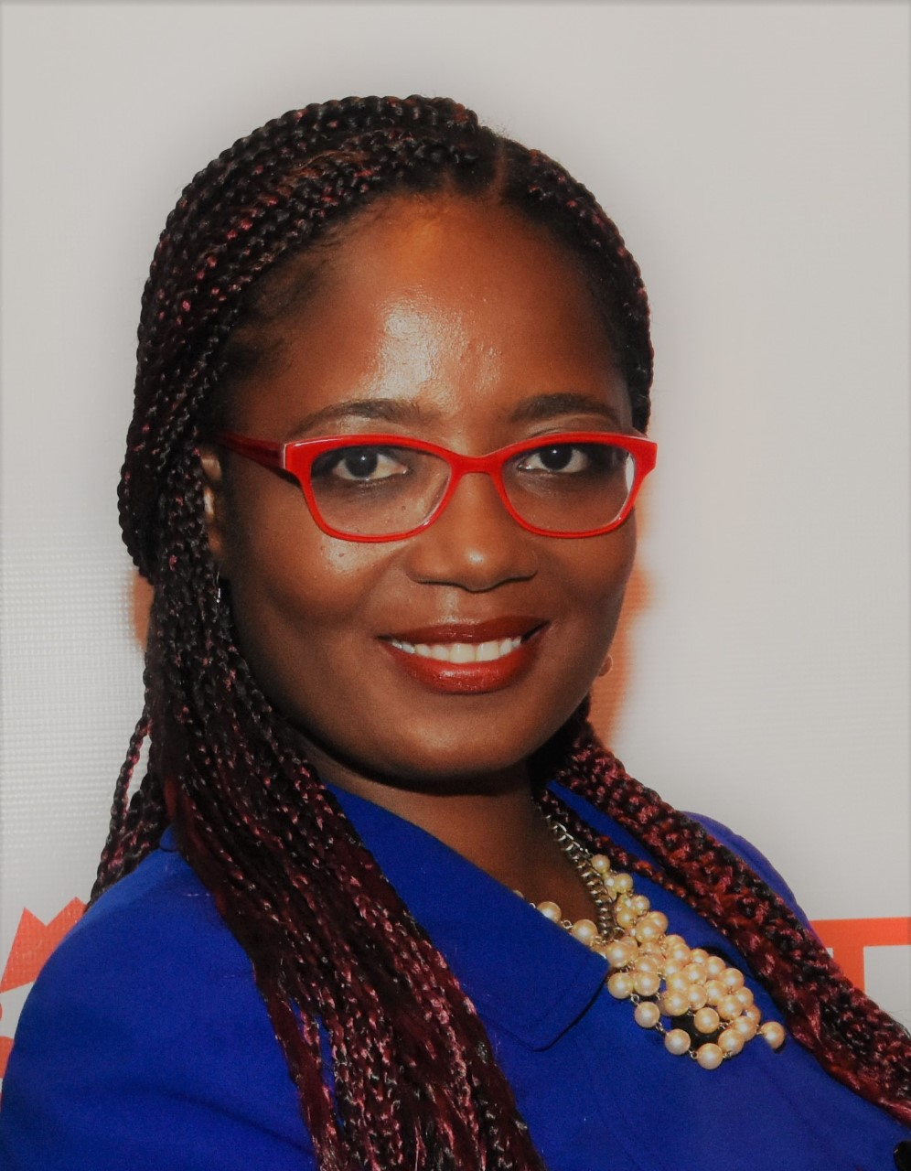
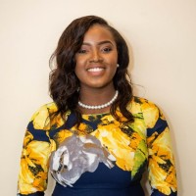
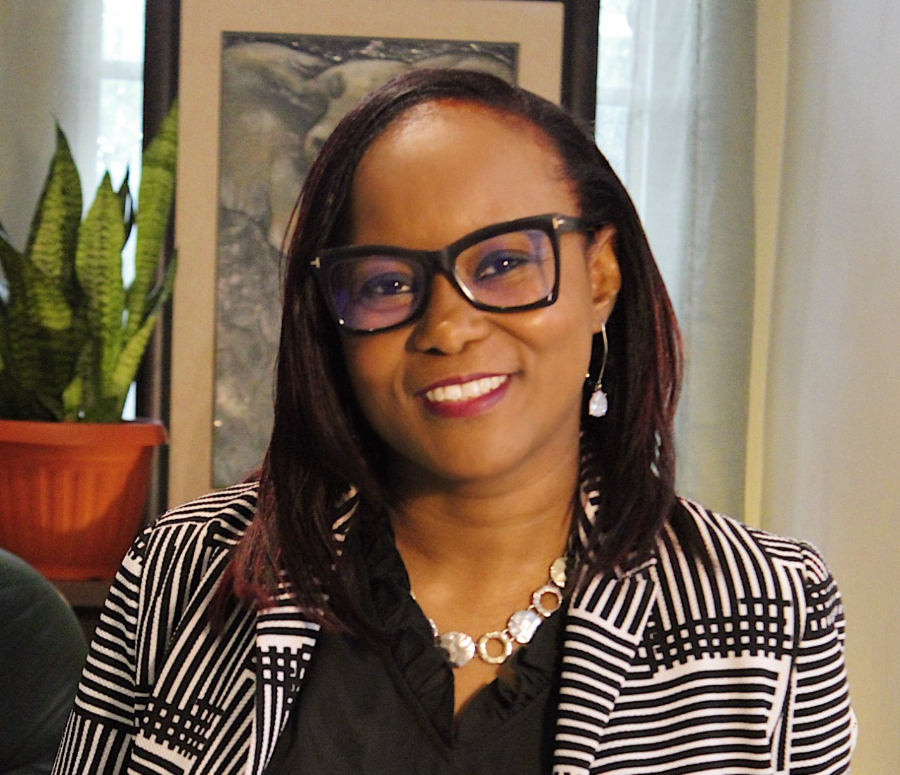
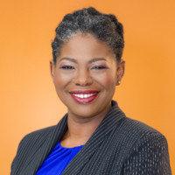
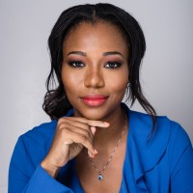
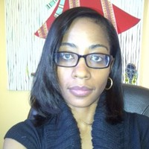
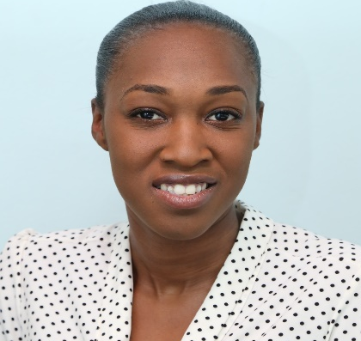
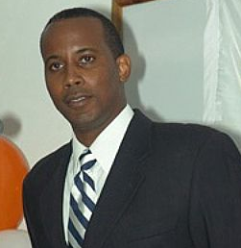
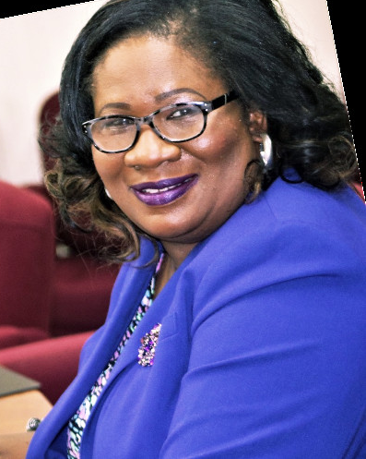
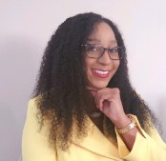
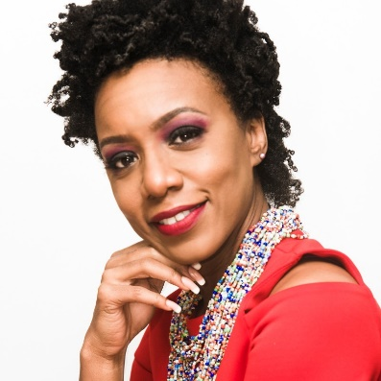
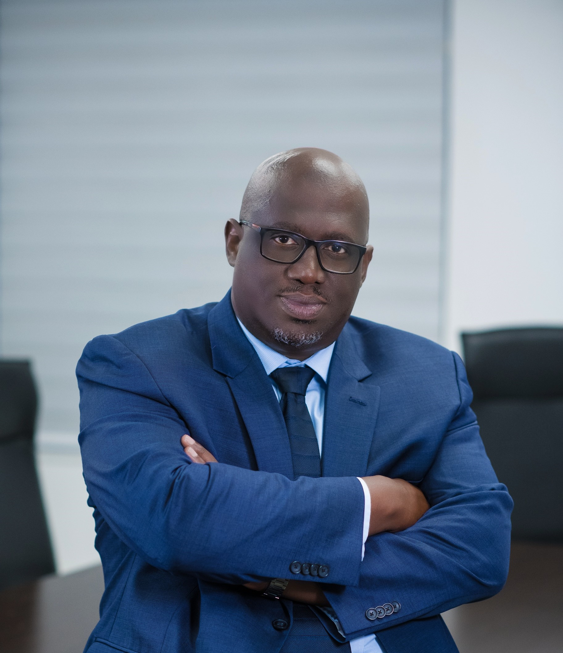
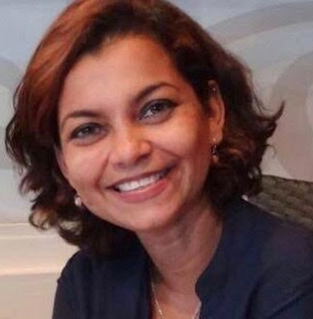
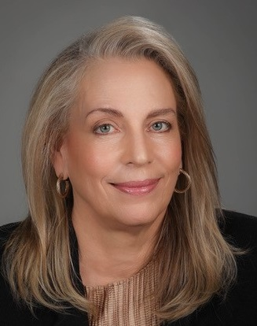
WHO WE ARE!
Chair, Janelle Pascall
Yolande
Agard-Simmons
Jayme Hoyte
Keisha Grant
Neeca Brathwaite
Board Champion
Christa Leith
Kim Mallalieu
Ayisha
Richards-McKay
Lianne
Dieffenthaller
Sheldon Keens Douglas
Vice Chair
Jennifer Britton
Candace Magloire
Dwayne Davis
Nicole Freakley
Melissa Harris

Slide 55
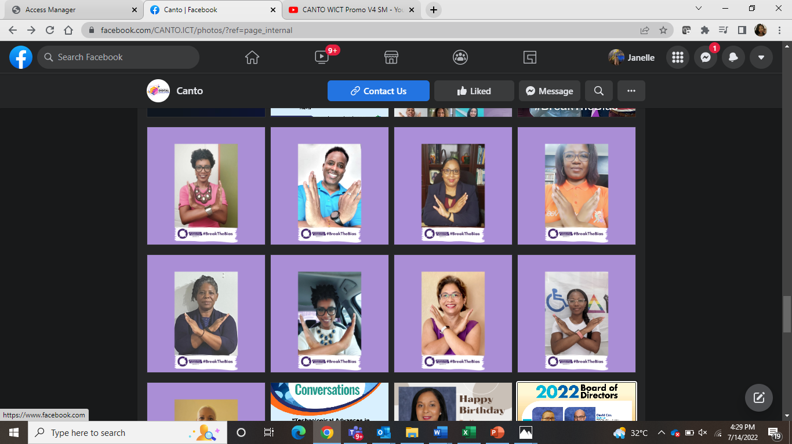


2022 ACTIVITIES
CANTO 38th ANNUAL AGM
INTERNATIONAL WOMEN’S DAY
GIRLS IN ICT DAY

Slide 56

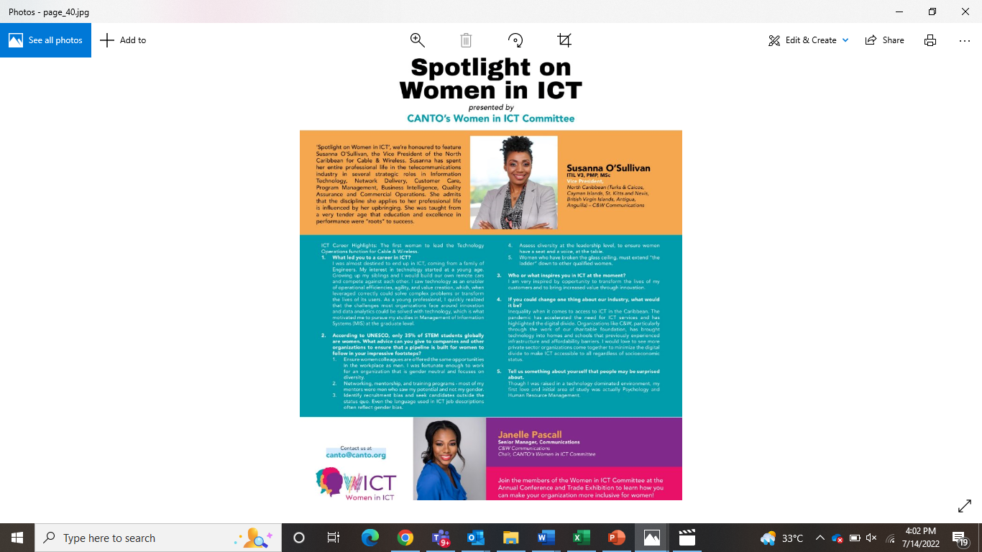

2022 ACTIVITIES
SUPPORTING WOMEN IN ICT
PROMOTING THE COMMITTEE
2022 ANNUAL CONFERENCE

